Slide 1

OKSCAUG 2017 Conference
3D GIS Implementation
using City Engine
19 September 2017
The CEDRA Corporation
Implementers of ArcGIS, ArcGIS Online and City Engine Technology
EXPERTISE
EXPERIENCE
COMMITTMENT
Notes:
The following presentation describes using Esri’s City Engine software to develop a 3D GIS from 2D GIS. The presentation begins with a few background slides on creating a 3D GIS and its applicability, while the remaining slides discuss the process that was used in creating the 3D model.

Slide 2
3D GIS Implementation using City Engine
Presentation Agenda
Formal Presentation
Slides discussing how City Engine can be used to develop a 3D GIS.
Commentary based upon our experience creating a 3D GIS using COE data.
Interactive presentation. Feel free to ask questions during the presentation.
Question and Answer Session
Responses to questions.
Notes:
During the presentation we encourage questions being asked. This leads to a more interactive presentation. So feel free to ask questions at any time.

Slide 3
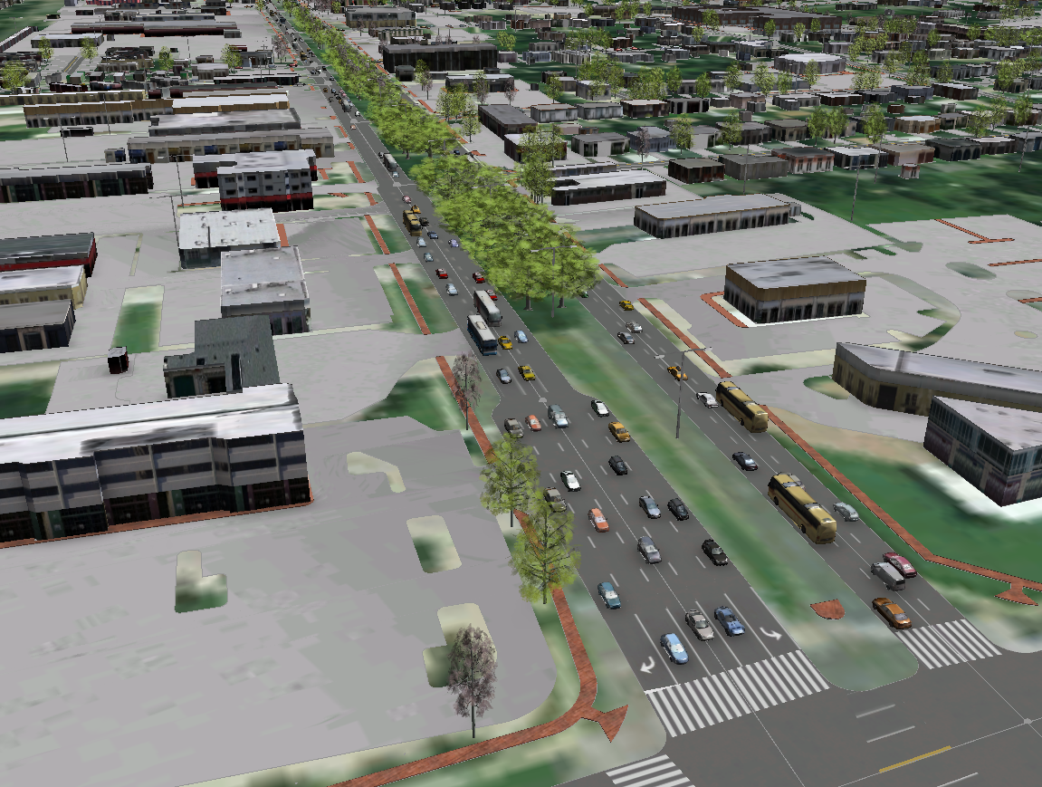
3D GIS Implementation using City Engine
Typical Questions
How do we get to this?
How long does it take?
How difficult?
How much?
Notes:
Let’s begin by showing an image of what we want to achieve. That is, a realistic 3D image of our GIS. As we go through the presentation we will explain each of the components comprising this image. In reviewing the image typical questions most people ask are shown in the slide. Hopefully by the end of the presentation we will have addressed these questions. For those interested, the south end of the image is the intersection of Broadway and 15th.

Slide 4
3D GIS Implementation using City Engine
Before starting the 3D development, the first Question to be Answered is:
How much detail is to be displayed in the 3D GIS?
The less detail to be displayed, the less time and less cost to create the model.
The greater the detail, the more time and cost to create the model.
As the level of detail increases the more realistic the model appears.
Model implies an approximation, not an exactness.
Notes:
The first thing to keep in mind in developing a 3D GIS is the more detail you desire, the more time intensive and expensive the model building effort will be. Additionally, one word that you will hear a lot with a 3D GIS is “model”. This is important because model implies an approximation, not an exactness.

Slide 5
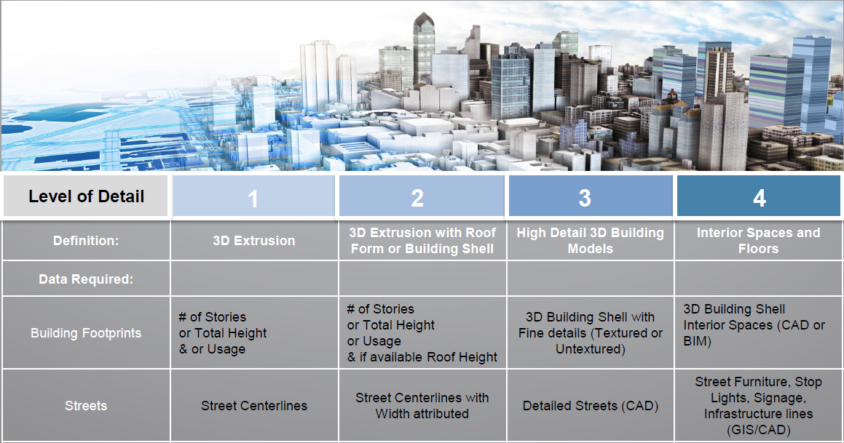
3D GIS Implementation using City Engine
Level of Detail (LOD) Definition as defined by Esri
Notes:
Here’s an Esri slide that illustrates the 4 levels of detail that Esri associates with a 3D GIS. As you can see, as you move up in level the more information that is included in the model. This also has the effect of the more realistic the 3D GIS becomes. So when creating a 3D GIS, consideration should be given as to what level of detail is the 3D GIS to fall into.

Slide 6
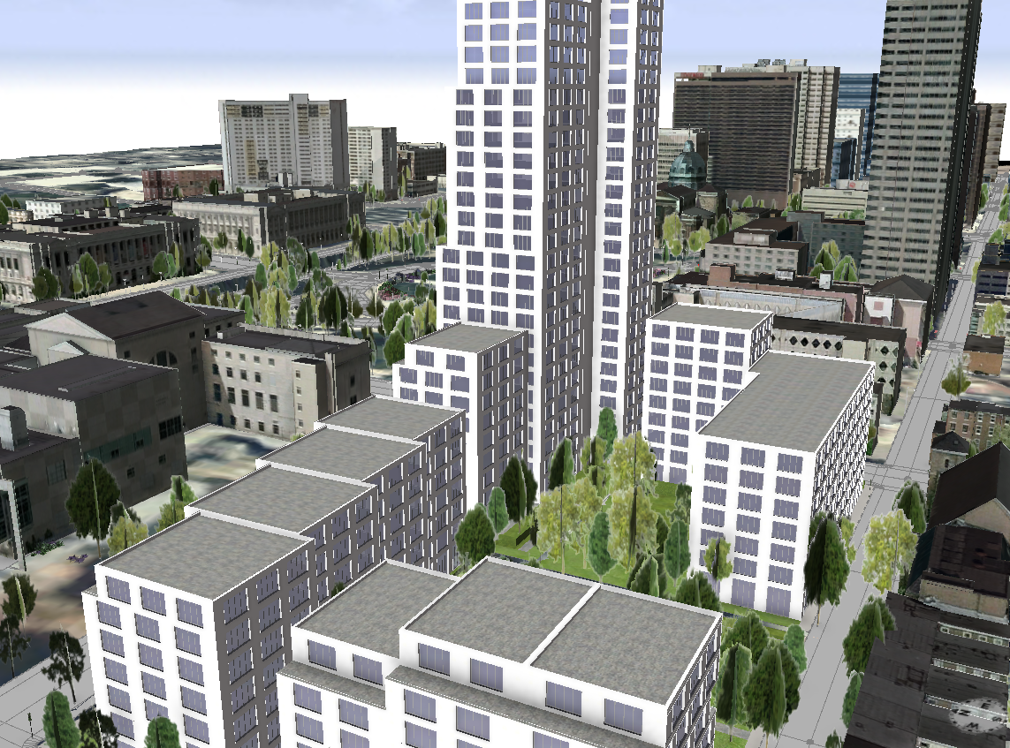
3D GIS Implementation using City Engine
Applications of a 3D GIS
Realistic Visualizations.
Comprehensive City Planning
Activities such as:
Flood Modeling.
Visibility Analysis of
New Developments.
Line of Sight analysis.
Redevelopment Scenarios
Notes:
Once the decision has been made to develop a 3D GIS the visualization benefits that are available can not be understated. Here is an image from the Philadelphia Example which is available for download from the City Engine gallery. As a matter of fact, there are a number of examples that are available for download from the City Engine gallery. The rules in these samples can be used as is or modified in other 3D models, if desired.

Slide 7
3D GIS Implementation using City Engine
The following datasets are typically used in creating a 3D GIS:
Ortho-imagery,
Digital Terrain Model - DTM,
Digital Surface Model - DSM,
Normalized Digital Surface Model - nDSM,
Street Centerlines,
Building Footprints,
Parcel Data,
Vegetation Data,
Zoning/Land Use Data,
Land Cover Data.
Basemap Image
3D Ground Surface Layer
3D Surface Layer
Difference between Ground and Surface
Road centerlines with pavement width
Outlines of building footprints
Parcel boundaries
Point locations of vegetation features
Zoning/Land Use delineations
Land Cover delineations
Notes:
The first step in building the 3D GIS is determining which datasets are to be included. The list shown are typical datasets people utilize. Obviously other datasets may be desired such as utilities, such as, sewer, water, storm water, electric, street signs, street lights, etc.

Slide 8
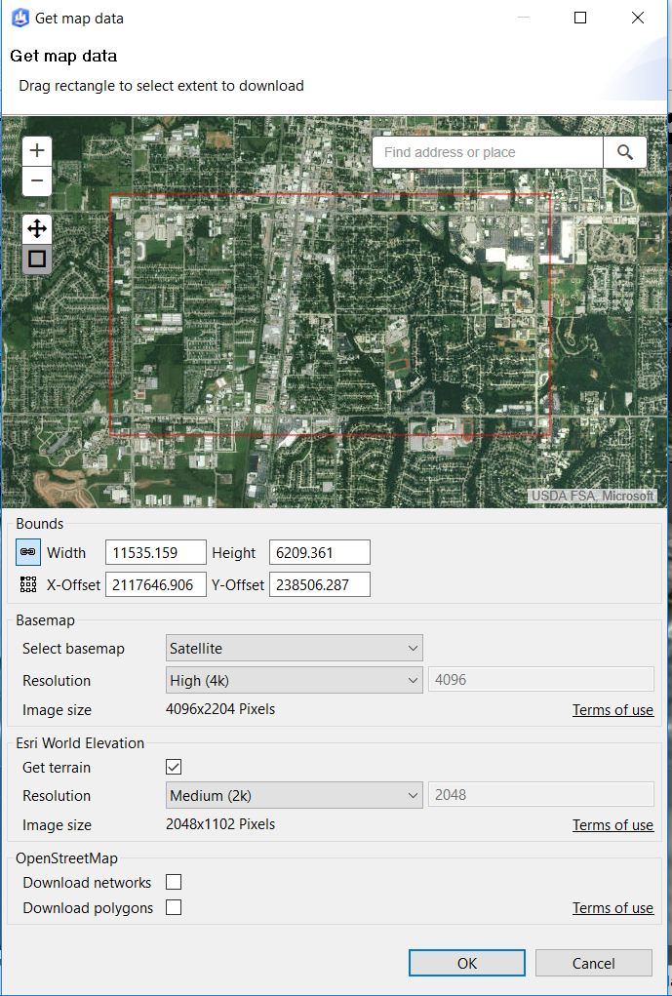
3D GIS Implementation using City Engine
Ortho-imagery / DEM – Two Options
Use in-house developed/purchased data
Use ArcGIS Online from within City Engine
Get Map Data… command
City Engine 2016 or greater
Data is stored in Maps folder
Elevation as TIFF (DEM)
Texture as JPG (Imagery)
Notes:
Regarding the basemap there are a couple options. The first is using an in-house ortho-image or cartographic basemap. Now this basemap could be 2D or 3D. That is to say, the basemap may or may not contain elevation information. The second option involves using ArcGIS Online. As can be seen from the slide, using the ArcGIS Online option allows the user to define the area of interest by defining a rectangle. We’ll discuss this further in a subsequent slide.

Slide 9
3D GIS Implementation using City Engine
Option 1
Use in-house developed or purchased Ortho-imagery
Notes:
Let’s examine the first option where in-house basemap information is to be used.

Slide 10
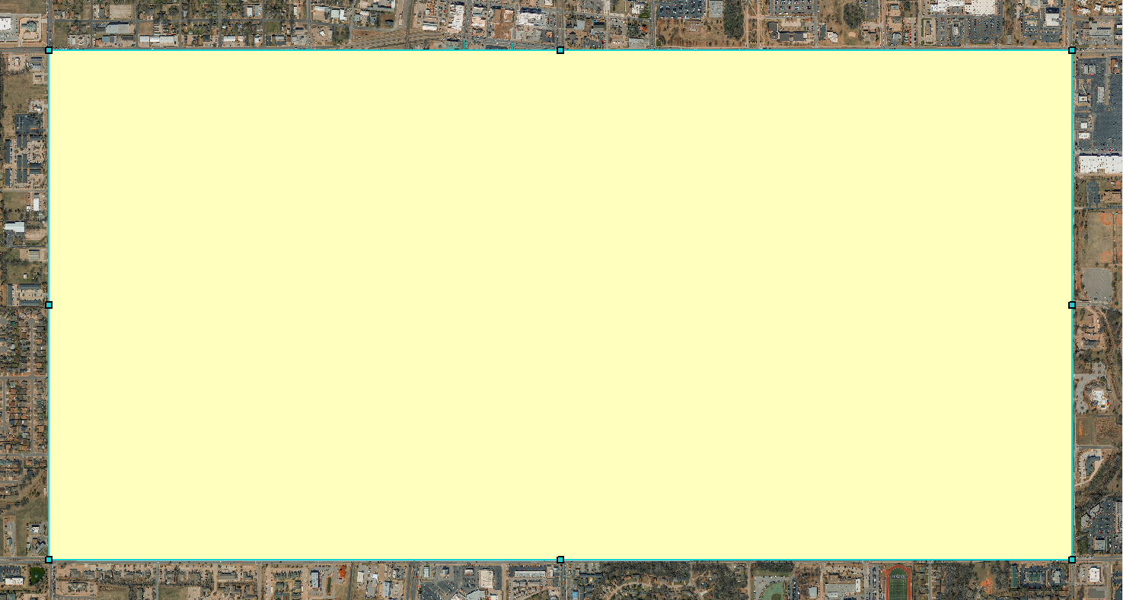
3D GIS Implementation using City Engine
COE Ortho-Imagery with Clipping Polygon for 140335 and 140336
Notes:
Typically a 3D GIS is a subset of the overall 2D GIS. As such, we will want to clip the overall basemap to the desired area of interest. This can be accomplished by defining a rectangle covering the desired area. Note that this rectangle is a graphic that the user interactively creates within ArcMap.

Slide 11
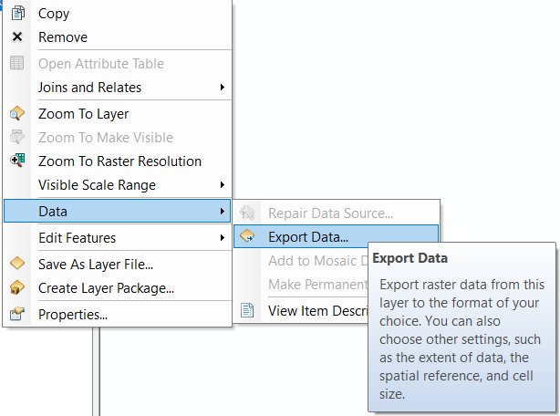
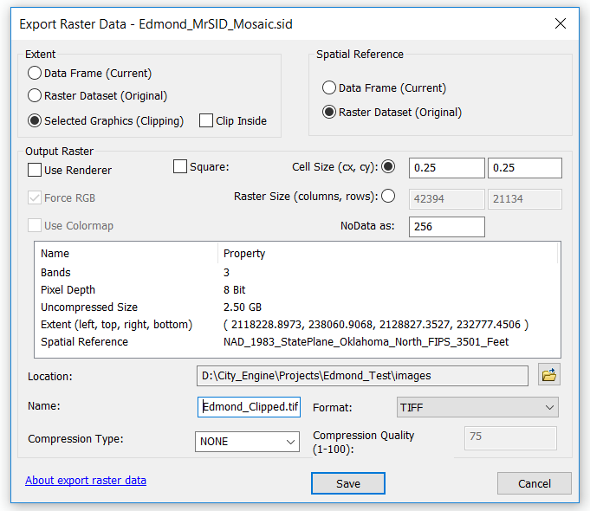
3D GIS Implementation using City Engine
3D GIS Implementation using City Engine
COE Ortho-Imagery Clipped Using the Export Data and Selected Graphic
Notes:
Using the Export Data command the user is able to generate a bitmap representing the area of interest.

Slide 12
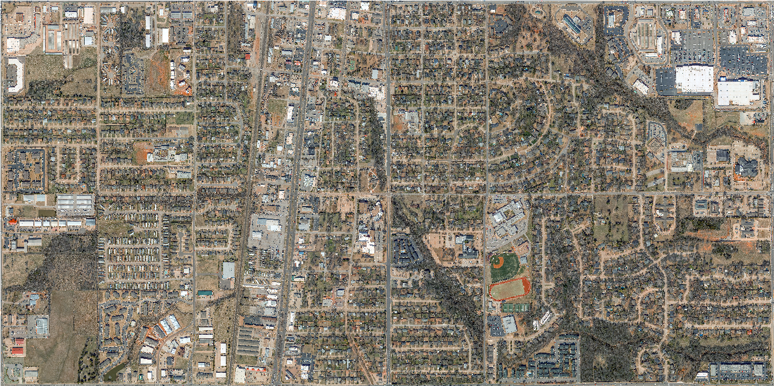
3D GIS Implementation using City Engine
COE Ortho-Imagery clipped to extent of 140335 and 140336
Notes:
In this example we have clipped the overall City ortho-imagery to the extents of sections 140335 and 140336.

Slide 13
3D GIS Implementation using City Engine
Option 2
Use ArcGIS Online from within City Engine
to obtain Ortho-imagery and DSM
Notes:
Now, if there is no existing basemap information in-house or if the user desires to use ArcGIS Online, the second option previously mentioned is available.

Slide 14
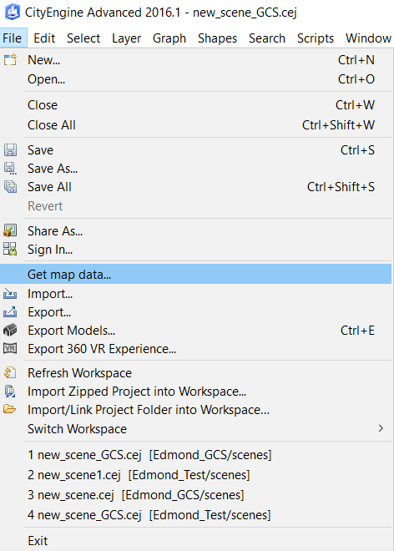
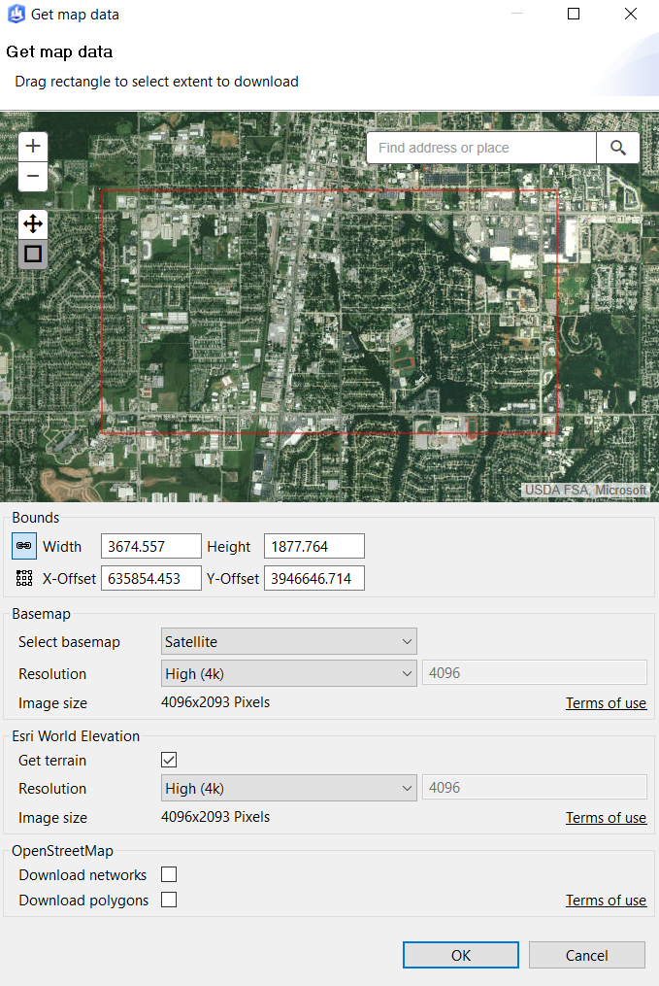
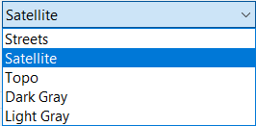
3D GIS Implementation using City Engine
ArcGIS Online Data
Map Data… command
City Engine 2016 or greater
Data stored in Maps folder
Elevation as TIFF (DEM)
Texture as JPG (Imagery)
User interactively drags a rectangle denoting the extent to be downloaded
User can specify type of data to be downloaded and the resolution
Notes:
In this mode of operation, the basemap can be obtained directly from within City Engine using the Get map data… command. The end result will be the same as with the first option. That is, a clipped rectangular image representing the area of interest. Note that generally speaking, in-house developed imagery will probably be more current and of higher resolution than that provided by Esri. However, if there is no existing basemap, this is an excellent resource for obtaining basemap data.

Slide 15
3D GIS Implementation using City Engine
Basic Feature Layer Datasets
Tree Locations
Street Lights
Street Centerlines
Building Footprints
Depending upon preference, data can be 2D or 3D
Notes:
As mentioned previously, there are a number of datasets that can be imported into the 3D GIS. During this presentation we will concentrate on trees, street lights, street centerlines, and building footprints. Additionally, the user will want to consider whether 2D or 3D feature data is to be imported into City Engine.

Slide 16
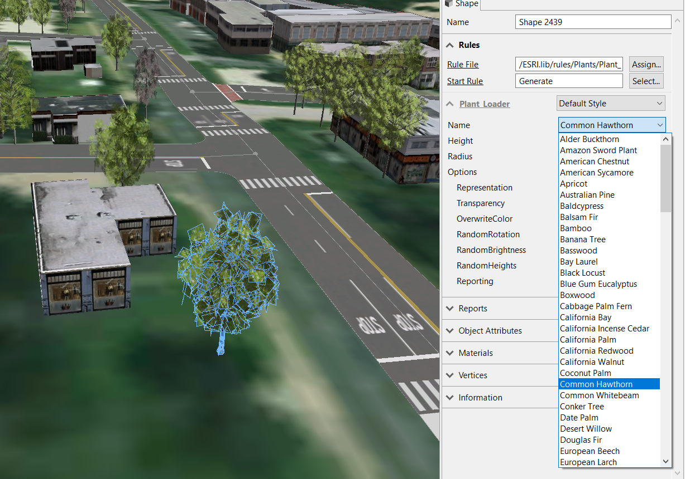
3D GIS Implementation using City Engine
Tree Layer Considerations
Point features denoting approximate center of tree
Use the Esri Out of the Box Rule File /ESRI.lib/rules/Plants/Plant_Loader.cga
The Rule File contains a robust list of Tree Types
Attributes for facilitating
generation of Trees
RULEFILE
STARTRULE
Name
Height
Radius
Notes:
The easiest dataset to convert into a 3D GIS is the Tree Layer. City Engine comes with a very robust Rule File which contains a lengthy list of various tree types. Facilitating the conversion will be the addition of the above mentioned attributes in the Tree Layer. If these attributes are present with the appropriate values, generation of the 3D trees can occur upon import into City Engine.

Slide 17
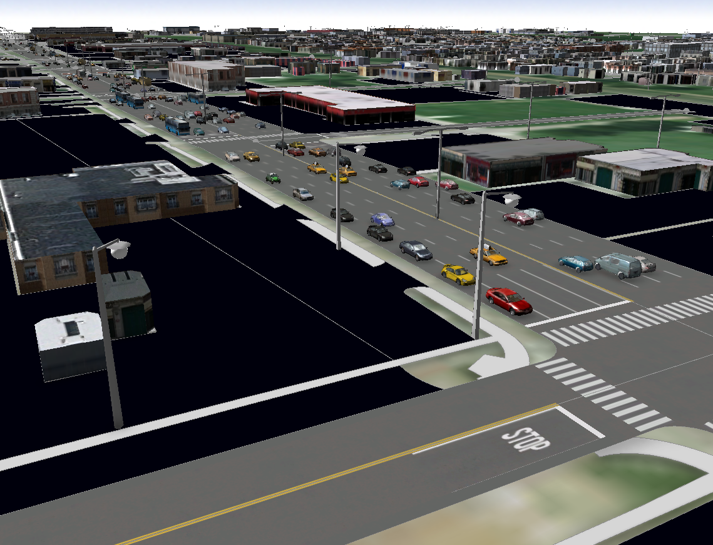
3D GIS Implementation using City Engine
Street Light Layer Considerations
Point features denoting approximate center of street light
Use the Rule File for Rendering Street Lights from the City of Philadelphia Example
/rules/Street Furniture.cga
Rule Contains a Variety of Street Lights
360Bulb Globe
LightwFlag Split and Tall
Attributes for facilitating generation of
Street Lights (case sensitive)
RULEFILE
STARTRULE
TYPE
SPECIFIC
SIZE
ROTATION
Notes:
Like the trees, street lights can be imported into City Engine. The attribute assignment can be done within City Engine or the underlying database can be modified to incorporate the Rule’s pertinent attributes.

Slide 18
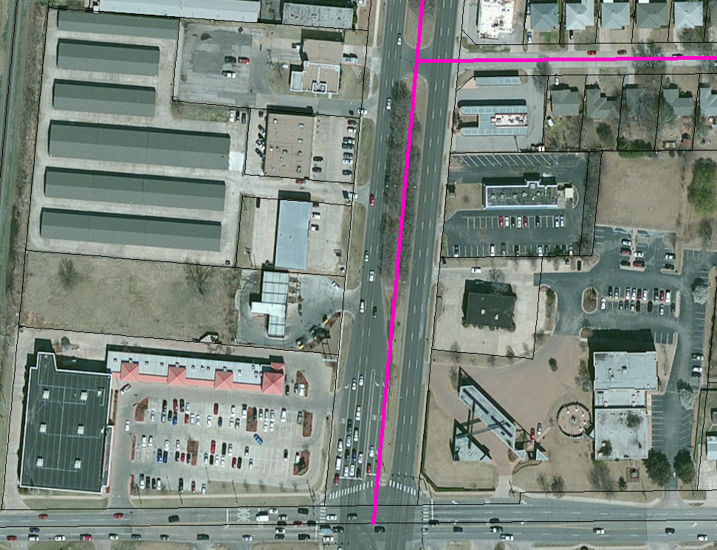
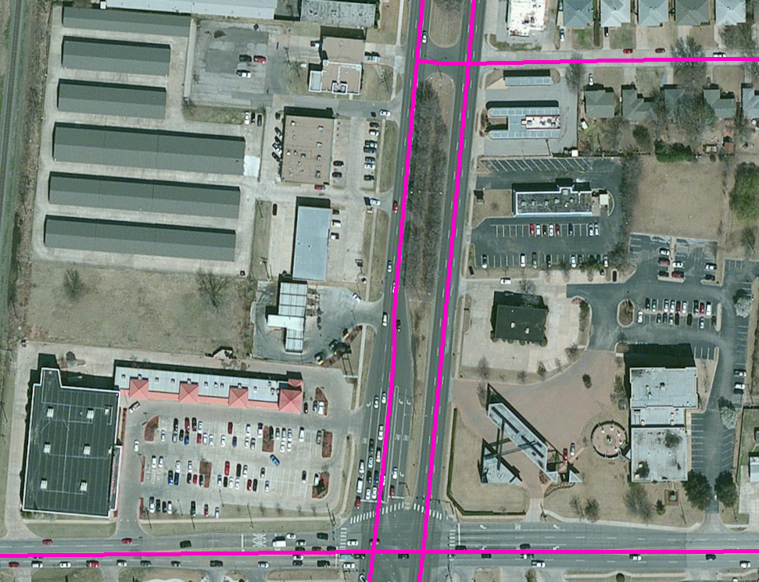
3D GIS Implementation using City Engine
Street Centerline Considerations
Recommend doing Street editing in ArcMap prior to importing into CE
One Line denoting the centerline of the ROW
One Line for each Roadway Direction
Notes:
It should be noted that prior to importing street centerline data, consideration should be given as to how the centerlines are to be represented. City Engine does offer the ability to model medians. As such, it may be appropriate to create a centerline that splits the street ROW rather than having two lines representing the road direction. In either case, the editing of the street centerline data will be easier in an ArcMap environment.

Slide 19
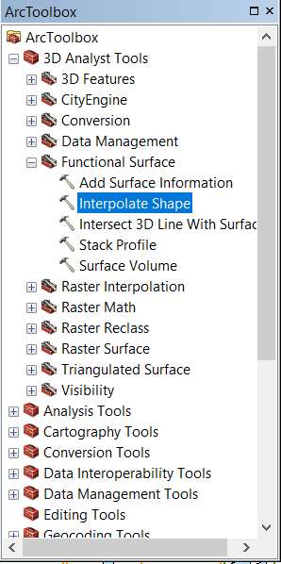
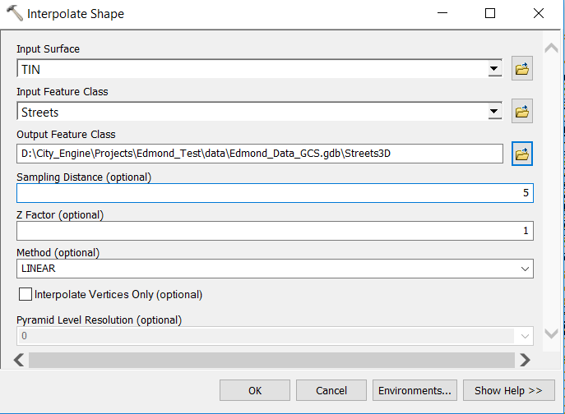
3D GIS Implementation using City Engine
If 3D data is desired, 2D datasets should be converted into 3D using the 3D Analyst Interpolate Shape toolbox command
Notes:
If 3D feature data is desired then the Interpolate Shape command can be used to convert 2D feature data into 3D feature data. Note the input surface, TIN. The TIN dataset was created using the 3D Analyst extension from the DSM that was downloaded from ArcGIS Online. Furthermore, note the Sampling Distance parameter. Since there is no draping functionality in City Engine, it is important that the 3D feature data contains enough intermediate vertices to properly reflect the surface of the terrain.

Slide 20
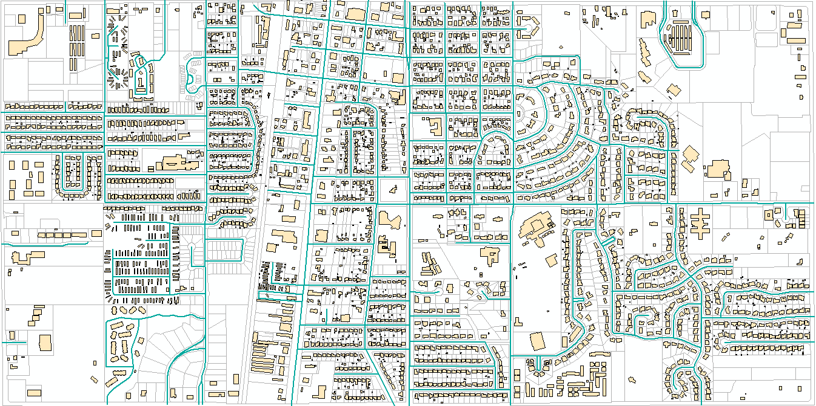
3D GIS Implementation using City Engine
COE Streets, Building Pads and Parcels within extent of 140335 and 140336
Notes:
So summarizing, we are going to take the above ArcMap datasets, trees, street lights, streets, building footprints, parcels, and import them into City Engine to create a 3D GIS.

Slide 21
3D GIS Implementation using City Engine
3D Development assisted by GIS Featureclasses containing pertinent Data
Streets
Pavement Width
Lane Width
Building Footprints
Total Height
Number of Floors
Floor Height
A City Engine Rule can be defined to extract a parameter’s value from a feature’s attribute value. All numeric values are in meters, not feet.
A File GeoDatabase was established containing the various featureclasses.
Depending upon the City Engine Rule the pertinent data will vary.
The attributes shown here are the most basic and pertinent.
City Engine is a Rule Based Modeler comprised of a Rule File and a Start Rule which can be stored as attributes in the featureclass.
Notes:
In developing the 3D GIS, the development process can be assisted by incorporating modeling information into the ArcMap featureclasses. That is to say, by adding certain attributes and populating them with the appropriate values the time to generate the 3D GIS can be greatly reduced.

Slide 22
3D GIS Implementation using City Engine
The Attribute Name must match the Variable Name in the Rule File
Complete_Street.cga Rule File
Lane_Width : double in meters
LOD_Setting : text value equal to High, Moderate, Low
3D_City_Design_Rules/Building Construction.cga Rule File
Floor_Count_Min : integer value > 0
Floor_Count_Max : integer value >= Floor_Count_Min
Rule File and Start Rule Attribute Names
RULEFILE : Rule File name attribute
STARTRULE : Start Rule name attribute
Variable Names in a Rule File are Case Sensitive
Notes:
Here are just a few attribute names that can appear for the Complete_Street and Building Construction Rule Files. Note the LOD_Setting attribute. This indicates how detail the texturing will be when rendering a feature. The higher the texture level the more memory that is needed. This has a major effect on the performance of City Engine. Finally, it is possible to store the Rule File and Start Rule values under the RULEFILE and STARTRULE attribute names.

Slide 23
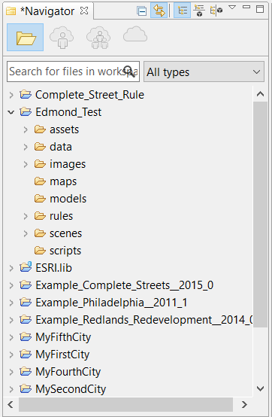
3D GIS Implementation using City Engine
City Engine Workspace
CE Workspace comprised of 1 or more Projects.
Each Project contains fixed set of folders.
Project Data stored in specific folders.
Assets contains the 3D images and textures.
Data contains Project datasets.
Images contains ortho-imagery.
Rules contains the CGA files used to generate the 3D models.
Scenes contains the 3D views.
Notes:
Those familiar with ArcMap’s desktop interface will find City Engine’s interface a little different. First of all, City Engine operates in a workspace, which is nothing more than a folder on a hard drive. Within the workspace, there can be one or more projects. Again, projects are nothing more than folders within the workspace folder. Each project is comprised of a fixed set of folders containing specific types of information. Note that it is possible for projects to reference information/data in other projects. For example, rules created in Project A can be accessed in Project B. In so doing duplicate information is avoided.

Slide 24
3D GIS Implementation using City Engine
Getting Started – Importing Data
2D City Engine Model (No DSM imported)
Import 2D Streets, 2D Parcels, 2D Buildings and Ortho-imagery for background
3D City Engine Model (DSM imported)
  Import 3D Streets, 3D Parcels, 3D Buildings and Ortho-imagery for background
  Import DSM
  Changes made to the GIS data are not reflected in the City Engine model, the model will need to be updated manually or by reimporting the GIS data.
Notes:
How ArcMap data is imported into City Engine will depend on whether 2D or 3D feature data is to be processed and if a DSM is involved. If a DSM is to be used, 2D or 3D feature data can be processed. If a DSM is not to be used, 2D feature data and ortho-imagery can be imported. Note the comment at the bottom of the slide, if the GIS changes, the City Engine model will need to be updated manually or by reimporting the data.

Slide 25
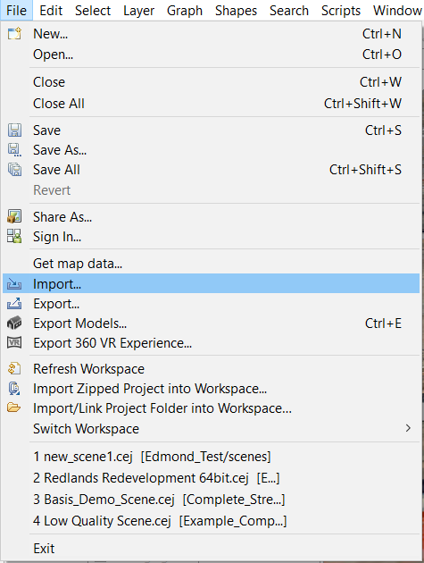
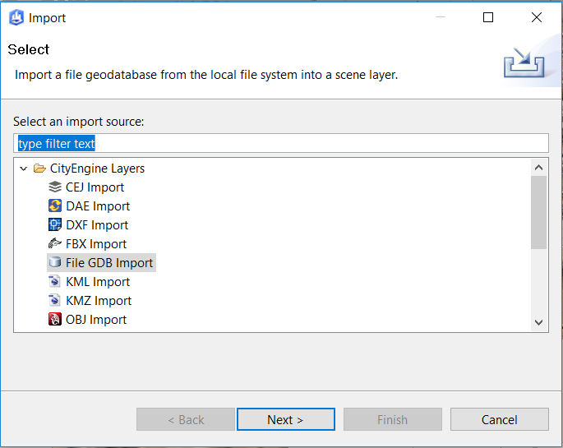
3D GIS Implementation using City Engine
Importing Feature Data from a File GeoDatabase
Notes:
Regardless if 2D or 3D feature data is to be imported, the Import command will be used to get ArcMap data into City Engine. Depending upon the ArcMap source, the appropriate command should be selected. In our example, we will use the File GDB Import command since our information is stored in a File GeoDatabase.

Slide 26
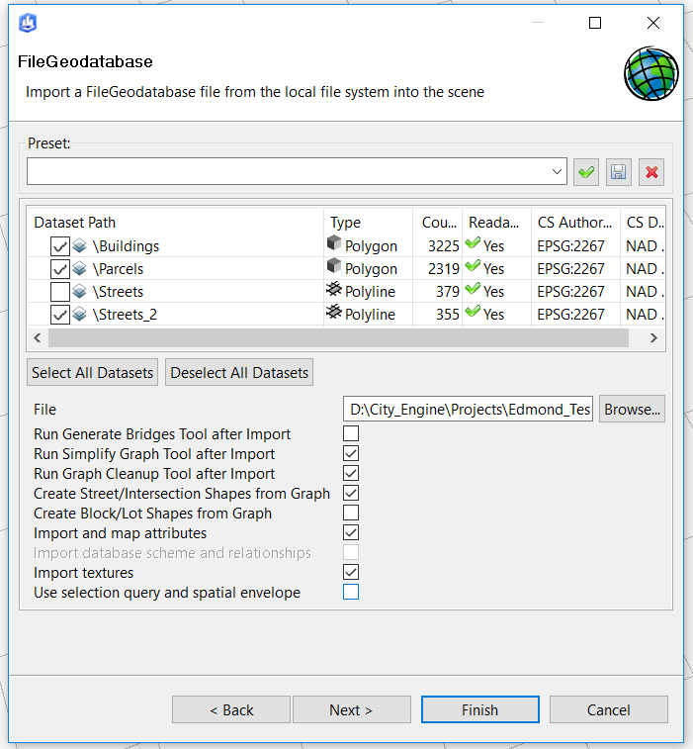
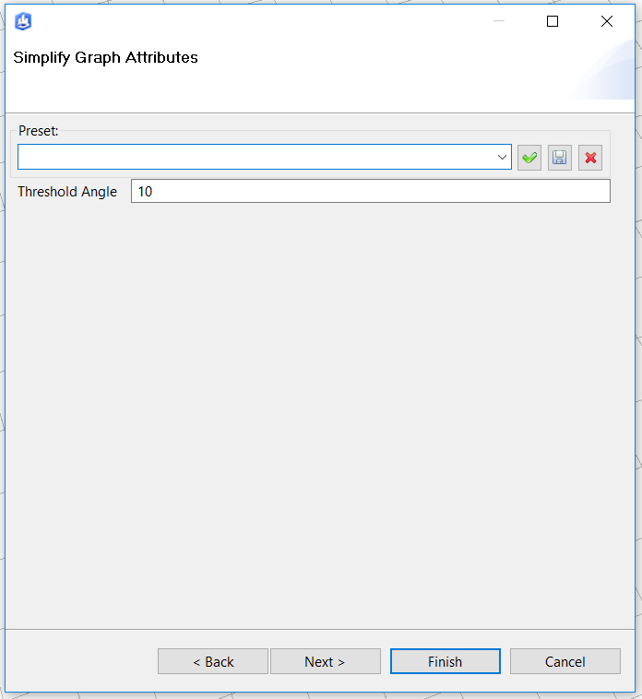
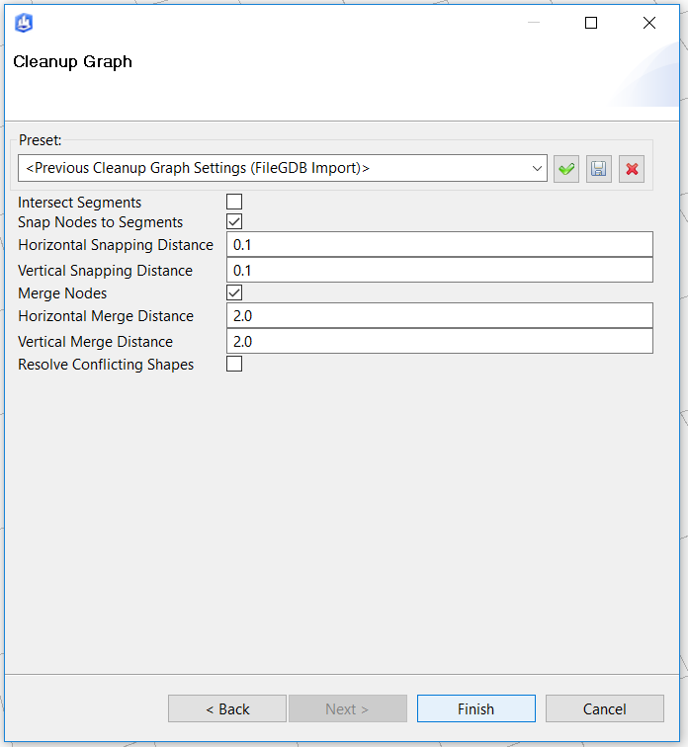
3D GIS Implementation using City Engine
File GDB Import Dialog Boxes
The Threshold Angle controls how sensitive the import will be in generating curves. The higher the number, the more curves.
Notes:
In importing File GeoDatabase featureclasses, the user has the option of importing one or more featureclass at a time. There are also a number of options that can be activated during the import. The settings of these parameters has a tremendous effect on the import process. So be prepared to try a few variations to determine the proper values.

Slide 27
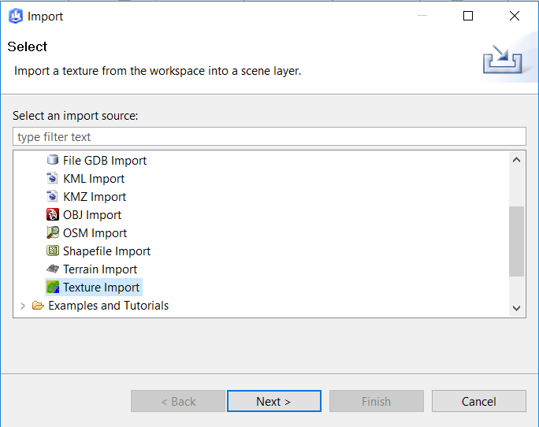
3D GIS Implementation using City Engine
Importing Ortho-imagery Data
Notes:
To import ortho-imagery, the Texture Import command should be selected.

Slide 28
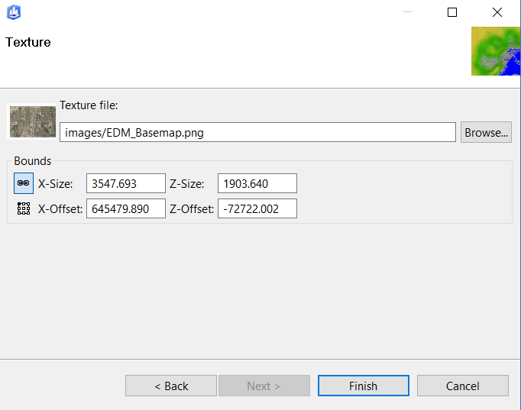
3D GIS Implementation using City Engine
Importing Ortho-imagery Data – Zero Elevation Based
Dialog box for importing the clipped ortho-imagery discussed earlier.
No elevation information is associated with this dataset.
Used solely for visual purposes.
Notes:
In our example we simply specify the clipped ortho-imagery file that was created using the Export Data command in ArcMap.

Slide 29
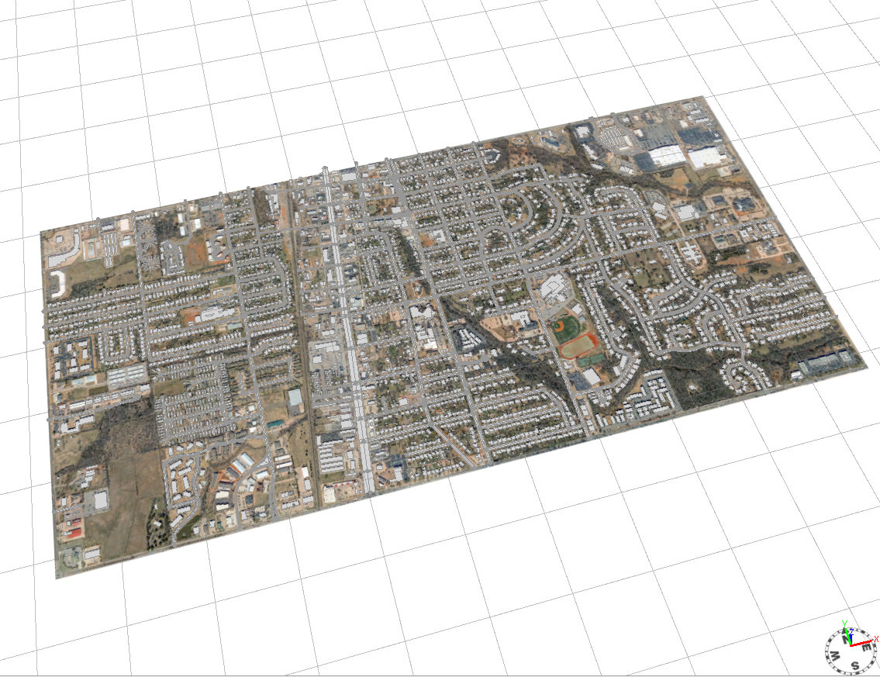
3D GIS Implementation using City Engine
Initial Display of GIS 2D Data in City Engine
The next tasks are to clean up any street geometry issues followed by assigning the Rule File and Start Rule for the features in the model
Notes:
Once the datasets have been imported this is what the display will look like. In this example there is no DSM so all of the data resides at elevation 0. The next step will be to clean up any geometry issues and there more than likely will be issues. Following this step, the user can then go through the process of assigning rules to the features. It is the rules that make the 3D images appear.

Slide 30
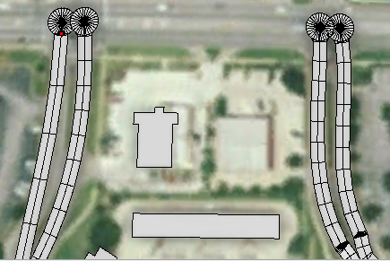
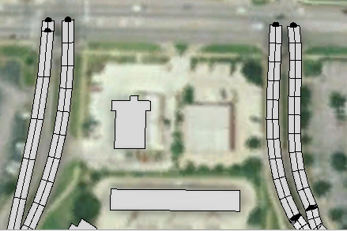
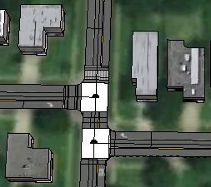
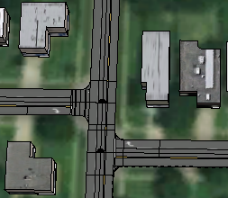
3D GIS Implementation using City Engine
Street Geometry Issues/Post-processing in City Engine
Dead end streets will have cul-de-sacs introduced. Change Intersection Type for the node from Smart to Freeway.
Intersections that are close to each other result in white area being displayed since road can not be modeled. Change Intersection Type for the node from Smart to Crossing or Junction depending upon geometry.
Notes:
The majority of the streets will be imported properly but there will be areas that will need to be addressed manually.

Slide 31
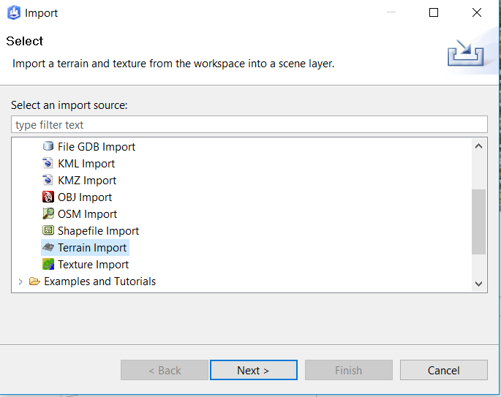
3D GIS Implementation using City Engine
Importing Terrain Data – Elevation Data Present
Notes:
If a DSM is to be imported, the Terrain Import command can be selected.

Slide 32
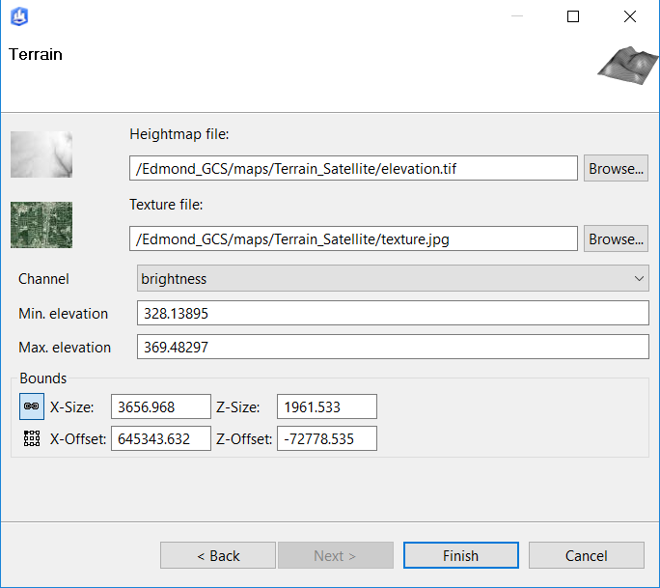
3D GIS Implementation using City Engine
Importing Terrain Data
Dialog box for importing the ArcGIS Online data discussed earlier.
Comprised of a DSM and an image or texture as referred to in City Engine.
Used for visual and elevation computation purposes.
Notes:
In this example we are importing the terrain we downloaded from ArcGIS Online. The DSM and Image files will be stored in the MAPS folder within the City Engine project folder.

Slide 33
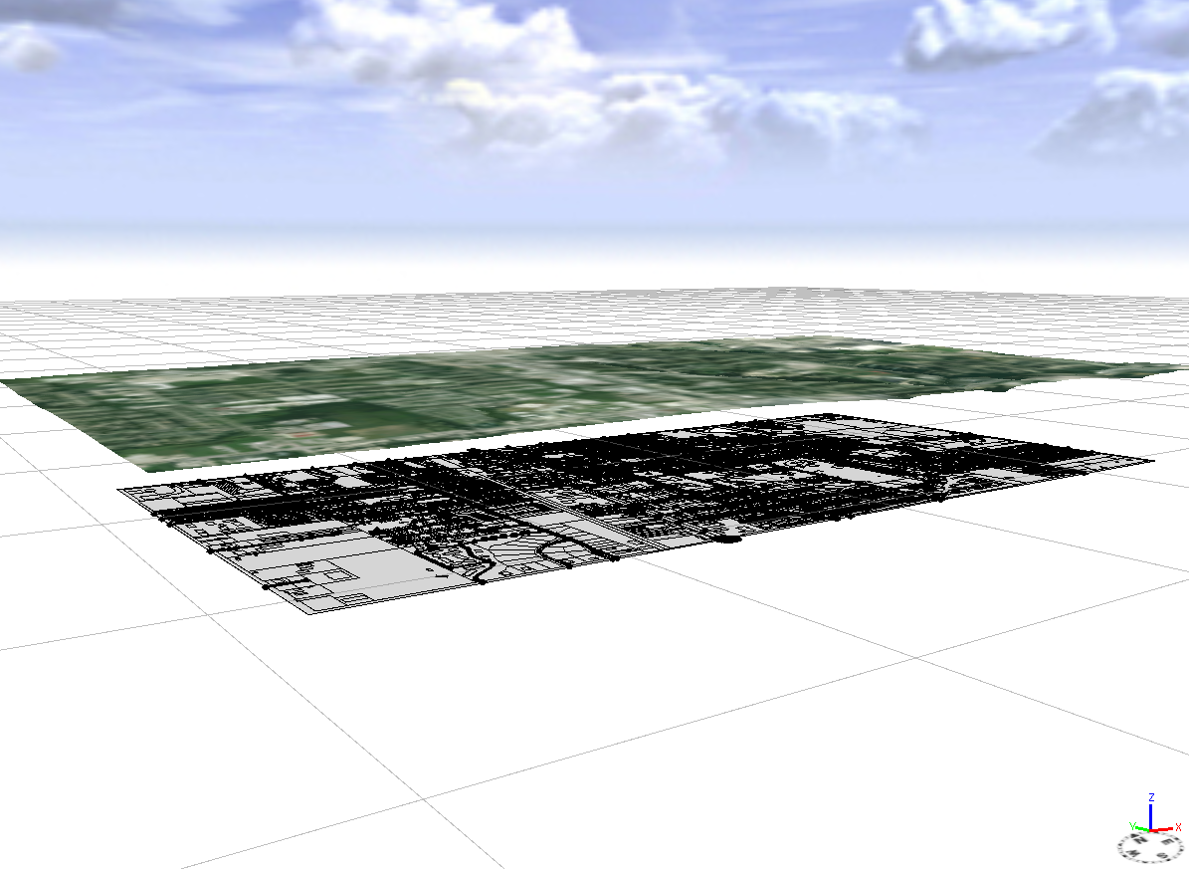
3D GIS Implementation using City Engine
2D GIS data imported with the ArcGIS Online DSM and Ortho-imagery
2D GIS data can be projected onto the DSM using the Align Shapes to Terrain and the Align Graph to Terrain commands.
Notes:
If a DSM is imported in conjunction with 2D feature data, you will find a display such as that shown in the slide. The DSM has elevation information while the 2D data is at elevation 0. City Engine has commands that will project the 2D feature data onto the DSM.

Slide 34
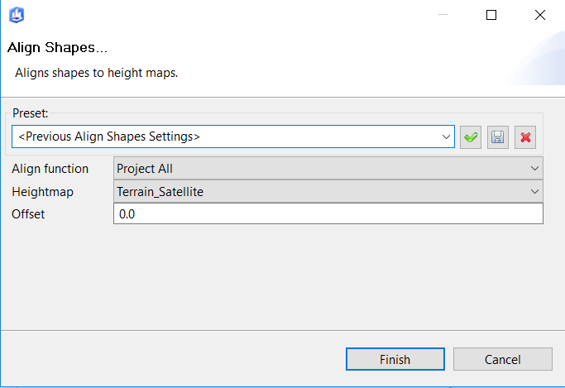
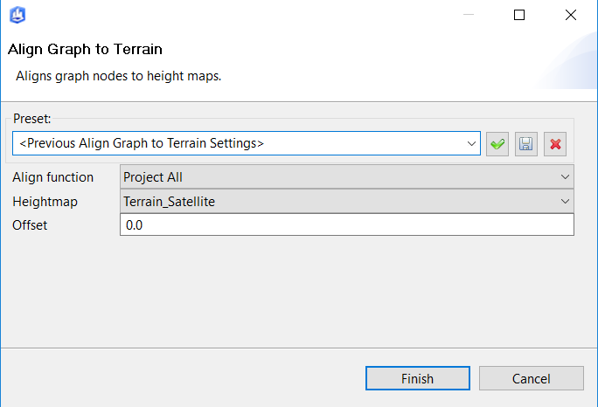
3D GIS Implementation using City Engine
The Align Shapes to Terrain and the Align Graph to Terrain commands enable the user to specify the Heightmap dataset and an offset from the DSM. The offset is used to eliminate interference with the DSM.
The Align Graph to Terrain command
is specific to Streets
Notes:
Specifically, the Align Shapes to Terrain and Align Graph to Terrain commands are used to project 2D feature data onto the DSM. The Align Graph to Terrain command is specific to street centerlines. The offset parameter enables the user to offset the features from the DSM by a specific amount in the Z direction.

Slide 35
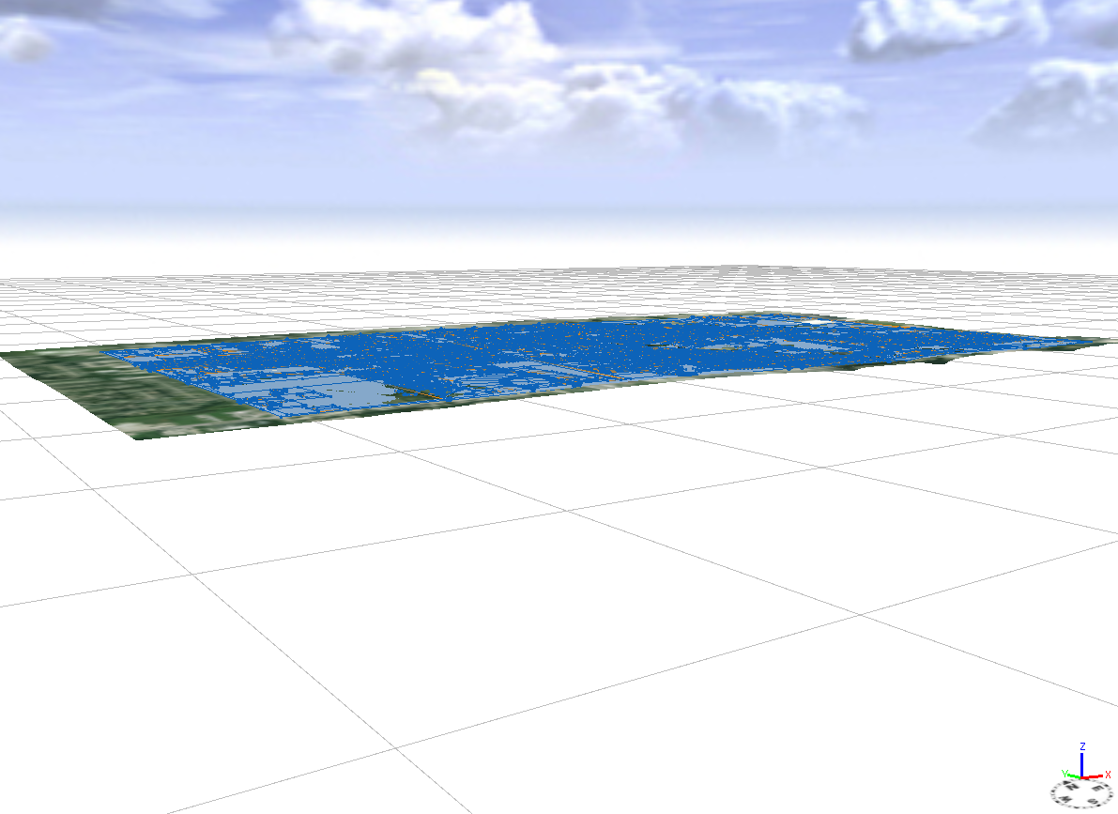
3D GIS Implementation using City Engine
Result of executing the Align Shapes to Terrain and Align Graph to Terrain commands.
Notes:
Once the two commands have been executed, the 2D feature data will have been converted to 3D data and aligned with the DSM.

Slide 36
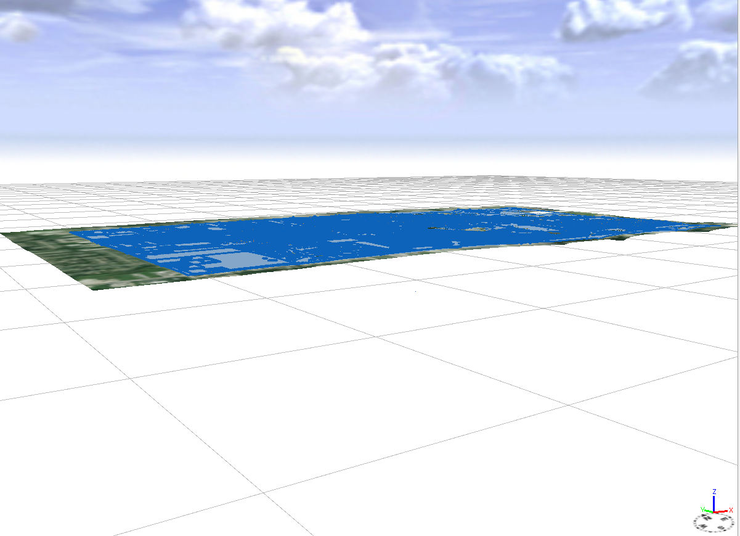
3D GIS Implementation using City Engine
Result of importing 3D Feature Layers.
Notes:
In the case of 3D feature data, the features should align with the DSM upon import. No additional processing should be required. However, if need be, the Align Shapes to Terrain and Align Graph to Terrain commands can still be utilized.

Slide 37
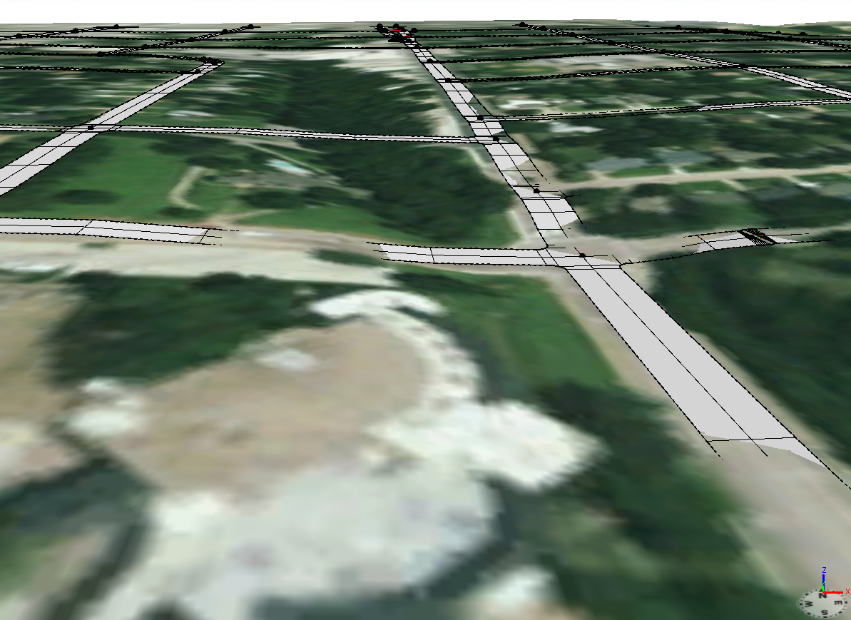
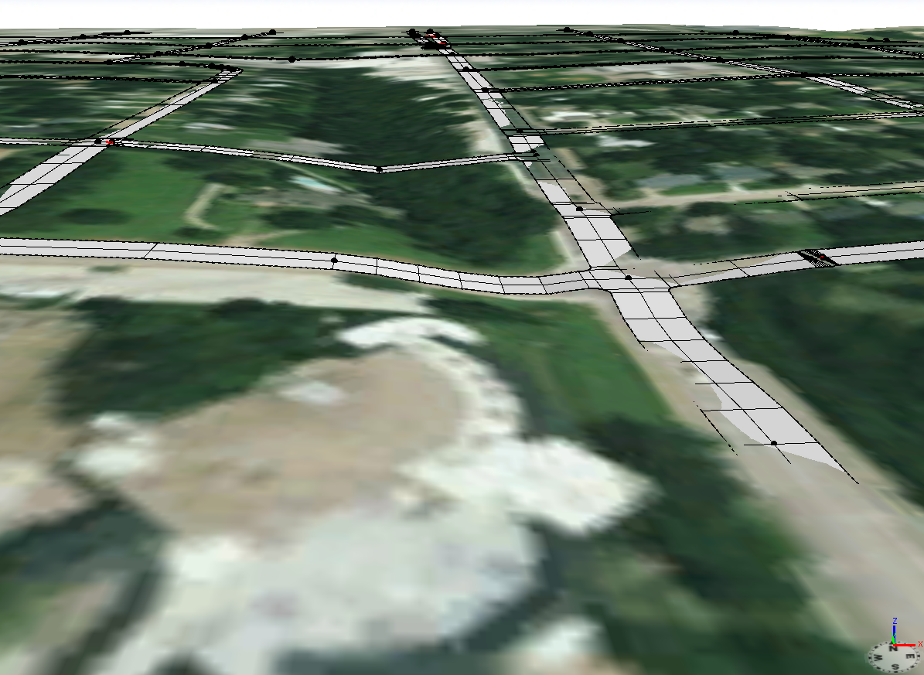
3D GIS Implementation using City Engine
Left side image represents the 2D GIS data projected onto the ArcGIS Online DSM.
Right side image represents the 3D GIS data which had interpolated vertices computed every 5 feet superimposed onto the ArcGIS Online DSM.
3D GIS data better fits the DSM due to the interpolated vertices.
Notes:
Previously we mentioned the Sampling Distance parameter when converting 2D feature data into 3D feature data. This parameter introduces intermediate vertices on a feature. The image on the left side represents 2D data with start and end points, no intermediate vertices. The image on the right side represents 3D feature data with intermediate vertices. Notice how the features in the right side image better follow the terrain of the DSM.

Slide 38
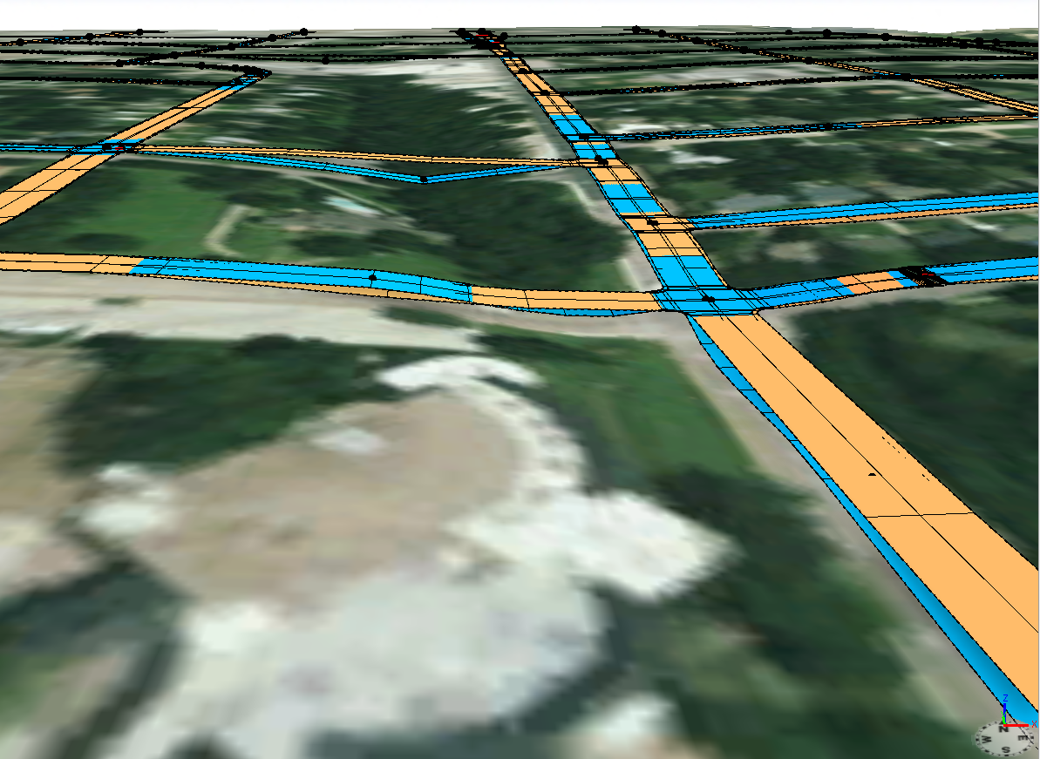
3D GIS Implementation using City Engine
The Gold roadway represents the projected 2D GIS data while the Blue roadway denotes the 3D GIS data with interpolated vertices.
If a DSM is to be used in the 3D Model the GIS Data should be comprised of 3D features with interpolated vertices
Notes:
Just to make the point clearer, the image above shows the 2D feature data in gold, while the 3D feature data is displayed in blue. The take away from this is, if a DSM is to be used, intermediate vertices should be inserted so that features properly align with the DSM. Note that the closer the intermediate vertices are, the better the features will follow the terrain. The downside is, the larger the dataset becomes.

Slide 39
3D GIS Implementation using City Engine
Overview of Rule Files and Rules
City Engine was designed for procedural modeling (computer graphics terminology for creating 3D models and textures from a set of rules).
Computer Generated Architecture (CGA) shape grammar is a programming language.
Rule Files are written in CGA and contain one or more rules.
Each feature is assigned a Rule File and a Start Rule which denotes how the feature is modeled/displayed.
If a model contains 100 unique buildings there will be 100 rules.
Esri has a Web Page containing City Engine Examples. The Rules in these examples can be copied into other project folders for use and/or modification.
Models created in Maya, Rhino, 3DS or Sketchup can be used in City Engine.
Notes:
With the feature data imported in City Engine, the modeler can now go about the process of creating/assigning the Rule Files and Rules to the features. This assignment can be done on a feature by feature basis or to a group of selected features in one operation. City Engine renders a feature based upon the rule assigned to the feature. Note that it is possible to use 3D models created by another 3D modeler in City Engine.

Slide 40
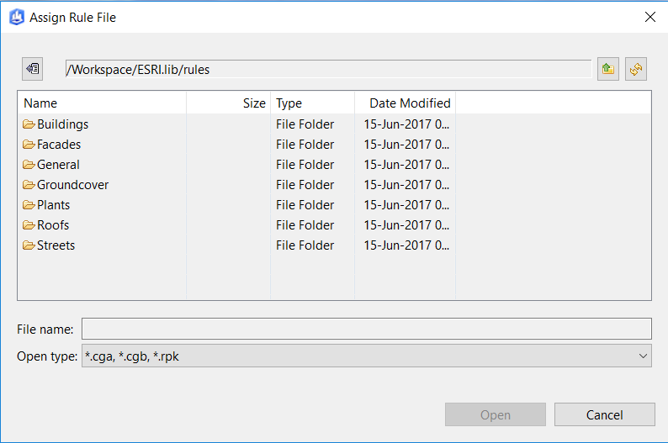
3D GIS Implementation using City Engine
Esri Default Rule Files and Rules
Rules for a variety of different feature types.
Rules generally not associated with feature attributes but rather use random number generation to create different “looks”
Very useful in generating non-reality scenes
Need to be modified to represent real world conditions.
Notes:
Creating Rules can be complicated and one does need some sort of programming, as well as 3D modeling, experience. However, City Engine does come with some pre-defined rules that can be used out of the box. Unfortunately these rules will not generate models that represent real world conditions. The image in the slide illustrates what entities have pre-defined rules. Within each of the folders shown in the image are one or more Rule Files.

Slide 41
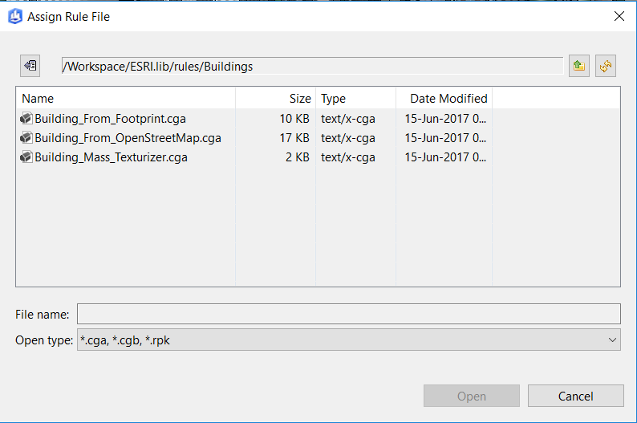
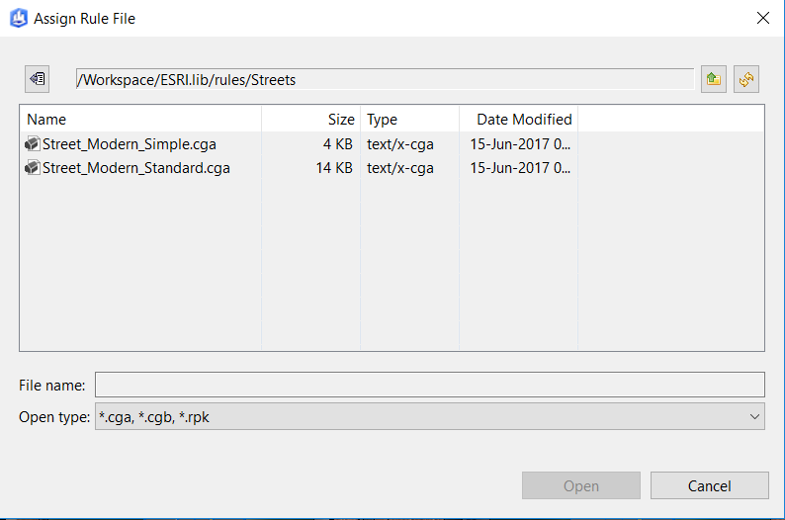
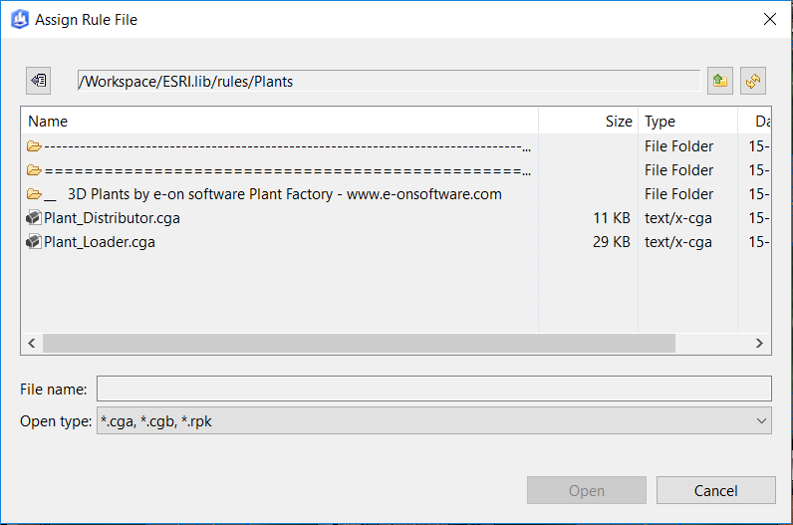
3D GIS Implementation using City Engine
Esri Default Rule Files for
Buildings
Plants
Streets
Notes:
Each of the folders shown in the previous slide contains one or more Rule Files. It is these Rule Files that the user selects.

Slide 42
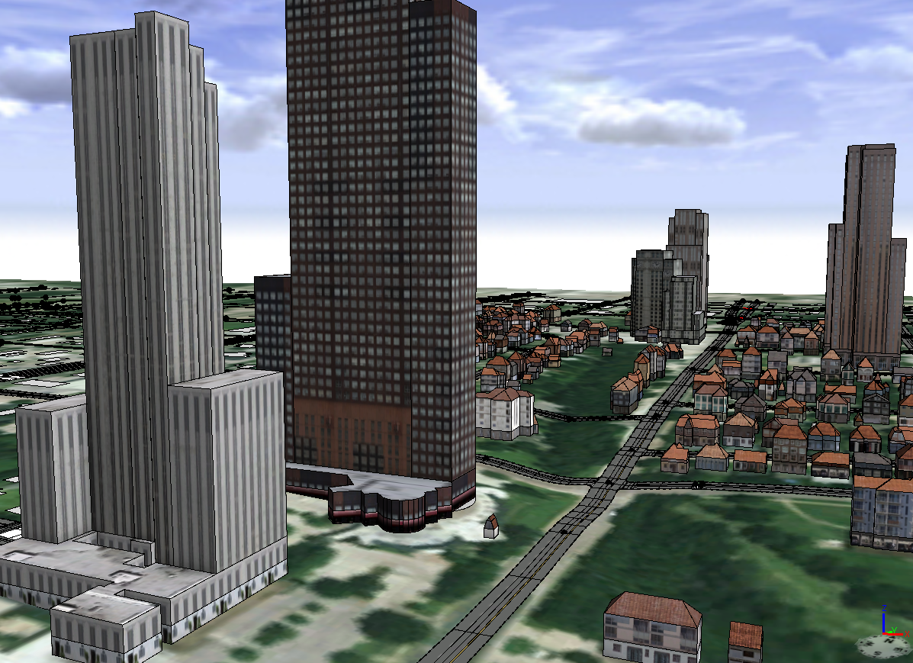
3D GIS Implementation using City Engine
Example of assigning the Esri Building from Footprint and Street Modern Standard Rules.
A random generator assigns building heights and styles. For streets, different street markings are assigned.
Notes:
Here is a slide illustrating the model that is generated using the Esri Building from Footprint and Street Modern Standard Rule Files.

Slide 43
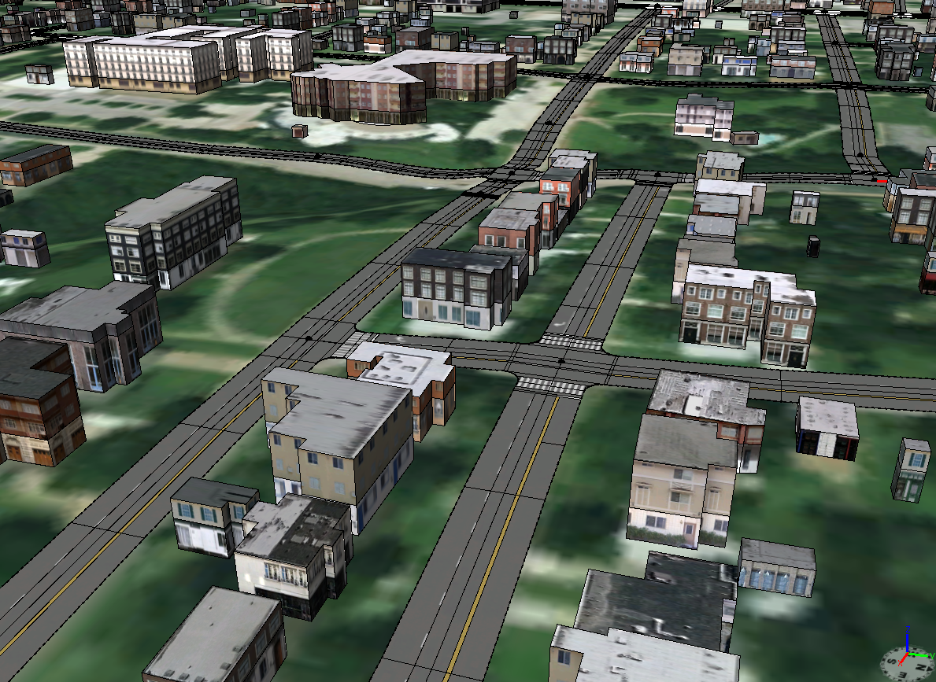
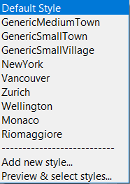
3D GIS Implementation using City Engine
Example of assigning the Esri Building from Open StreetMap Rule using the GenericMediumTown style.
Notes:
Here is a slide illustrating the model that is generated using the Esri Building from Open StreetMap and Street Modern Standard Rule Files. With the Building from Open StreetMap Rule File the user has a few options as to how the buildings should be modeled. In this example, the GenericMediumTown option is displayed.

Slide 44
3D GIS Implementation using City Engine
Esri Rule File for Streets – Complete_Street.cga
Example Complete Streets Features 2015 released by ESRI Redlands.
Comprised of the following Start Rules:
Street Junction
Bridge Crossing Median_TreeSplit
Crossing Roundabout
Freeway RoundaboutIsland
Freeway Entry Sidewalk
Joint
Based on the Rule different look and different set of parameters.
The Streets Rule has an extensive set of parameters as shown in the next 2 slides.
Notes:
In addition to the default Rule Files, Esri offers the Complete_Street.cga Rule File. This is a robust Rule File that can serve as a starting point for rendering streets.

Slide 45
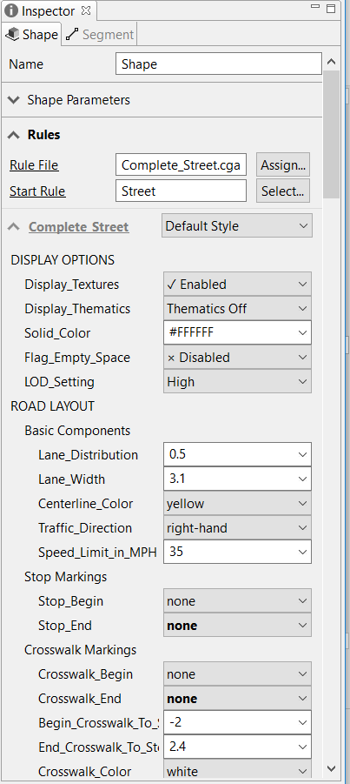
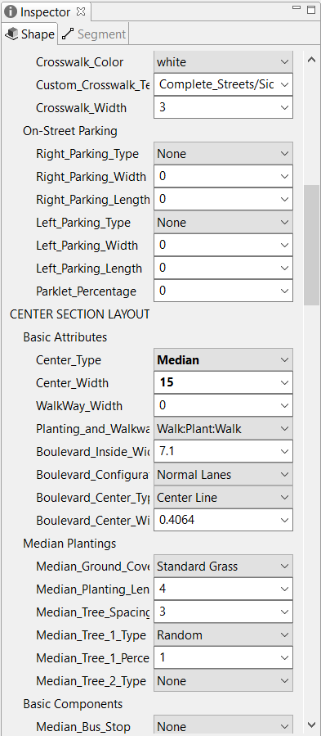

3D GIS Implementation using City Engine
Notes:
As can be seen, there are a number of parameters the user can modify to achieve the desired look. Note that distances such as Lane Width are specified in meters, not feet. This applies to all types of distances.

Slide 46



3D GIS Implementation using City Engine
Notes:
The Population category enables the user to add images of vehicles and people to the model.

Slide 47





3D GIS Implementation using City Engine
Esri Rule File for Streets – Complete_Street.cga – Available Tree Names
Notes:
A rather extensive list of tree names are available as well. These can be used when specifying Median and Sidewalk plantings.

Slide 48



3D GIS Implementation using City Engine
Various Design Scenarios
By adjusting the values of the Complete Street parameters the user is able to quickly generate various design scenarios. In this example, (a) no median, (b) median with planting and (c) a median with barrier and shoulder and side street parking are shown.
Notes:
Using the parameters in the Complete_Street Rule, various roadway designs can be generated.

Slide 49
3D GIS Implementation using City Engine
Esri Rule File for Buildings – 3D_City_Design_Rules
Example Redlands Redevelopment 2015 released by ESRI Redlands.
Comprised of a number of Rule Files
Based on the Rule different look and different set of parameters.
Included with the Redlands Redevelopment Example.
Comprised of the following Start Rules:
Footprint Parcel Lot
The Building Construction Rule has an extensive set of parameters as shown in the next 2 slides.
Notes:
Moving on to Buildings, in the Redlands Redevelopment 2015 example there are a number of Rule Files. The Building Construction Rule File pertains to buildings, as the name implies. We decided to use this Rule File because of its robustness in being able to generate various types of building facades.

Slide 50



3D GIS Implementation using City Engine
Notes:
As can be seen there is an extensive list of parameters. A Key parameter is the Facade Construction parameter which controls the building style that is generated.

Slide 51



3D GIS Implementation using City Engine
Notes:
More parameters for the Building Construction Rule File.

Slide 52

3D GIS Implementation using City Engine
Facade Construction Parameter for the Building Construction Rule
Offers 14 Building Styles.
Mixed Use, Residential and Office
Accounts for Green construction.
Notes:
Using the Facade Construction parameter the user can generate different building styles.

Slide 53

3D GIS Implementation using City Engine
Facade Building Styles 1 through 5 for the Building Construction Rule
Redlands_Mixed_Use_1
Redlands_Mixed_Use_Green_Building_1
Redlands_Mixed_Use_2
Redlands_Mixed_Use_3
Redlands_Mixed_Use_Eco_2
Notes:
Here are examples of the types of building facades that can be generated. Note that the user can control the number of floors, window size, balcony size and so forth.

Slide 54

3D GIS Implementation using City Engine
Facade Building Styles 6 through 11 for the Building Construction Rule
Redlands_Residential_1
Redlands_Residential_2
Redlands_Office_Eco_1
Redlands_Office_1
Redlands_Mixed_Use_Green_Building
Redlands_Residential_3
Notes:
The second set of building styles.

Slide 55

3D GIS Implementation using City Engine
Facade Building Styles 12 through 14 for the Building Construction Rule
Redlands_Residential_4
Redlands_Office_2
Redlands_Residential_5
Notes:
The final set of building styles.

Slide 56

3D GIS Implementation using City Engine
Three Building Rule Files displayed in this view:
Generic Modern Buildings
Building
Building Construction
Notes:
In addition to the Building Construction Rule File within the 3D City Design Rules there are other building rule files that can be downloaded and accessed. The Rule Files mentioned in this slide were obtained from the Philadelphia 2011 Example, the Complete Streets 2015 Example and the Redlands Redevelopment 2015 Example, respectively. Another building rule file that can be considered is the /ESRI.lib/rules/Buildings/Building_From_Footprint.cga Rule File. This offers a number of different building styles with a much simpler user interface. This rule file is very applicable in cases where it is desired to assign a common building facade based upon zoning type.

Slide 57
3D GIS Implementation using City Engine
Buildings – Modeling Approaches
Create a Rule for every Building.
Yields a very detailed and realistic model
Very time consuming and expensive
Create a Rule for every Type of Building.
Yields an accurate model based upon use
Cost-effective
Utilize Digital Photos as building facade texturing.
Yields a very detailed and realistic model
Very time consuming and expensive
Notes:
Summarizing, depending upon how exact you want the model to look you can create a rule for every building or a rule for every type of building. Obviously, the less number of rules you have to create the faster the model building process will be. You can also download rules from the City Engine gallery and use those rules directly or customize them. Furthermore, the ability to utilize a digital photo of a building facade can be employed.

Slide 58

3D GIS Implementation using City Engine
Notes:
One last image illustrating the 3D terrain and ortho-imagery downloaded from ArcGIS Online with the 3D street centerlines and 3D building footprints. The streets have been assigned the Complete Streets Rule and the building footprints the Building from Open StreetMap Rule using the GenericMediumTown style. The most time consuming part of creating this model was the geometry post-processing of the streets in City Engine.

Slide 59


3D GIS Implementation using City Engine
Creating a Web Scene for Viewing in a Browser (Chrome, Firefox, IE, etc.)
Two Step Process.
Create a City Engine Web Scene (3ws). Note, must select objects to be exported first.
Once the 3ws File is created upload the file to ArcGIS Online or to an internal Server for hosting.
Notes:
Once the model has been built there will probably be a need to make the model available for public or internal consumption via the Internet. To accomplish this, a City Engine Web Scene must first be created. This is an optimized web file carrying the 3ws extension. Once the file has been created it can be uploaded to ArcGIS Online or to an internal Server for hosting.

Slide 60


3D GIS Implementation using City Engine
Notes:
Once the user confirms that a City Engine Web Scene is to be created, there are a couple dialog boxes that are presented to the user. An important hint to remember is to disable the Simplify Terrain Meshes option. This will keep the Web Scene file small. Additionally, the Textures parameter enables the user to control the level of detail that appears in the Web Scene, while the Metadata parameter controls what attributes will be displayed when a feature is identified.

Slide 61


3D GIS Implementation using City Engine
Previewing the Web Scene File
from within City Engine
Notes:
Prior to uploading the City Engine Web Scene file, it is possible to preview the Web Scene by navigating to the file from within City Engine and right-clicking on the file and opening the file using the 3D Web Scene Viewer. Note at the bottom of the Web Scene image, thumbnails of the bookmarks in the City Engine project will appear. To publish the Web Scene to ArcGIS Online, the Share As… menu item in the pop-up menu list can be selected.

Slide 62
The Research Foundation for The State University of New York
Online GIS-based Invasive Species Data Management System
End of
Formal Presentation
We’d be pleased to
Respond to any Questions or Comments
Notes:
At the beginning of the presentation we had four questions we wanted to answer. We’ve addressed two of the four. That is how do we build the model and the level of difficulty. The remaining two, how long and cost really depends upon the level of detail that is desired in the model. The other factor to consider is the maintenance of the model. Like any other database there will be a maintenance effort to ensure the 3D GIS is current. As a rough estimate we would say that, for a two to six square mile area, a simple model can be generated in one to two weeks. A moderately realistic model is probably in the 1 to 3 month neighborhood, and a highly realistic model will be considerably longer. This assumes that the street centerline data will be used as is. If the centerline data has to be “cleaned up”, the amount of time goes up.

Slide 63
The CEDRA Corporation
Implementers of ArcGIS, ArcGIS Online and City Engine Technology
1600 Moseley Road – Suite 500
Victor, NY 14564
Ph. 585.414.6541
Fx. 585.924.8614
Visit us at: www.cedra.com

