Slide 1
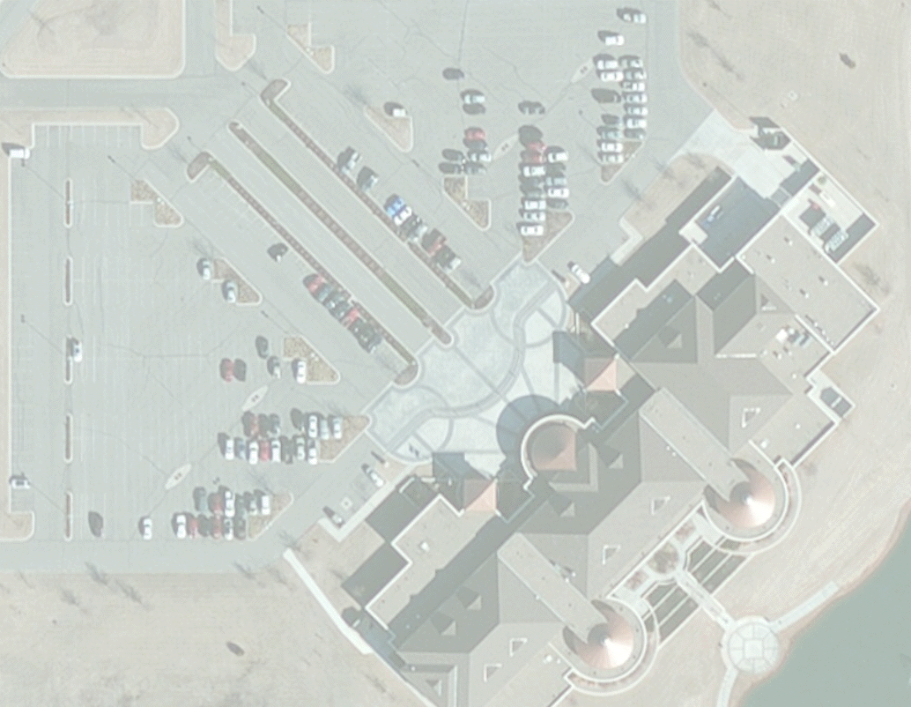
GIS Utility Needs Assessment
Nick Tonias, P.E.
Notes:
This is a presentation on the development of a GIS DESIGN STUDY REPORT for the Utilities Department of The City of Punta Gorda, Florida. This project involved conducting a study for implementing a comprehensive GIS for the City’s Wastewater and Water systems.

Slide 2
The CEDRA Corporation
1985 The CEDRA Corporation is established.
1987 CEDRA begins a long standing relationship
with Esri.
1993 CEDRA becomes an authorized Esri Business
Partner and Developer.
CEDRA offers engineering/GIS solutions in the form of software and services to governmental agencies, engineering consultants, tax assessors, oil companies and various utility enterprises.
Notes:
Here is a brief description of The CEDRA Corporation. As can be seen CEDRA has been in business for over 30 years and an Esri Business Partner for 25 years. CEDRA also has a great deal of experience in dealing with municipalities throughout the U.S.

Slide 3

Who Likes Puppies
Notes:
Now, how may people like puppies? Here’s a little dog trivia for you. What is the most popular dog breed? The answer, Labrador Retrievers. German Shepherds, is number 2 and Golden Retrievers is number 3. The following link: http://www.akc.org/content/news/articles/labrador-retriever-is-once-again-americas-most-popular-dog/ identifies the top breeds. For you dog lovers out there.

Slide 4
City Background
Located in southwest portion of Florida.
The Utilities Department was the driving force in this project.
Utilities Department provides water and sewer service to customers both inside and outside the City Limits.
Since 2004, the City has had an interest in developing a Utility GIS.
Population of approximately 20,000.
City has an Enterprise License Agreement with Esri.
Notes:
Here’s a little background on The City of Punta Gorda. Punta Gorda is very similar to hundreds if not thousands of cities throughout the US.

Slide 5
Utility GIS Implementations
Many County Appraisers have developed GIS databases for their parcels.
Utility Departments, however, have typically lagged behind in implementing GIS.
The reason for this varies from lack of funding, lack of staff, lack of expertise and so forth.
For Utility Departments who do finally commit to implementing GIS the first step in this process is the development of a GIS Utility Needs Assessment document.
Notes:
Given the acceptance of GIS and how many County Appraisers and others are using GIS, it is very surprising the number of Utility Departments which have not adopted and implemented a GIS for their requirements.

Slide 6
Goals of the Report
The GIS Utility Needs Assessment document or GIS Design Study report as it is sometimes referred to as represents a road map or play book for implementing GIS.
This document typically contains an assessment of current work flows and data and a plan for converting existing data into the GIS and the development of pertinent applications.
Notes:
When the City of Punta Gorda decided to implement a Utility GIS, they recognized the need to have a plan in place for the implementation. This plan would identify key benchmarks along the implementation where data and applications would be implemented and available.

Slide 7
The City of Punta Gorda
Developers ask if water and sewer service is available in their areas of interest. To address their request the paper maps of the Map Atlas are referenced to determine whether water and or sewer service is available or not in the area of interest.
The City’s records are in the form of a Map Atlas, comprised of approximately 80 paper maps containing water and wastewater lines.
The City has shapefiles representing the geometry of the water and wastewater systems but there are no attributes assigned to the features and the position of the features is not very accurate.
Notes:
One of the key reasons for the City to implement a Utility GIS was the time that City staff needed to spend to answer a simple developer question of if there was service in the area of interest. Without a GIS, this was a very intensive research endeavor. Fortunately, the City did have some utility information in digital form, albeit without pertinent information such as pipe size, diameter, material, capacity and so forth. This digital information would serve as a starting point for the Utility GIS.

Slide 8



Project Approach
5 Month Time Frame using a Three Step Process
Begin with a General Approach and Understanding of the GIS and its Implementation
Determine the GIS database design and applications (months 2 and 3)
Develop Detail Information for the GIS Implementation (months 4 and 5)
1
2
3
Notes:
Phase I of the project involved the development of the GIS Design Study Report. A 5 month time period was established for creating the report. Over this time, the report would evolve from a general document into a very detailed plan of implementing a robust and comprehensive Utility GIS.

Slide 9
Project Scope
Investigate existing plans, records, maps of Utility facilities.
Design the GIS Database Structure.
Describe the GIS tools to view and analyze utility data.
Define methods to collect and input utility data.
Describe a Utility Map Book method to view, display and print utility data.
Establish a timeline for bringing the GIS online.
Notes:
The City had specific items that they wanted accomplished in the GIS implementation. The GIS Design Study Report would describe how the above items would be accomplished and the timeline for their implementation.

Slide 10
Assessment of Current
Esri Software and Hardware
Type of Esri Software used (ArcGIS 10.x, ArcGIS Pro, ArcGIS Server, etc.)
License Level (Basic, Standard, Advanced)
Number of Licenses
Utilization of ArcGIS Online
Utilization of Collector, Survey 123
Utilization of GPS Technology
Hardware available for GIS Implementation
Notes:
As would be expected, the first step in developing the GIS Design Study Report was to analyze and assess the City’s current computing infrastructure. This included hardware, software and network capabilities.

Slide 11
Assessment of Existing Records
Identify Departments to be considered in the GIS Development
Availability of Aerial Photography & other Digital Information
Department by Department Review
Availability of Existing Plans (paper, digital, microfilm, etc.)
Magnitude of Data (# drawings, # projects, hydrants, manholes, etc.)
Condition of Existing Records (good, fair, poor)
Existing Data Conversion Methodology to be used (COGO, Scanning, GPS, Combination)
Notes:
As with any municipalities, the City of Punta Gorda has a wealth of information in the form of as-built and design drawings. As mentioned earlier, the City had also spent some time on developing shapefiles for their wastewater and water systems. Unfortunately, the shapefiles only contained geometric information and the accuracy of which was not that of what the City desired to have in their GIS.

Slide 12

Department Commitment
Assess Department’s Interest Level in GIS
Develop methodology to spur interest & address department’s needs
Communicate the possibilities of a successful GIS Implementation
Set Goals at various stages of the Implementation
Establish a GIS Steering Committee
Emphasize the benefits of implementing a GIS
Establish Good Communication with Stakeholders
Notes:
One of the key components in ensuring a successful GIS implementation is a Department commitment in wanting the GIS to succeed. Without this commitment you'll be left with one or two pioneers leading the way which is not the most effective way in implementing a GIS. Since 2004, the City had been discussing implementing a Utility GIS. Finally, the inertia to actually start with implementing a GIS was achieved.

Slide 13
Department Commitment
Key Return on Investment Opportunities with a successful GIS Implementation
Increase Productivity (optimize work order processing, location of underground infrastructure, production of maps and reports)
Target areas to perform work, more responsiveness to citizen requests
Save Time (capital projects using GIS to find background data instead of going to multiple sources)
Save Money (data can be queried quickly reducing time spent researching records, providing electronic copies of maps to customers reducing printing costs)
Compliance with Regulatory Requirements (mapping of storm water outfalls and other assets)
Notes:
Some of the rationale that can be used in “selling” a Utility GIS is shown on this slide. In reviewing these items, they may seem obvious but once a municipality puts these items on paper they seem to take on greater significance.

Slide 14
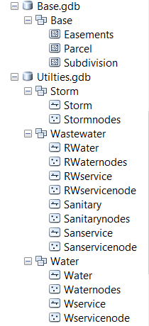
GIS Database Design
Custom
File GeoDatabase Based
Datasets and Feature Classes
Tailored for City Requirements
Great Flexibility in Design of Datasets and Feature Classes
Use Previous work as a Template and Refine for City specific requirements
File GeoDatabase
Feature Dataset
Feature Class
Feature Dataset
Feature Class
Notes:
One of the first decisions to be made in implementing a Utility GIS is the type of database design to be used. Utility Departments actually have a choice. The first is a custom database design.

Slide 15
GIS Database Design
LGIM
Local Government Information Model GeoDatabase
File or Enterprise GeoDatabase Based stored Locally or in the Cloud
14 Feature Datasets and 150 Feature Classes (Database Templates/Schemas)
Address CadastralReference Demography
ElectoralDistricts Elevation FacilitiesStreets
FireServiceOperations InfrastructureOperations LandUsePlanning
LawEnforcementOperations ParcelEditing ParcelPublishing
PublicSafetyPlanning ReferenceData
Fixed Database Design although can be modified (add fields, modify aliases)
Integrated with Esri’s ArcGIS Solutions
Industry-Specific Configurations (maps and applications) for ArcGIS
Notes:
The second option, in a Utility GIS database design, is the Esri Local Government Information Model or LGIM as it is commonly referred.

Slide 16
GIS Database Design
LGIM
Local Government Information Model GeoDatabase – ArcGIS for Water
Sewer, Water and Storm water are included as part of the ArcGIS Solutions
http://solutions.arcgis.com/gallery/#s=0&md=industries:water
ArcGIS for Water provides maps and applications to maintain comprehensive water, sewer, and storm water records; coordinate and plan capital projects; and improve the operations of utility networks that provide clean drinking water and protect public health
Deployed using ArcGIS Online (Esri hosted) or Portal for ArcGIS (City hosted)
The Design Study Report will contain a cost comparison between the Custom and the LGIM approaches
Notes:
The ArcGIS for Water solution is the category containing wastewater, water and storm water applications. Many of these applications can be deployed via ArcGIS Online or Portal for ArcGIS for those who have in-house hosting infrastructure and staff. What may be a little confusing is the name ArcGIS for Water. At first thought it seems to apply only to Water systems but in actuality it addresses, Wastewater, Water and Storm Water applications.

Slide 17
GIS Database Design
LGIM
ArcGIS Solutions – The Maps and Apps of Main Interest to the City Utility Department
Sewer Utility Network Configuration
Configures a utility network to behave like a sewer network.
Stormwater Utility Network Configuration
Configures a utility network to behave like a storm water network.
Water Distribution Utility Network Configuration
Configures a utility network to behave like a water distribution network.
The above create the Feature Datasets and Feature Classes used in a LGIM for
Sewer, Storm water and Water Utilities
Notes:
These are the main editing applications for the ArcGIS for Water category.

Slide 18
GIS Database Design
LGIM
ArcGIS Solutions – Additional Maps and Apps of Interest to the City
CCTV Manager Use CCTV Manager to view CCTV condition data and associated videos and photos.
Watering Violations Enables field crews to log water conservation violations on a smartphone or tablet.
Lead Service Management Enables an organization to inform the public and internal stakeholders about the
status of lead in service lines.
Water Service Request Enables customers and the public to report issues with water, sewer, or
storm water infrastructure.
Water Restrictions Informs the public about watering restrictions, permitted water uses, and allowed
watering times by service area zone.
Water Leak Investigator Enables field staff to record the location and details of leaks.
Valve Exercising Enables utilities to capture valve exercising data on a smartphone or tablet.
Utility Isolation Trace Enables a utility to deploy a web application informing staff which valves
to close to isolate a main break and what customers and assets will be affected.
Notes:
There are a number of applications ready for configuration and deployment which municipalities can select from for implementation. Many of these are of extreme usefulness to a Utility Department.

Slide 19
GIS Database Design
LGIM
ArcGIS Solutions – Additional Maps and Apps of Interest to the City
Stormwater Construction Site Violation Enables field staff to record construction site storm water violations.
Sewer Service Lookup Helps the public determine if a utility's services are available at location.
Manhole Inspection Enables field staff to inspection manholes using a smartphone or tablet.
Outage Viewer A self service website for customers to look up water service outages at locations.
Proposed Water Design Enables users to rapidly lay out a proposed water network.
Main Break Notification Provides real time notifications and alerts of main breaks.
Leak Logger Analysis Provides tools to plan the placement of leak listening devices, manage device
collected data, and perform notifications for an identified leak.
Illicit Discharge Trace Enables utilities to find potential sources of storm water pollution by identifying
upstream business customers.
Notes:
More applications.

Slide 20
GIS Database Design
LGIM
ArcGIS Solutions – Additional Maps and Apps of Interest to the City
Hydrant Maintenance Inspection Enables utilities to use a smartphone or tablet to perform fire hydrant
inspections.
Drinking Water Advisory Enables utilities to communicate with the public about drinking water
alerts and advisories.
Backflow Inspection Enables field crews to inspect backflow prevention devices.
Map Change Request Enables staff to log discrepancies between a utility's maps and reality I
the field.
Capital Improvement Plan Capital Improvement Plan can be used by the general public and other
interested parties to review projects included in the Capital Improvement
Plan.
Capital Project Review Capital Project Review can be used by plan review staff to examine proposed
Notes:
More applications.

Slide 21
GIS Database Design
LGIM
ArcGIS Solutions – Additional Maps and Apps of Interest to the City
Capital Improvement Planning Estimate the costs of capital improvement projects and share results with
organization.
Capital Project Reports Capital Project Reports can be used by project leads to communicate the
schedule, cost, and quality of active capital projects to executives.
Capital Project Dashboard Capital Project Dashboard can be used by public works executives t
monitor the status of active capital projects in their community.
Capital Project Locator Capital Project Locator can be used by the general public and other
interested parties to review the status of capital projects under
construction in their community.
Capital Project Plans Capital Project Plans can be used by project leads to organize new capital
project plans and revise project information during the planning process.
Adopta Adopta can be used by government agencies and other organizations to
engage the public in the maintenance of natural and man-made assets.
Notes:
And yet another set of applications to select from.

Slide 22
Tools to view and analyze utility data
Custom GIS Database Design
Create custom ArcGIS Desktop, ArcGIS Server or ArcGIS Online applications offering the desired functionality
Native ArcMap functionality, as well as existing CEDRA developed applications
LGIM GIS Database Design
ArcGIS Solutions are downloaded and configured for use
Functionality in these applications are fixed
Over 25 applications presently and increasing
Native ArcMap functionality
Notes:
From an end user point of view, the Utility GIS Map Viewer will be the main interaction with the Utility GIS. In creating a Map Viewer, a custom application can be created using Esri’s JavaScript API or an ArcGIS Online template can be configured with hosted services (map or feature based).

Slide 23
Methods to Collect and Input Utility Data
Converting Existing Record Information into a GIS
The Desired Level of Accuracy (LOA) will control the method that is used
> 3’ 1’ - 3’ < 1’
Coordinate Geometry (COGO) transcription
Heads-up Digitization
Supplement with GPS information (valves, hydrants, manholes, inlets, etc.)
Scanning Existing Drawings hyperlinked to GIS features
Utilization of Survey 123 and/or Collector
Notes:
In building the Utility GIS, it is important to understand the level of accuracy that the GIS is to contain. As can be expected, the better the accuracy, the longer and more expensive in creating the GIS. The level of accuracy will also dictate the methods used in importing data into the GIS. It is also possible to start with a coarse accuracy and through a methodical approach improve the accuracy by incorporating field collected data.

Slide 24
Utility Map Book Creation
Define the Contents of the Map Book (Title Page, Index Page, Map Pages, etc.)
Create an ArcMap Document File for the:
Title Page
Index Page
Map Page
Utilize ArcMap’s Data Driven Pages functionality to mass produce the Map Pages
Employ Esri’s Python scripting module, arcpy.mapping, to produce a complete Map Book
Notes:
The City was interested in being able to create a Utility Map Book. Using ArcMap’s Data Driven Pages functionality this is relatively easy to implement.

Slide 25
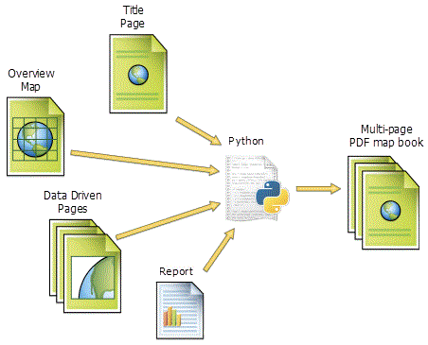
Utility Map Book Creation
Schematically speaking this is how building a Map Book would look.
Separate ArcMap Document Files with one Document File incorporating Data Driven Pages, note requires an Index Layer.

Slide 26
GIS Needs Assessment
Survey Form
Topics covered in the Questionnaire
Computing Environment
Software
Data
Field Work
Notes:
These are the topics covered in GIS Needs Assessment Survey Form. During the kickoff meeting interviews were conducted with staff getting responses which appears on a questionnaire form. There were over 50 questions that appeared in the questionnaire.

Slide 27
Computing Environment
1. Describe your PC configuration
2. Is your digital data backed up?
3. Do you use GPS surveying equipment
4. Does the Department have access to a scanner
5. Does the Department have access to a printer
Notes:
Questions posed in the Computing Environment section.

Slide 28
Software
1. Are you using Esri ArcGIS Software?
2. Are you using Esri ArcGIS Online?
3. Have you had formal ArcGIS training?
4. Do you use CAD software (AutoCAD, MicroStation, etc.)
5. Do you use PCSWMM stormwater modeling?
6. Do you use InfoSWMM hydrologic, hydraulic and wastewater modeling?
7. Do you use EPANET water modeling?
8. Is there other modeling software that is used in the Department?
Notes:
Questions posed in the Software section.

Slide 29
Data
1. Do you share information with other Departments, Agencies?
2. Do you use information from other Departments, Agencies?
3. Is there information that you do not have that would be helpful?
4. Do your maps use the Florida State Coordinate System ?
5. Are there other coordinate systems that you deal with?
6. Do you use aerial imagery in your operations?
7. How often do you need to reference record information
8. Do consultants provide project data in digital format (DXF, DWG, etc.)?
9. Does the Department make data available to the Public?
10. Does a software package manage your Work Orders?
11. Are as-builts drawings scanned?
12. What documents would be of benefit to have hyperlinked to a GIS feature.
Notes:
Questions posed in the Data section.

Slide 30
Field Work
1. Is there a need for Automated Vehicle Tracking (AVL) for field crews?
2. Do the field crews have a need for routing functionality?
3. Do the field crews use mobile computing devices?
4. What are the typical field operations that are performed.
Notes:
Questions posed in the Field Work section.

Slide 31
Design Study Report Outline
Chapter 1 Utility Department Overview
Chapter 2 Department Commitment
Chapter 3 Needs Assessment
Chapter 4 Integration with City GIS
Chapter 5 Data Collection Methods
Chapter 6 Geodatabase Design
Chapter 7 Symbology and Classification
Chapter 8 Application Software
Chapter 9 Pilot Project Identification
Chapter 10 Data Collection/Conversion
Methodology
Chapter 11 Data Collection/Conversion
Schedule
Chapter 12 Training and Costs
Notes:
The outline of the GIS Design Study Report contained 12 chapters with a number of sub-chapters. All proposed implementation options contained an estimated fee and timeline for implementation.

Slide 32
Thank you!
Questions
And
Answers
Notes:
Thank you for viewing this presentation and if you should have any questions or comments feel free to contact Nick Tonias at 585-414-6541 or nicktonias@cedra.com.

