Slide 1



Traffic Sign Inventory and
Maintenance
Nick Tonias, P.E.
Christy Batterson
The CEDRA Corporation
The City of Edmond
Notes:
This is a presentation on how the City of Edmond, Oklahoma developed its Traffic Sign Inventory database and maintains the database in an ArcGIS environment. This presentation is a case study of a project the City undertook with The CEDRA Corporation.

Slide 2

Topics to be Covered
u Brief Intro to CEDRA and City of Edmond
u Overview of Developing the Traffic Sign Inventory
u Traffic Sign Inventory Database Design
u Traffic Sign Inventory Collection Process
u Maintenance and Updating Process
u Summary then Q&A
Notes:
During the course of the presentation the above items will be discussed. The goal of the presentation is to illustrate how a Traffic Sign Inventory can be established and maintained in an ArcGIS environment. As we know, if a database is not maintained, it becomes useless pretty quickly. You’ll also notice there are a number of signs that appear in some of the slides. You’ll want to read them, some of them are very funny. Those of you interested in the link where these signs appear will want to visit this site: https://www.bing.com/images/search?q=traffic+signs&qpvt=traffic+signs&qpvt=traffic+signs&qpvt=traffic+signs&FORM=IQFRML

Slide 3



Before We Begin
u How many have a Traffic Sign Database they maintain?
u How many are thinking of developing a Traffic Sign Database?
Notes:
Before we start let’s get a feel for the type of audience we have. How many folks currently have a Traffic Sign Inventory database? Now, how many folks are interested in developing a Traffic Sign Inventory database?

Slide 4

Who Likes Puppies
Notes:
Now, how may people like puppies? Here’s a little dog trivia for you. What is the most popular dog breed? The answer, Labrador Retrievers. German Shepherds, is number 2 and Golden Retrievers is number 3. The following link: http://www.akc.org/content/news/articles/labrador-retriever-is-once-again-americas-most-popular-dog/ identifies the top breeds. For you dog lovers out there.

Slide 5
The CEDRA Corporation
1985 The CEDRA Corporation is established.
1987 CEDRA begins a long standing relationship
with Esri.
1993 CEDRA becomes an authorized Esri Business
Partner and Developer.
CEDRA offers engineering/GIS solutions in the form of software and services to governmental agencies, engineering consultants, tax assessors, oil companies and various utility enterprises.
Notes:
Here is a brief description of The CEDRA Corporation. As can be seen CEDRA has been in business for over 30 years and an Esri Business Partner for close to 25 years. CEDRA also has a great deal of experience in dealing with municipalities throughout the U.S.

Slide 6
The City of Edmond
v In 1996 The City began creating its GIS.
v The City utilizes an ArcGIS environment comprised of ArcGIS Desktop, ArcGIS Server and ArcGIS Online.
v The City utilizes Desktop and Web based applications.
v The City’s GIS is an integral part of its daily operations.
v The City’s population is approximately 90,000 with more than 27,000 water and 36,000 electric accounts.
Notes:
Here is a brief description of The City of Edmond and how GIS is utilized throughout the City.

Slide 7
The City of Edmond
The City offers the following data layers amongst others:
Waste Water Engineering Projects
Water Engineering Districts
Storm Water Forestry
Parcels Public Trees
Easements Fire Access
Street Centerlines Storm Shelters
Outdoor Warning Devices Planimetrics Topo
Electric Ortho Photo
Notes:
As you can see GIS is widely deployed throughout the City.

Slide 8

Reasons for Creating Inventory
v Municipal owned assets.
v Safety/Design and Manual on Uniform Traffic Control Devices (MUTCD) standards need to be met.
v Signage may be needed where it is not present.
v Prioritization for Repair/Replacement.
v FHWA mandate.
Notes:
Here are a few of the driving reasons a municipality should be interested in establishing a Traffic Sign inventory.

Slide 9
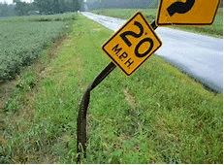
Developing the Inventory
v 2012 The City undertakes the establishment of a Traffic Sign Inventory database.
v The Manual on Uniform Traffic Control Devices (MUTCD) was used as a guide.
v In-house staff used to collect the data.
v Trimble GeoExplorer 6000 Series GeoXH equipment used.
Notes:
In developing an inventory the first question that needs to be resolved is, will in-house resources be used or will the work be out-sourced. Some municipalities will use summer interns while others will use utility or line maintenance staff who have down time from their typical duties.

Slide 10
Inventory Database Design
v The design is based upon a Traffic Sign Pole feature layer and a Traffic Sign table.
v Features in the layer represent traffic sign poles.
v Records in the table represent signs on a pole.
v Records in the table are linked to features in the layer based upon a Traffic Sign Pole Facility ID value.
v Traffic Sign Poles can have one or more signs.
Notes:
In designing the database, the City’s approach was to have a feature layer represent the traffic sign poles and a table record represent a traffic sign. An ID assigned to the traffic sign pole would then be used to relate the records in the table to the feature in the layer.

Slide 11
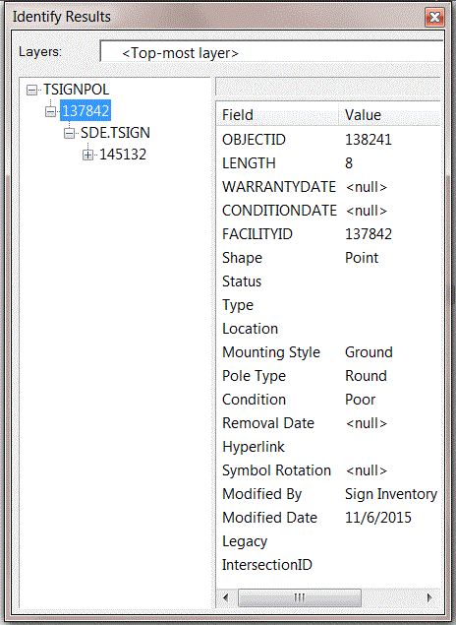
Traffic Sign Pole Attributes
The FACILITYID attribute is the one that is used to relate the Traffic Sign to the Traffic Sign Pole
This value will appear in the Traffic Sign Table for every sign belonging to the Pole
Notes:
Here are a few of the attributes assigned to the Traffic Sign Pole Layer.

Slide 12
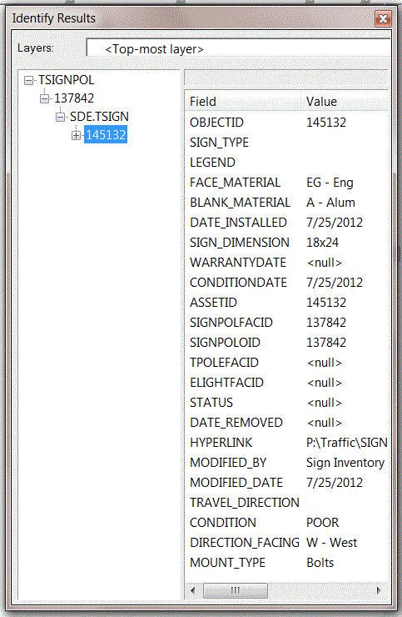
Traffic Sign Attributes
Pertinent Sign information such as the Sign’s Face Material, Installation Date, Condition and so forth are stored in the Traffic Sign Table
This information can then be analyzed
Notes:
Here are a few of the attributes assigned to the Traffic Sign Table.

Slide 13

Inventory Collection Process
v A form filled template was created enabling the crews to enter the appropriate information.
v Multiple crews used to collect field data.
v 2.5 year period to collect majority of inventory.
v ~8000 Poles and >14,000 Signs collected.
v On going collection being performed.
v Digital images of signs were taken.
Notes:
The collection process, as stated previously, was performed by City personnel over a multi-year period. Initially began with 3 staff members collecting data for 2.5 years which eventually dropped to 2 and now currently 1 who performs routine maintenance pick-up.

Slide 14
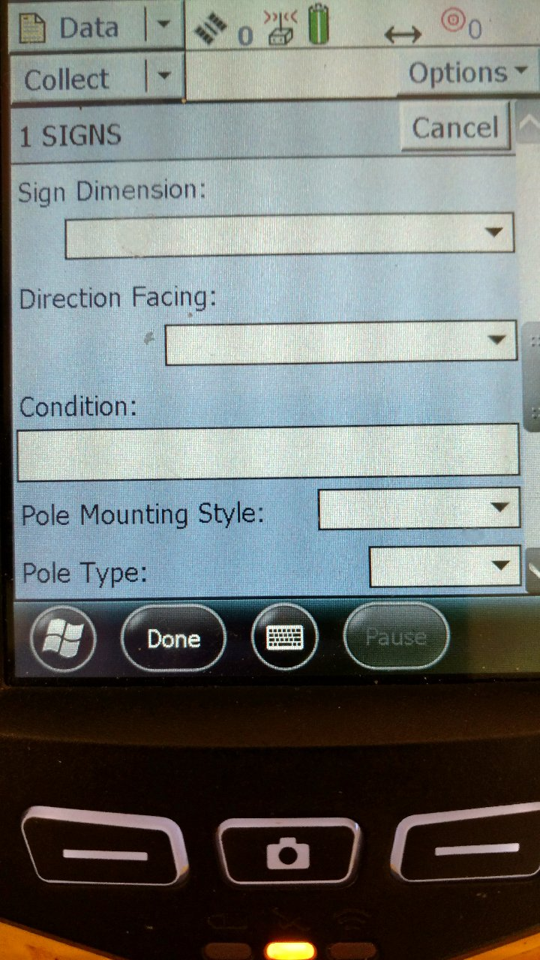
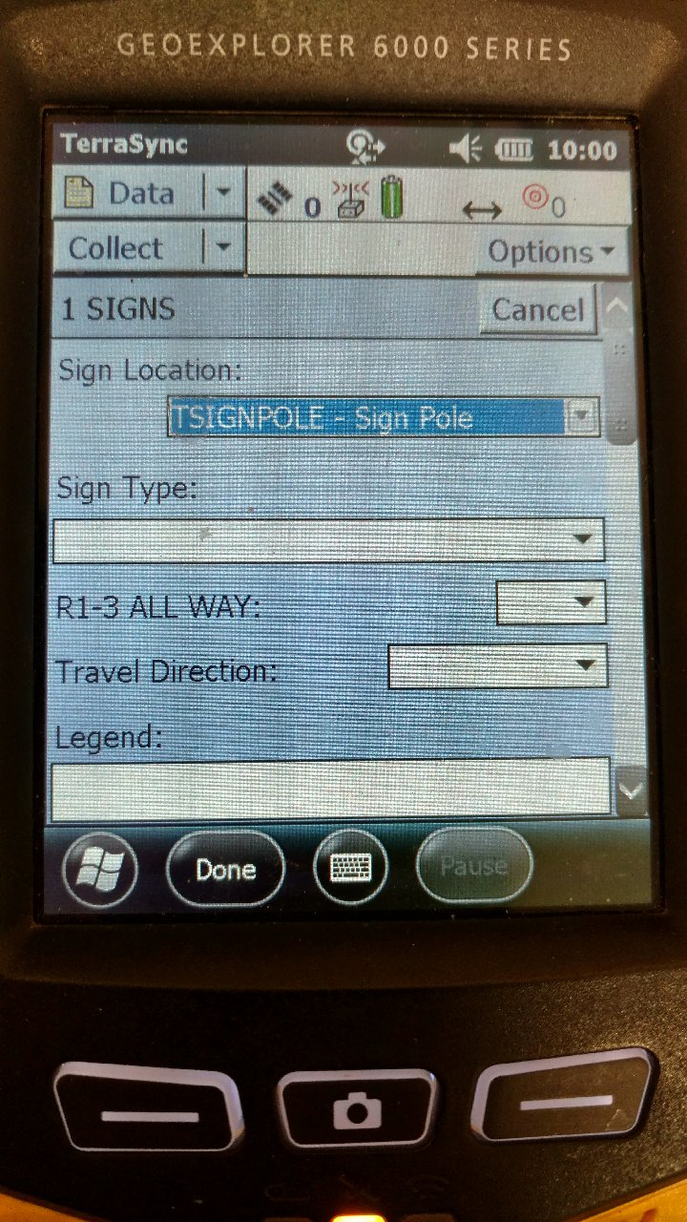
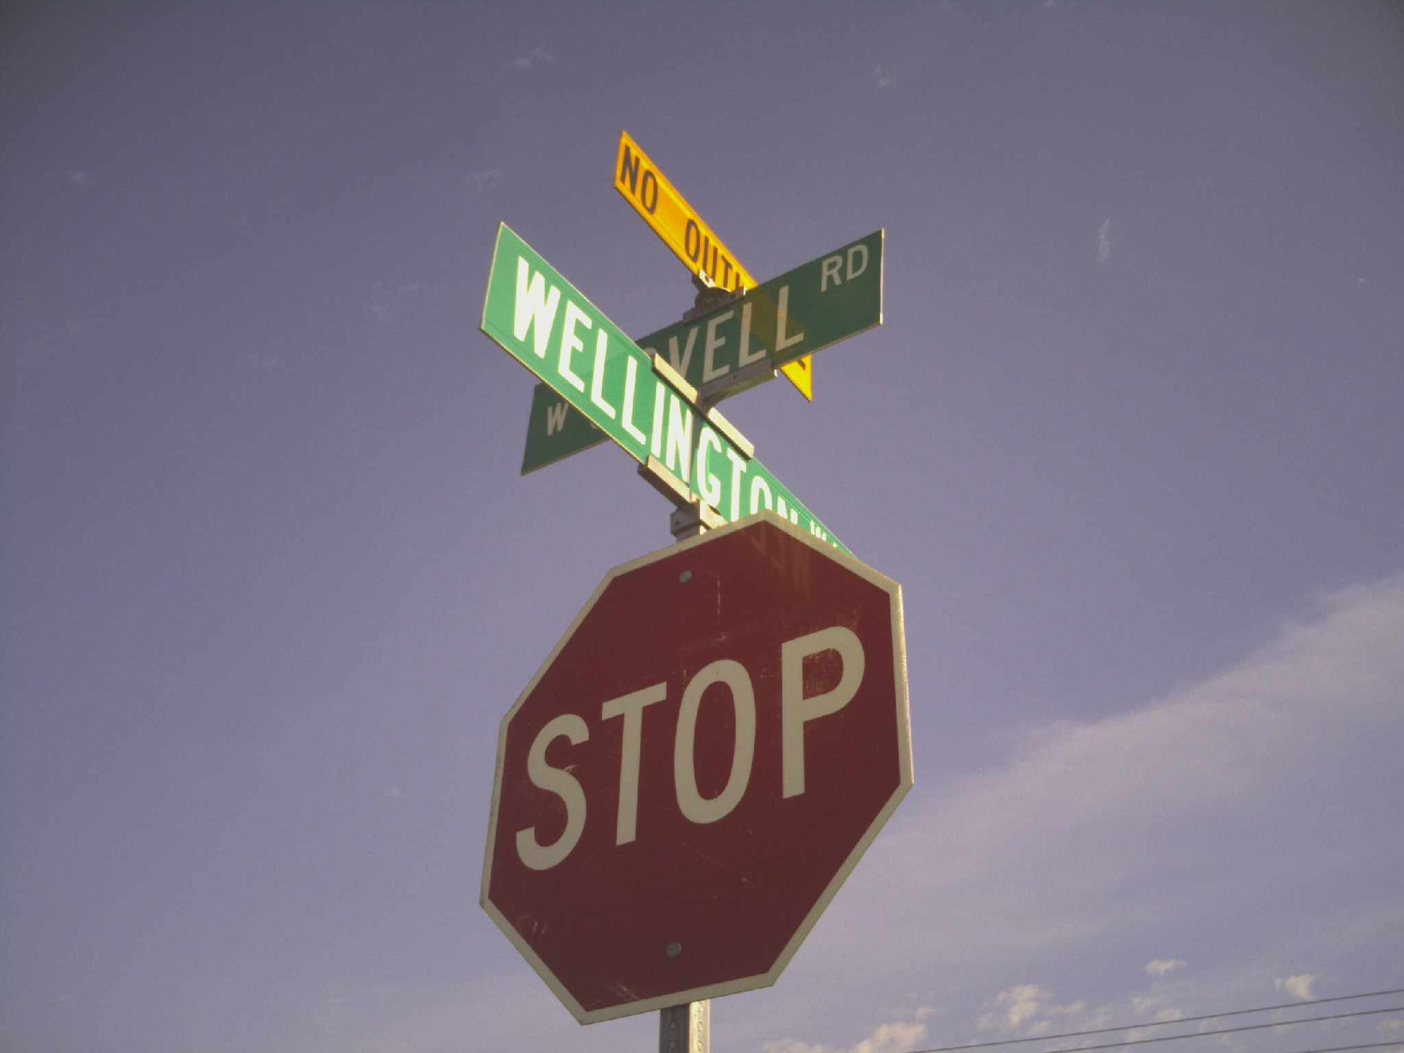
Field Collection Process
On average 1 to 2 minutes to collect data per sign, 17 attributes
Notes:
Here is an image of what the survey crews actually work with in the field. As you can see it’s basically a form fill-out process that is employed. An average range of signs that was collected by a single field crew member in a day ranged between 60 and 70.

Slide 15
Maintaining/Updating Process
v Field crews were bringing in many files that needed to be processed.
v An automated process was needed to update the TSignPole Layer and TSign Table.
v The ability to handle addition of new features as well as modifying existing features.
v The ability to check the results prior to committing to the database (i.e. Work_Type codes, existing database Street Names).
Notes:
Once the field crews began to collect the data and bring it back into the office the next task was to update the database with the field information. The City initially began to manually process the information but quickly came to the realization that an automated process had to be created in order to effectively and efficiently process the survey information. In processing the data the automated process needed to handle various scenarios or cases. Specifically, 4 cases needed to be accounted for.

Slide 16
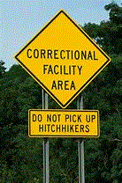
Case 1
New Post with One Sign
In this case, the field survey point is not close to any existing poles and there is only one field survey point
at this location. Under this condition, the command adds one feature to the TSIGNPOLE layer and one record to the TSIGN table. The coordinates of the new Traffic Sign Pole feature will match those of the field survey point.
Notes:
Here is the description for Case 1.

Slide 17

Case 2
New Post with Multiple Signs
In this case, there are field survey points that are not close to an existing pole and these points are within the proximity tolerance. Under this condition, the
command will add one feature to the TSIGNPOLE layer and one record for every field survey point to the TSIGN table. The coordinates of the Traffic Sign Pole feature will be the average of the field survey points.
Notes:
Here is the description for Case 2.

Slide 18
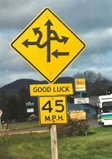
Case 3
Add Sign(s) to Existing Post
In this case the field survey point is close to an existing post. Additionally, the field survey point must have the WORK_TYPE attribute with the value NEW_SIGN
assigned to it in order for this case to function. Under this condition, the command will add one record to the TSIGN table for every sign appearing at the existing post.
Notes:
Here is the description for Case 3.

Slide 19
Case 4
Replace Sign(s) on Existing Post
In this case the field survey point is close to an existing post. Additionally, the field survey point has the WORK_TYPE attribute value set to "REPLACE_SIGN" or the attribute is not present. In order to determine which sign is to be replaced the SIGN_TYPE and LEGEND fields in the field survey shapefile are examined. Using the SIGN_TYPE attribute, a sign code is extracted using the space character as the delineating character.
Notes:
Here is the description for Case 4.

Slide 20
Case 4 (cont’d)
Replace Sign(s) on Existing Post
In the TSIGN table the records associated with a post will contain the post's Facility ID. These records are then examined to make a match on the sign code. If there is only one record in the TSIGN table the existing record is modified using the TSIGN field mapping information. If there are two or more records the processing varies depending upon the sign code value.
Substantial Custom Logic Involved in this Case
Notes:
As you can see Case 4 involves some custom logic that was implemented to facilitate the updating of existing signs.

Slide 21

All Cases
Attribute Assignment
In all 4 cases previously mentioned, field survey data needed to be transferred to the appropriate fields in the Traffic Sign Pole Layer and Traffic Sign table.
Two text files called TSIGNPOLEMAPPING and TSIGNMAPPING files are used to indicate what fields the survey information is to be stored in the Traffic Sign Pole Layer and Traffic Sign table.
Notes:
For all 4 cases the information collected by the survey crew had to be transferred to the feature layer point and the table records. To provide flexibility Attribute Transfer Files were employed. In so doing should the City wish to incorporate new attributes or use different field name, no programming is required.

Slide 22
Field Mapping Files
TSIGNPOLEMAPPING
TSIGNMAPPING
/*
POLE_TYPE,POLE_TYPE
/*
POLE_LENGT,LENGTH
/*
POLE_MOUNT,MOUNTING_STYLE
/*
GPS_DATE,MODIFIED_DATE
/*
/* Hard coded value to be stored in MODIFIED_BY
"SIGN_INVENTORY",MODIFIED_BY
/*
SIGN_DIMEN,SIGN_DIMENSION
/*
DIRECTION_,DIRECTION_FACING
/*
CONDITION,CONDITION
/*
REPLACEMEN,REPLACEMENT_SIGN
/*
DATE_INSTA,DATE_INSTALLED
/*
COMMENTS,COMMENTS
/*
IMAGERY,HYPERLINK
Notes:
Here are excerpts of the Field Mapping files used for transferring data from the Survey shapefile to the Pole Feature Layer (TSIGNPOLE) and Sign Table (TSIGN). The /* characters denote a comment line, which is disregarded during processing. On a data line two entries are specified with the first being the attribute in the Survey shapefile and the second being the attribute in the Pole Feature Layer or Sign Table that the Survey shapefile attribute value is to be transferred to.

Slide 23
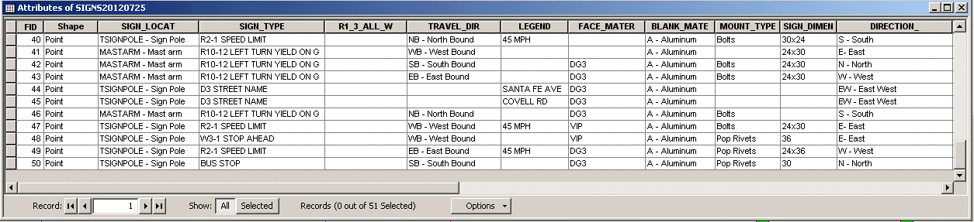
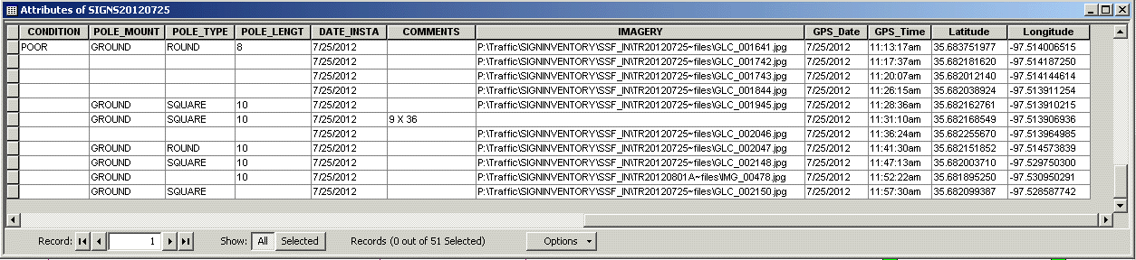
Survey GPS Shapefile
Notes:
The field survey file is brought into ArcMap as a point shapefile containing the various information collected by the field crew.

Slide 24
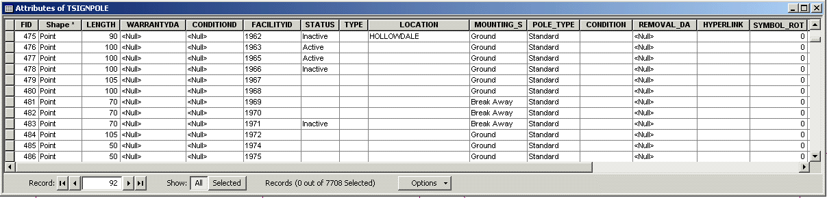
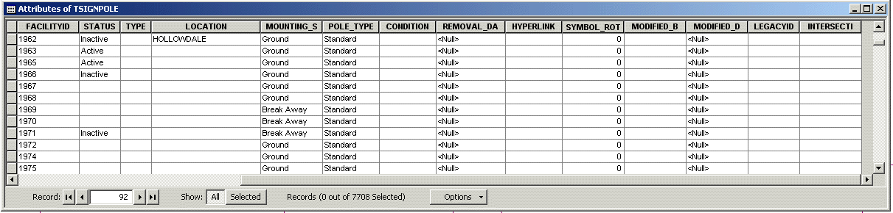
Sign Pole Layer - TSIGNPOLE
Notes:
Here is the attribute table for the Traffic Sign Pole feature layer.

Slide 25
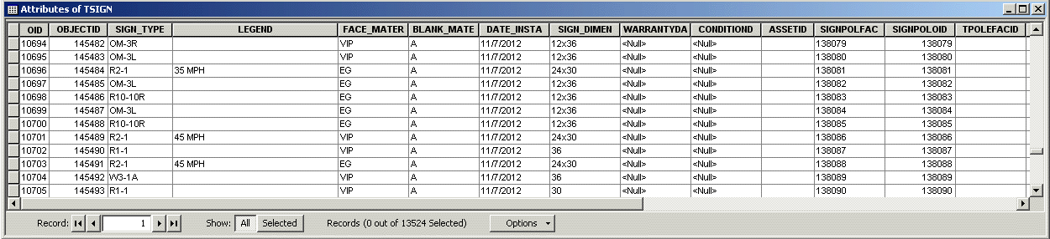
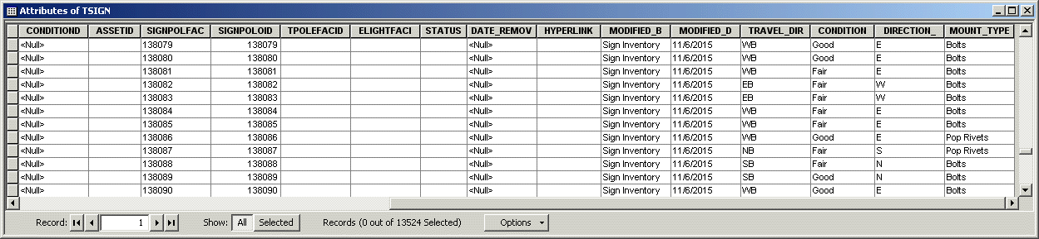
Sign Table - TSIGN
Notes:
Here is the attribute table for the Traffic Sign Table. With these 3 data sources, the Survey GPS Shapefile, Sign Pole Layer and Sign Table, an ArcMap document file is created containing these data sources. As additional Survey GPS Shapefiles are generated, these can simply be added to the ArcMap document file for processing.

Slide 26
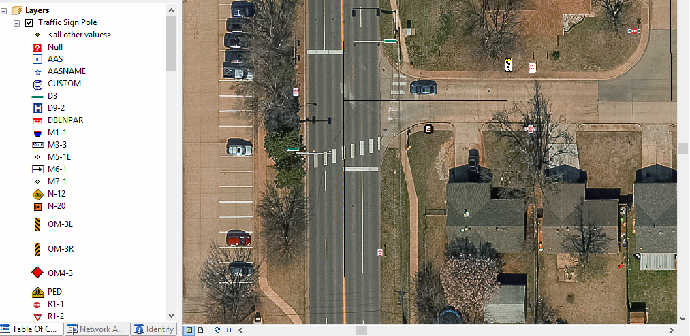
Traffic Sign Type Classification
Notes:
Here is a display of the ArcMap document illustrating the classification used to distinguish the various sign types.

Slide 27
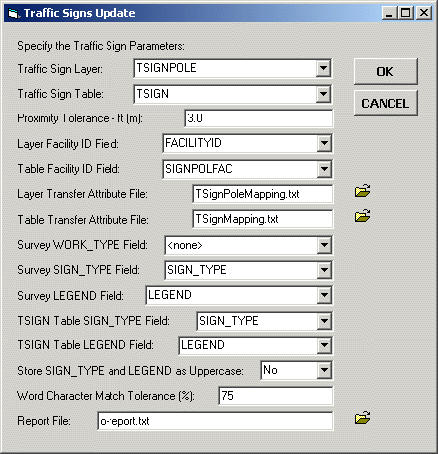
Traffic Sign Update Command
Prior to executing this command the user selects the GPS Shapefile(s) to be processed in the Table of Contents
A formal report file contains the results of the processing
Notes:
Using the Traffic Sign Update Command that was created, the user is able to take a survey shapefile and update the Traffic Sign Pole feature layer and the Traffic Sign Table. As you can see there are a number of parameters that need to be specified. The user is able to save these settings and recall them prior to processing another survey shapefile. So that the user can fill out the form once and simply recall the previous values when the next survey shapefile is to be processed. In addition to updating the Traffic Sign Pole feature layer and Traffic Sign Table, a formal report file is generated which the user can review.

Slide 28

The Report File - Header
Traffic Sign Data Processing
Traffic Sign Layer: TSIGNPOLE
Traffic Sign Table: TSIGN
Layer Transfer Attribute File: TSignPoleMapping.txt
Table Transfer Attribute File: TSignMapping.txt
Proximity Tolerance: 3
TSIGNPOL Highest Facility ID currently assigned is: 140271
Notes:
The formal report file is used to review the quality of the data collected by the field crew. The Header portion of the file simply contains some base information as shown above.

Slide 29

The Report File – Part 1
PART 1: Processing the active Survey Data Shapefiles
Processing SIGNS20120725 data
1. FID 0 existing Traffic Sign
2. FID 1 existing Traffic Sign
3. FID 2 existing Traffic Sign
4. FID 3 within 3 existing Traffic Signs
5. FID 4 within 3 existing Traffic Signs
6. FID 5 existing Traffic Sign
7. FID 6 existing Traffic Sign
8. FID 7 existing Traffic Sign
9. FID 8 existing Traffic Sign
10. FID 9 existing Traffic Sign
11. FID 10 existing Traffic Sign
12. FID 11 existing Traffic Sign
13. FID 12 new Traffic Sign
14. FID 13 existing Traffic Sign
15. FID 14 existing Traffic Sign
Notes:
Part 1 of the file contains a listing of the survey points and whether the survey point denotes a new traffic sign pole or an existing one.

Slide 30

The Report File – Part 1
The end of Part 1 contains a summary of the survey data that was processed
Total Points Processed: 51
Total Points not close to Existing Sign: 5
Total Points close to Existing Sign: 42
Total Points close to Multiple Existing Signs: 4
Notes:
At the end of Part 1, the report file contains a summary of the total points processed, the number of points denoting new traffic sign poles, the number of points close to existing traffic sign poles and the number of points that are close to multiple traffic sign poles. The shots close to existing traffic sign poles need to be examined and then reprocessed, perhaps using a smaller proximity tolerance value.

Slide 31
The Report File – Part 2
PART 2: Adding New Features to TSIGNPOLE and New Records to TSIGN
1. Layer: SIGNS20120725 FID 12 added to TSIGNPOL and assigned Facility ID 140272
Table: SIGNS20120725 FID 12 added to TSIGN and assigned Facility ID 140272
2. Layer: SIGNS20120725 FID 20 added to TSIGNPOL and assigned Facility ID 140273
Table: SIGNS20120725 FID 20 added to TSIGN and assigned Facility ID 140273
3. Layer: SIGNS20120725 FID 24 added to TSIGNPOL and assigned Facility ID 140274
Table: SIGNS20120725 FID 24 added to TSIGN and assigned Facility ID 140274
4. Layer: SIGNS20120725 FID 31 added to TSIGNPOL and assigned Facility ID 140275
Table: SIGNS20120725 FID 31 added to TSIGN and assigned Facility ID 140275
Table: SIGNS20120725 FID 32 added to TSIGN and assigned Facility ID 140275
Total New Traffic Poles Created: 4
Total New Traffic Sign Data Created: 5
Notes:
Part 2 of the report contains a listing of the new traffic sign poles and new traffic signs. At the bottom of Part 2 is a summary of the total new poles and signs that were created.

Slide 32
The Report File – Part 3
PART 3: Modifying Existing Data in TSIGNPOLE and the Table TSIGN
1. Layer: SIGNS20120725 FID 0 within proximity of TSIGNPOL FID 2328
SIGN_TYPE: W3-1 STOP AHEAD LEGEND:
Modified TSIGNPOL OID 2328
Table: SIGNS20120725 FID 0 within proximity of TSIGN OID 4249
SIGN_TYPE: W3-1A LEGEND: STOP AHEAD SYMBOL
Modified TSIGN OID 4249 SIGN_TYPE: W3-1 LEGEND:
2. Layer: SIGNS20120725 FID 1 within proximity of TSIGNPOL FID 987
SIGN_TYPE: R1-1 STOP LEGEND:
Modified TSIGNPOL OID 987
Table: SIGNS20120725 FID 1 within proximity of TSIGN OID 2157
SIGN_TYPE: R1-1 LEGEND:
Table: SIGNS20120725 FID 1 within proximity of TSIGN OID 3164
SIGN_TYPE: R1-3-4 LEGEND:
Modified TSIGN OID 2157 SIGN_TYPE: R1-1 LEGEND:
Notes:
Part 3 of the report contains a listing of the survey points that were close to an existing traffic sign pole and the action that was taken based upon the SIGN_TYPE value.

Slide 33
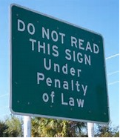
The Report File – Times
At the end of the report file is the date and time the report file was generated
Started: 02:27:11 PM 7 Mar 2017
Stopped: 02:27:31 PM 7 Mar 2017
Duration: 00:00:20
Notes:
At the very end of the report are the processing start and end times as well as the duration. As can be seen it did not take very long to process the 51 points in this file.

Slide 34
Update Confirmation
v The Edits made to the TSignPole Layer and TSign Table are not committed but rather are placed in an Undo operation.
v The User can review the Report File and check if any problems exist.
v If there are problems the User can Undo the operation, make the appropriate modifications and then re-execute the command.
Notes:
Once the processing has finished, no edits have been confirmed to the database. Rather, the Editor is in an edit state where the modifications can be undone using the Undo command or by stopping the Editor and not saving the edits. This approach allows the user to review the report file and determine if any modifications need to be made either to the survey shapefile or the existing database depending upon the case.

Slide 35
Summary
v Without the Traffic Sign Updating Tool a series of steps had to be manually performed that was time intensive and had to be repeated for every GPS file that was brought into the office.
v The Traffic Sign Updating Tool greatly reduced the time to process the GPS files and virtually eliminated user processing errors since an automated repeatable process was in place.
Series of Steps to Couple Button Clicks
Notes:
As you probably are aware more and more municipalities are establishing traffic sign inventories. Some municipalities are even mandated to have such an inventory. The thing to remember is that these databases can get very large and you need to have a mechanism for efficiently transferring the GPS information collected in the field to the database with the ability to have some sort of quality control on the transferring. The Traffic Sign Updating Tool provided this capability for the City.

Slide 36


Thank you!
Questions
And
Answers
Notes:
Thank you for viewing this presentation and if you should have any questions or comments feel free to contact Nick Tonias at 585-414-6541 or nicktonias@cedra.com.

