Slide 1
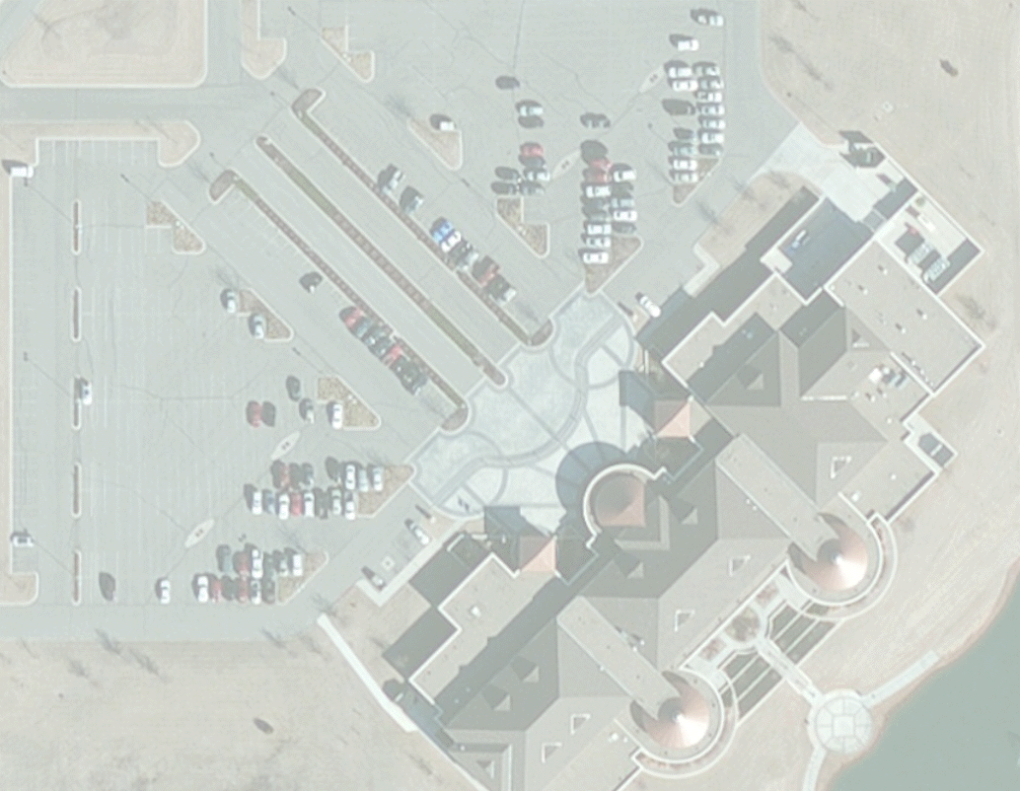
Developing ArcGIS Web Mapping Applications
Nick Tonias, P.E.
Ian Peebles, GISP
The CEDRA Corporation
The City of Edmond
Notes:
This is a presentation on how ArcGIS Web Based Applications can be created. The application development environments to be covered include ArcGIS Online, the Web AppBuilder and ArcGIS Server. The authors have over 5 years of experience of working together in developing and deploying ArcGIS Web Based Applications.

Slide 2
Topics to be Covered
u Brief Intro to CEDRA and City of Edmond
u Creating Apps using ArcGIS Online
u Creating Apps using ArcGIS Server
u Presentation of City of Edmond Web Mapping Apps
u Pros and Cons of ArcGIS Online and ArcGIS Server
u Summary then Q&A
Notes:
This presentation is comprised of two parts. The first covers how applications can be created using ArcGIS Online and ArcGIS Server. The second part covers the experience the City of Edmond has had in developing and deploying a number of applications for a variety of departments in the City.

Slide 3
The CEDRA Corporation
1985 The CEDRA Corporation is established.
1987 CEDRA begins a long standing relationship
with Esri.
1993 CEDRA becomes an authorized Esri Business
Partner and Developer.
CEDRA offers engineering/GIS solutions in the form of software and services to governmental agencies, engineering consultants, tax assessors, oil companies and various utility enterprises.
Notes:
Here is a brief description of The CEDRA Corporation. As can be seen CEDRA has been an Esri Business Partner for close to 25 years. CEDRA also has a great deal of experience in dealing with municipalities throughout the U.S.

Slide 4
The City of Edmond
The City has more than 5 years of experience in developing web based mapping applications and 26 live web based applications.
The City maintains their web applications on a number of platforms.
These applications currently use the Esri JavaScript API, Silverlight application viewer, and the Web Application Builder (WAB).
Notes:
Here is a brief description of The City of Edmond’s work in developing ArcGIS web based mapping applications.

Slide 5
CEDRA and The City of Edmond
CEDRA-DataEditor has been embedded in 9 of The City of Edmond’s web applications.
CEDRA-DataEditor is a JavaScript ArcGIS Server based application for data editing and maintenance.
CEDRA-DataEditor provides for custom single and multi-column user-dialog boxes via configuration file thereby eliminating any programming.
Notes:
The CEDRA-DataEditor software is a desktop and web-based application ideal for data editing and maintenance. It provides the user the ability to create custom single and multi-column dialog boxes via a configuration file. That is to say, no programming is required to create the dialog boxes. The City uses this software in both the desktop and web-based environments. In the web-based environment, the software has been embedded in the City’s ArcGIS Server applications.

Slide 6
Why go Web Based?
Cross-platform compatibility (Wide variety of browsers running on Windows, Linux, Mac OS)
More manageable (need to install on server rather than numerous PCs)
Highly deployable (just need a URL address to access an application and data)
Reduced costs (less support, maintenance and lower end user requirements, i.e. less desktop licenses)
Notes:
There a number of reasons for going web-based but the biggest reason in the ability to reduce costs. In a web environment, the number of ArcGIS desktop licenses can be greatly reduced. A web-based environment is also easier to maintain since there are less desktop licenses to deal with.

Slide 7
Creating Web Applications
ArcGIS Online (Cloud Based Mapping Platform)
ArcGIS Online application templates
Web App Builder
ArcGIS Viewer for Flex
ArcGIS Viewer for Silverlight
ArcGIS Server (Organization Server Platform)
Web Mapping APIs (JavaScript, Flex, Silverlight)
HTML, CSS
Notes:
In creating ArcGIS applications there are basically two environments that can be used. ArcGIS Online is ESRI’s cloud based development environment, while ArcGIS Server is a development environment that is installed on an organization’s server.

Slide 8
ArcGIS Online vs. ArcGIS Server
ArcGIS Online
Subscription based (minimal cost)
No Server infrastructure required
Application Customization via Configuration
Multi-platform support including mobile
ArcGIS Server
Server infrastructure required
Programming and IT Expertise required
Application Customization via Programming
$$$
Notes:
Here are some issues that need to be considered when deciding on whether to use ArcGIS Online or ArcGIS Server. For those that do not have programming expertise or the ability to maintain a server environment in-house, ArcGIS Online make a great deal of sense. For those that have programming expertise and a server infrastructure, ArcGIS Server offers an environment where the development group can have total control over the application and its capabilities.

Slide 9
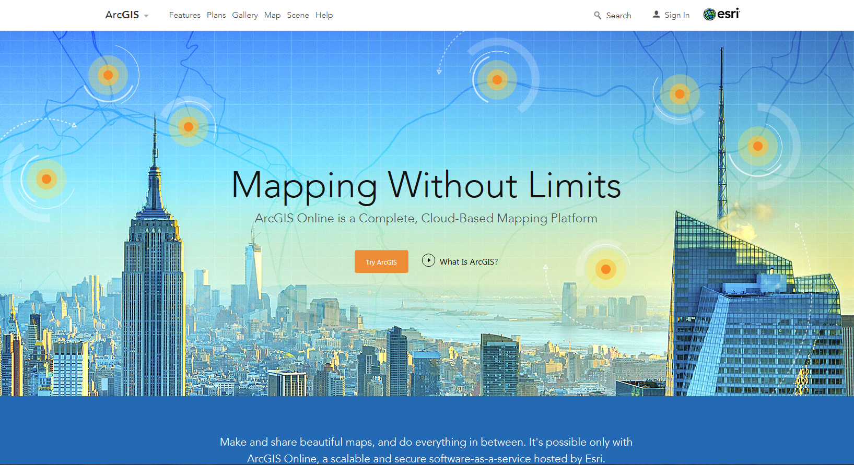
ArcGIS Online – Sign In
https://www.arcgis.com/features/index.html
Notes:
When accessing ArcGIS Online, the user needs to initially sign in with a username and password.

Slide 10
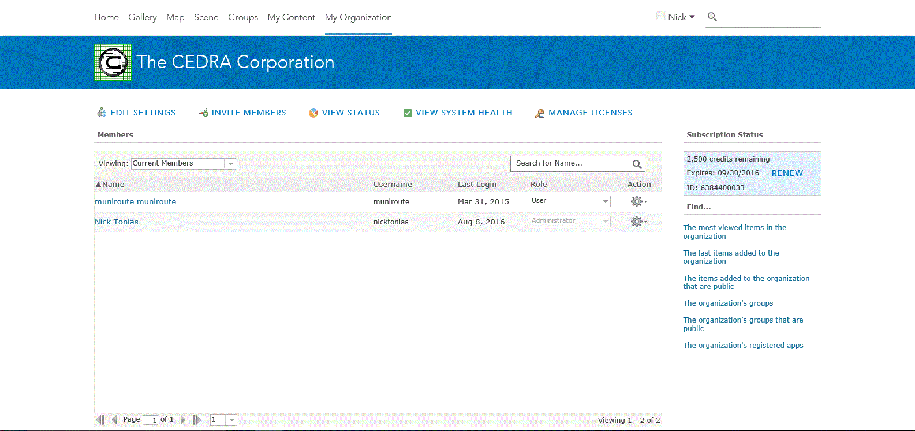
ArcGIS Online – My Organization
Use the Tabs to navigate ArcGIS Online
My Organization Tab can be used to manage the Organization’s members and view information regarding the organization
Notes:
The user can navigate ArcGIS Online by clicking on the appropriate tab at the top of screen.

Slide 11
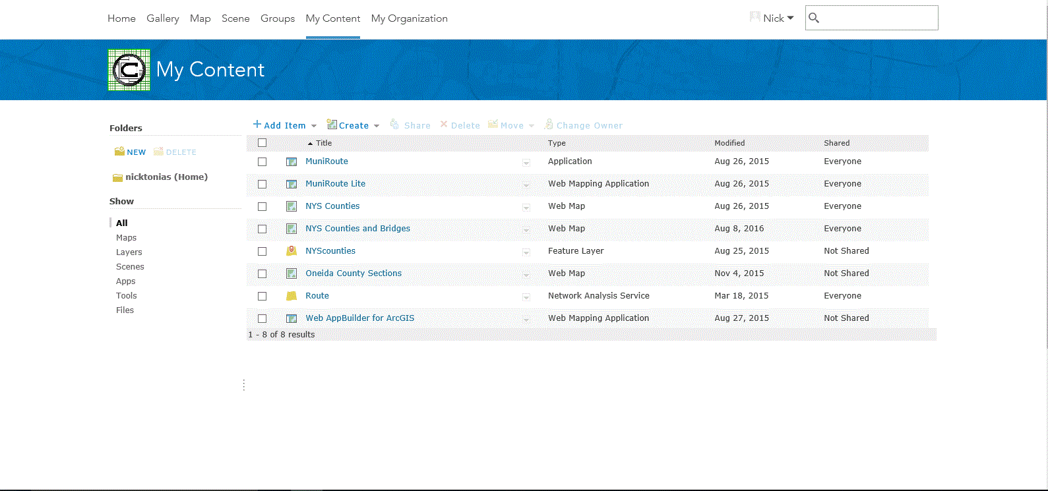
ArcGIS Online – My Content
My Content Tab can be used to manage the Organization’s Maps and Applications
Notes:
Using the My Content tab the user can list all of the maps and applications that an organization has created. An application can also be created from within this tab by clicking on the Create menu item. A drop-down list will then appear. In this drop-down list the menu item App can be selected and an application created by using: (a) a template, or (b) the Web AppBuilder.

Slide 12
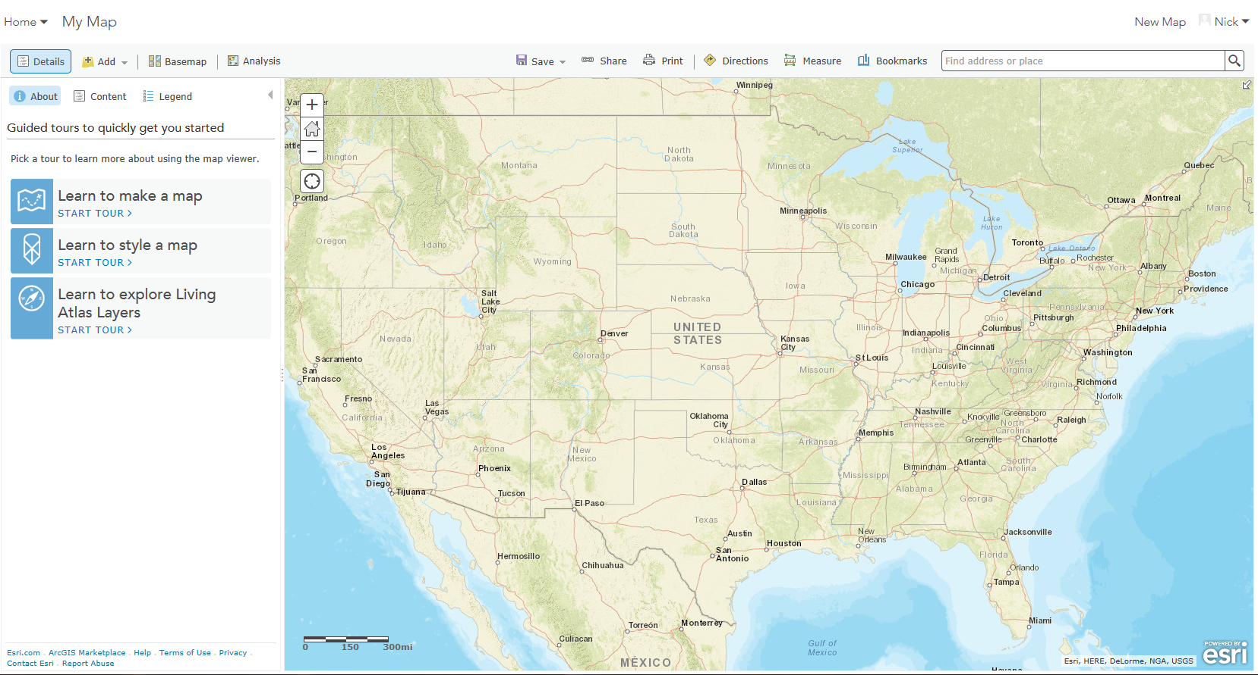
ArcGIS Online – Map Viewer
Prior to creating an App, a map must be created by clicking the Map Tab
Notes:
The Map Viewer, which is accessed under the Map tab, is the location where maps can be created. Before creating an app, the user must have a map that the app will interact with.

Slide 13
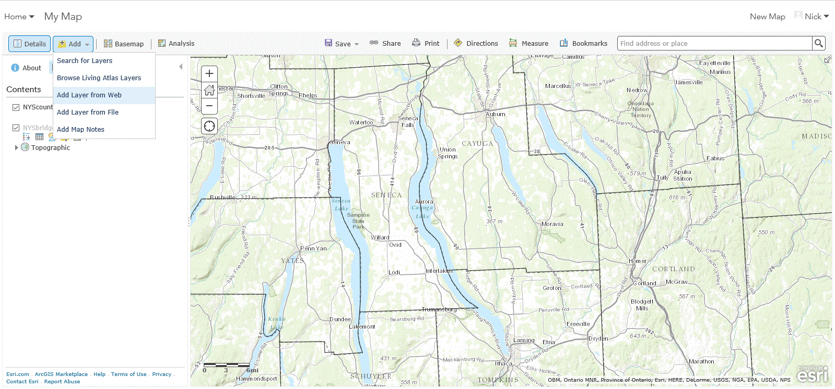
ArcGIS Online – Add Layer
Map Layers can be added on top of the basemap by specifying a URL to a Map Service
http://www.xxxxxx.com/arcgis/rest/services/NYSbridges/MapServer/0
Notes:
In the Map Viewer, the user can add various layers to the basemap. Layers are added by specifying a URL address to a map service.

Slide 14
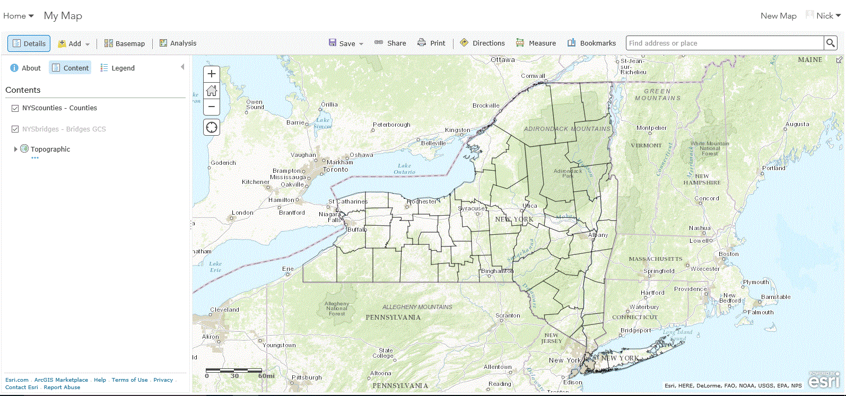
ArcGIS Online – Layers Added
As the Map Layers are added they appear in a Table of Contents
Notes:
As the layers are added to the map the names appear in the Table on Contents on the left side.

Slide 15
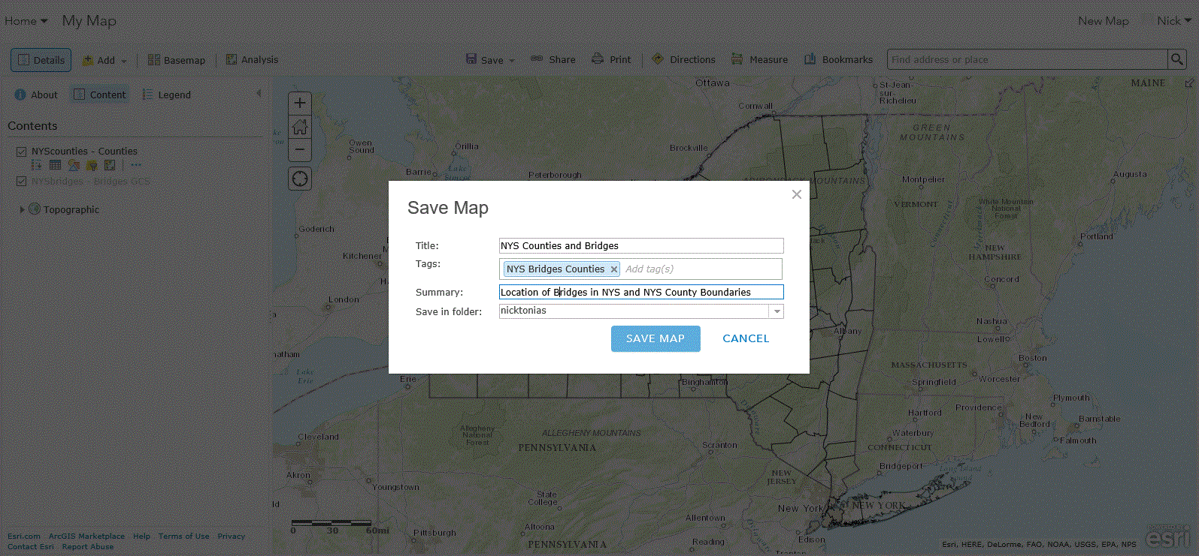
ArcGIS Online – Save the Map
Once all of the layers have been added, the map can be saved
Notes:
Once all of the layers have been added, the map can be saved and pertinent information can be entered which describes the map.

Slide 16
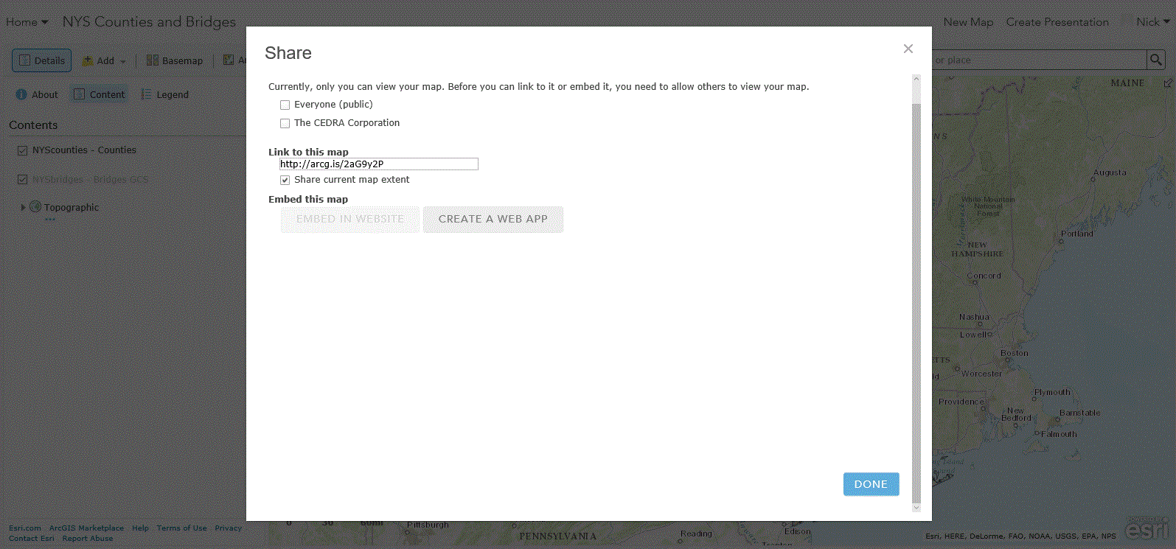
ArcGIS Online – Share the Map
The map can then be saved for Internal or Public Consumption
Notes:
The map can be saved for internal or public consumption.

Slide 17
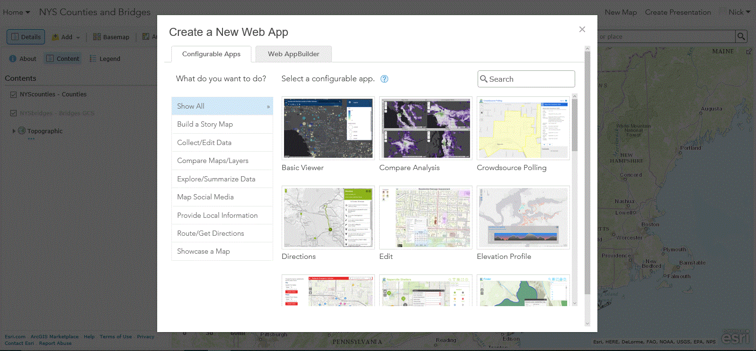
ArcGIS Online – Create an App
To create an App, a Configurable App can be used or the Web App Builder
Categories of Configurable Maps
Notes:
Once a map has been defined, an application can be created enabling a user to interact with the map. Within ArcGIS Online there are two options for creating an application. The first is by configuring a Configurable App while the second is using the Web AppBuilder.

Slide 18
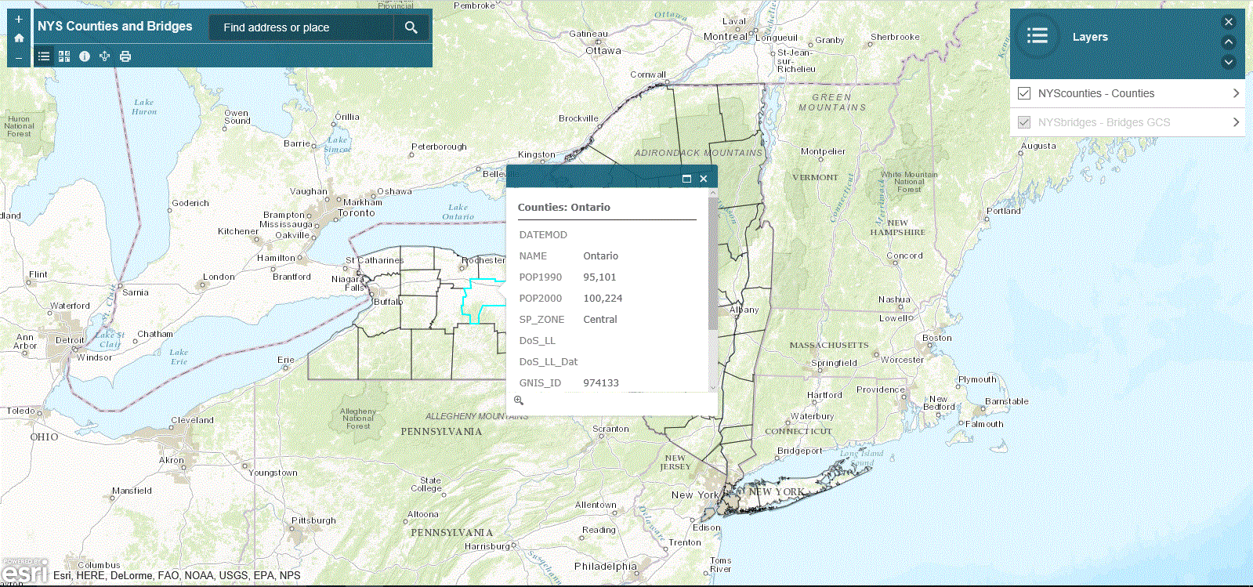
ArcGIS Online – Basic Viewer
The Basic Viewer is an example of a configurable App
Configurable Apps offer specific functionality
as well as look and feel
Notes:
The Basic Viewer is an example of a Configurable App. In a Configurable App the look and feel of the app as well as its functionality is predefined. The variable which the user can control is the map that the Configurable App interacts with.

Slide 19
ArcGIS Online – Web App Builder
The Web App Builder can be used in the following manners:
ArcGIS Online
Develop and Deploy the App in the Cloud
Web App Builder (Developer Edition)
Download and install the WAB locally
Develop the App locally
Upload the App to ArcGIS Online
Upload the App to Organization’s Server
Notes:
For those who want a little more flexibility in creating an app, the Web AppBuilder can be used. The Web AppBuilder can be used entirely via ArcGIS Online for a cloud based experience or the Web AppBuilder (Developer’s Edition) can be downloaded on a PC and the app created locally then published either back to ArcGIS Online or to the organization’s server.

Slide 20
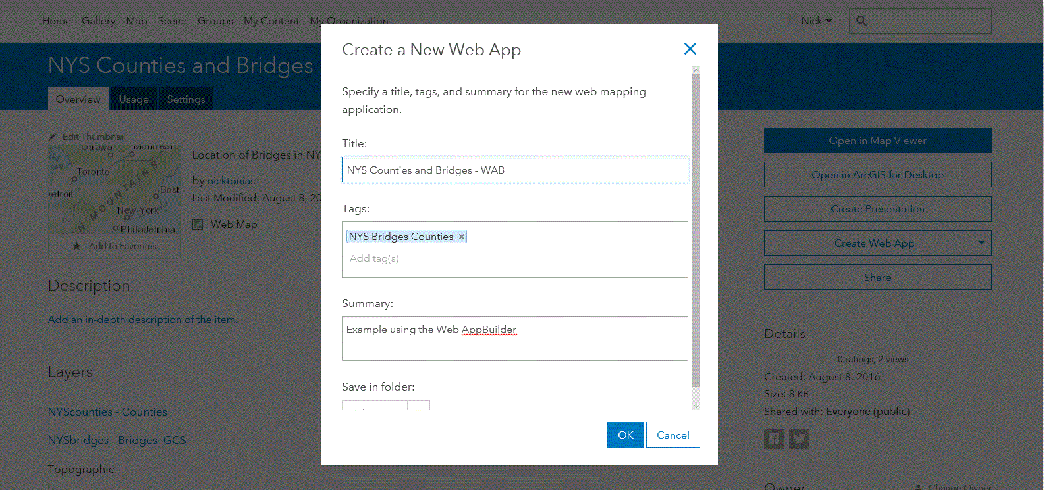
ArcGIS Online – Web App Builder
The WAB is the alternative to a configurable App
WAB provides more flexibility in customizing the App
Notes:
In creating an app using the Web AppBuilder the user runs through a series of screens that will customize the app. The Web AppBuilder provides the user more flexibility in controlling the look of the app.

Slide 21
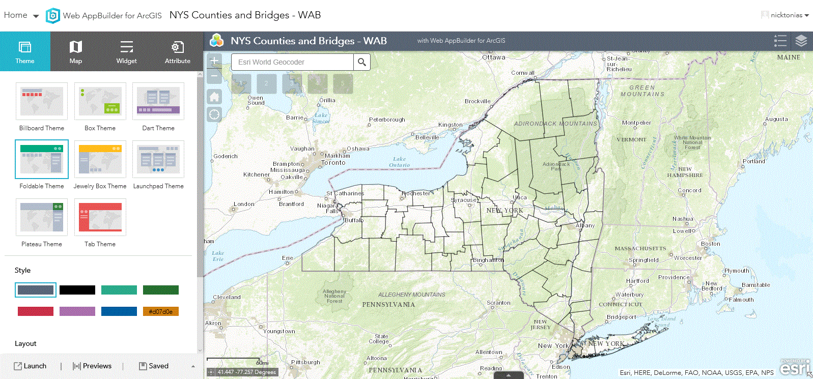
ArcGIS Online – Web App Builder
Configure the App by clicking on the desired Theme, Style, Layout
Notes:
In this screen, the user can control the Theme, Style and Layout of the app by simply clicking the desired item on the left side of the screen.

Slide 22
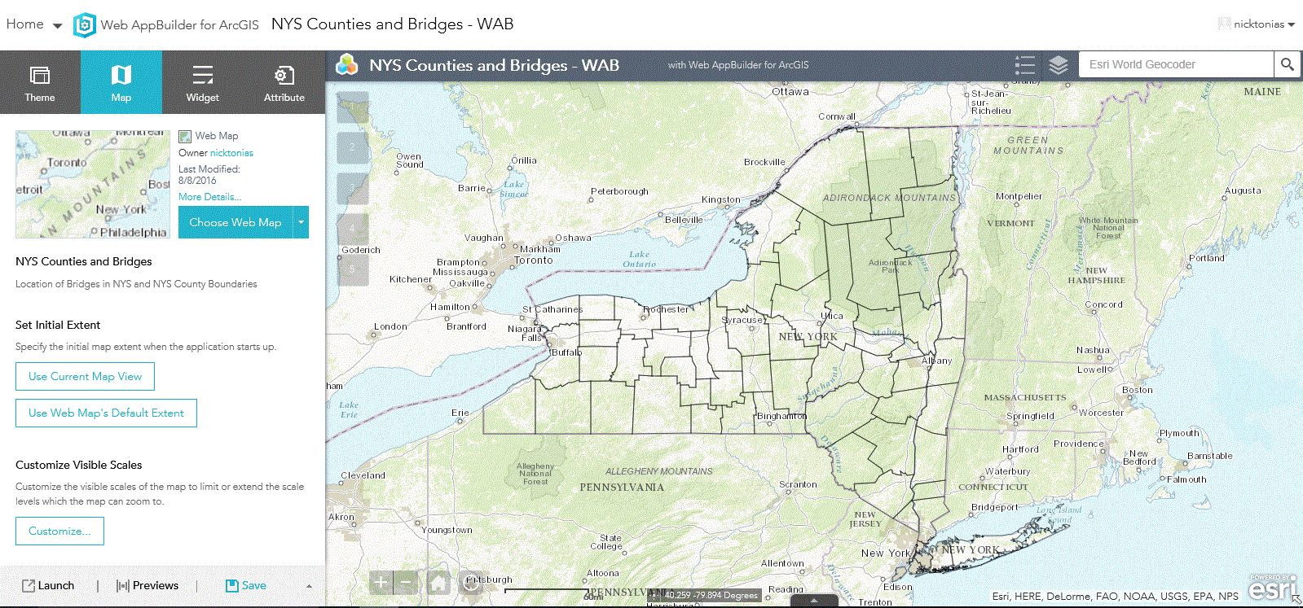
ArcGIS Online – Web App Builder
Configure the App by specifying the desired Map Properties
Initial Extent
Visible Scales
Etc.
Notes:
Here the user can control the app’s initial extent and visible scales

Slide 23
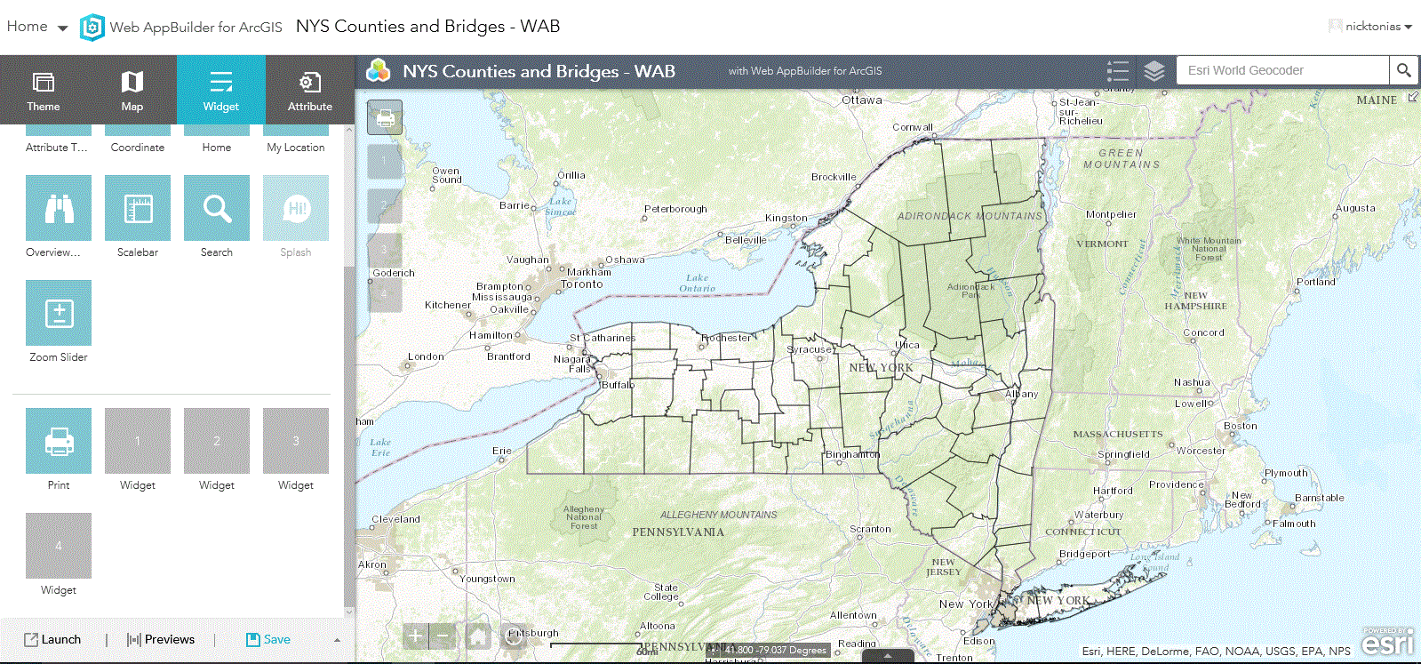
ArcGIS Online – Web App Builder
Configure the App by specifying the desired widgets to be included in the App
Notes:
The functionality offered by the app is controlled by specifying which widgets are to be included in the app.

Slide 24
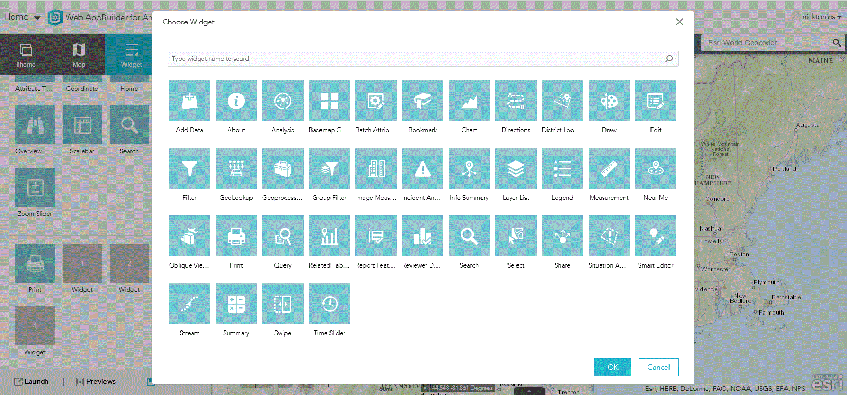
ArcGIS Online – Web App Builder
Available
Widgets
for
Printing
Querying
Basemaps
Drawing
Editing
…
Notes:
As can be seen there are a number of widgets that the user can select from.

Slide 25
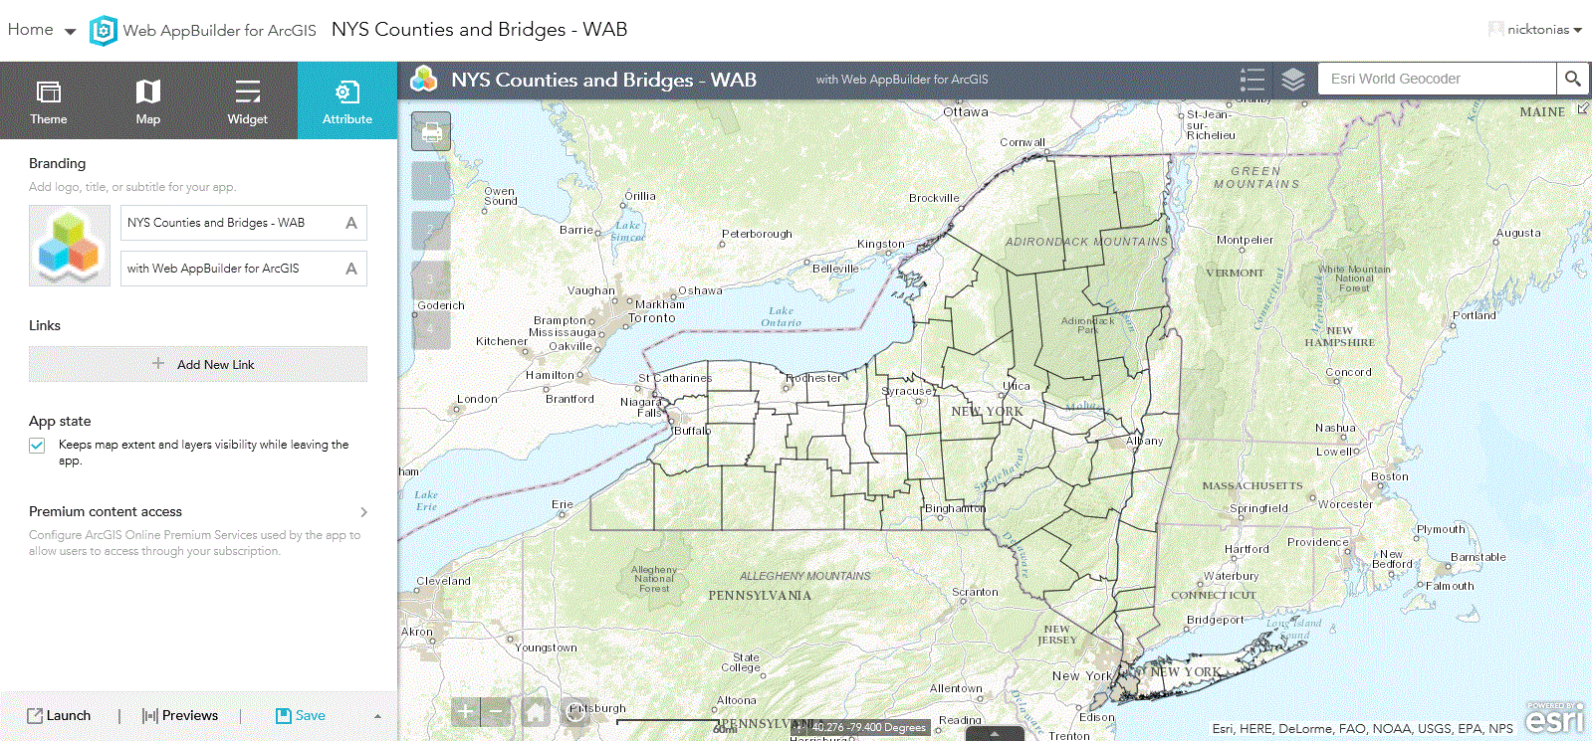
ArcGIS Online – Web App Builder
Configure the App by specifying a logo and additional text in the Apps’s title bar
Notes:
Additional properties that the user can control include the app’s logo and title.

Slide 26
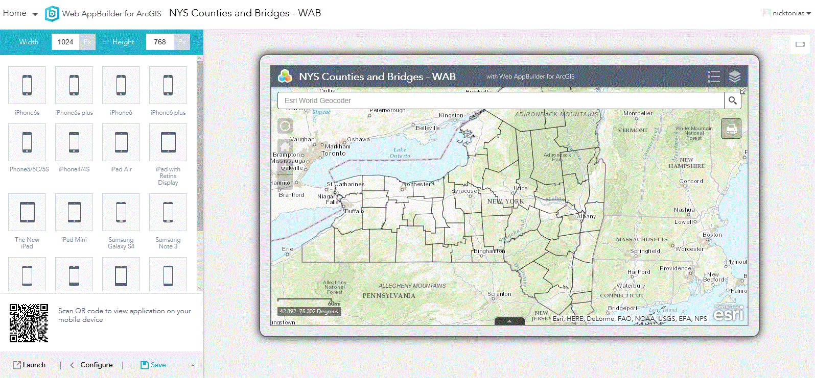
ArcGIS Online – Web App Builder
Prior to launching the App, the App can be previewed at different resolutions, such as Mobile Devices
Notes:
Prior to launching the app, the user can preview the app in a variety of resolutions to verify the appearance of the app is as desired.

Slide 27
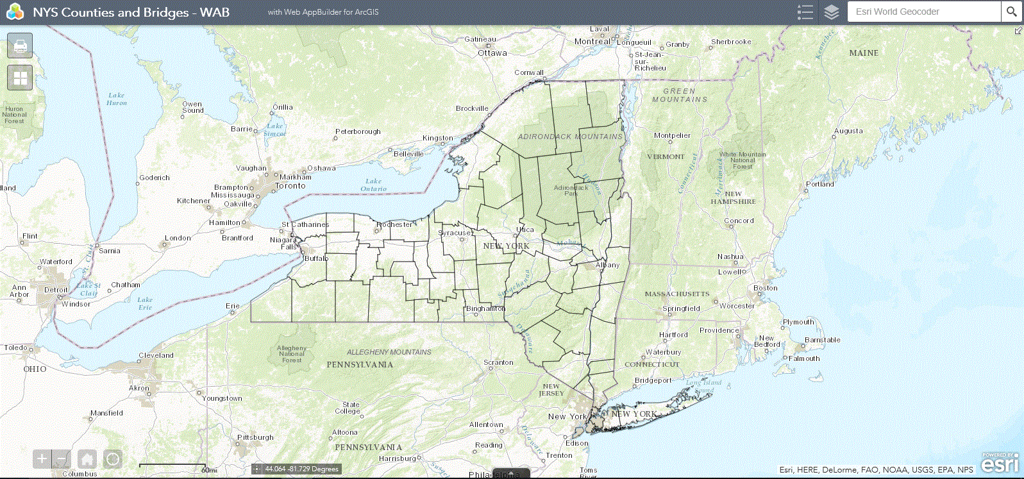
ArcGIS Online – Web App Builder
Once the App has been configured, it can be Saved and Launched
for
Internal or
Public Consumption
Notes:
Once the user has customized the app, the app can be saved and launched for internal or public consumption.

Slide 28
ArcGIS Online – Summarizing
Apps can be created using:
1. a Configurable Template or
2. the Web App Builder (locally or cloud)
Using the ArcGIS Online interface, Apps can be created by the user starting from the following:
Map Viewer (Map Tab)
Gallery (Gallery Tab)
My Content (My Content Tab)
Item Details (My Content Tab)
Notes:
Summarizing, ArcGIS Online offers the user two means of creating apps. The first is using a Configurable Template and the second is the Web AppBuilder, which can be executed through the cloud or locally (the Developer’s Edition). The Web AppBuilder offers more flexibility in customizing the app. Additionally, when creating an app with ArcGIS Online there are a number of ways that the user can get to creating an app.

Slide 29
ArcGIS Server
“Things to have”
ArcGIS Server, SQL Server, Windows Server software
A Development Environment
Notepad ++, Sublime Text Editor, etc.
Web Mapping APIs (JavaScript, Flex, Silverlight)
Programming Experience (JavaScript, HTML, CSS)
Notes:
The alternative to ArcGIS Online is ArcGIS Server. When using ArcGIS Server there is some infrastructure that the user has to have prior to beginning developing apps. This infrastructure includes, software, a development environment, programming experience and obviously server hardware.

Slide 30
Application Location
“Ever wonder where an Application is stored”
Applications reside in the inetpub\wwwroot folder
on the Organization’s Server
Development can occur locally or on a server
Notes:
When creating an app using ArcGIS Server, location of the app is important. The app must be placed in a specific folder. Specifically, the inetpub\wwwroot folder. Apps can be created locally on a PC then moved to the server, or the app can be created directly on the server, if so desired. Regardless of where the app is created (locally or server) the app must reside in the inetpub\wwwroot folder.

Slide 31
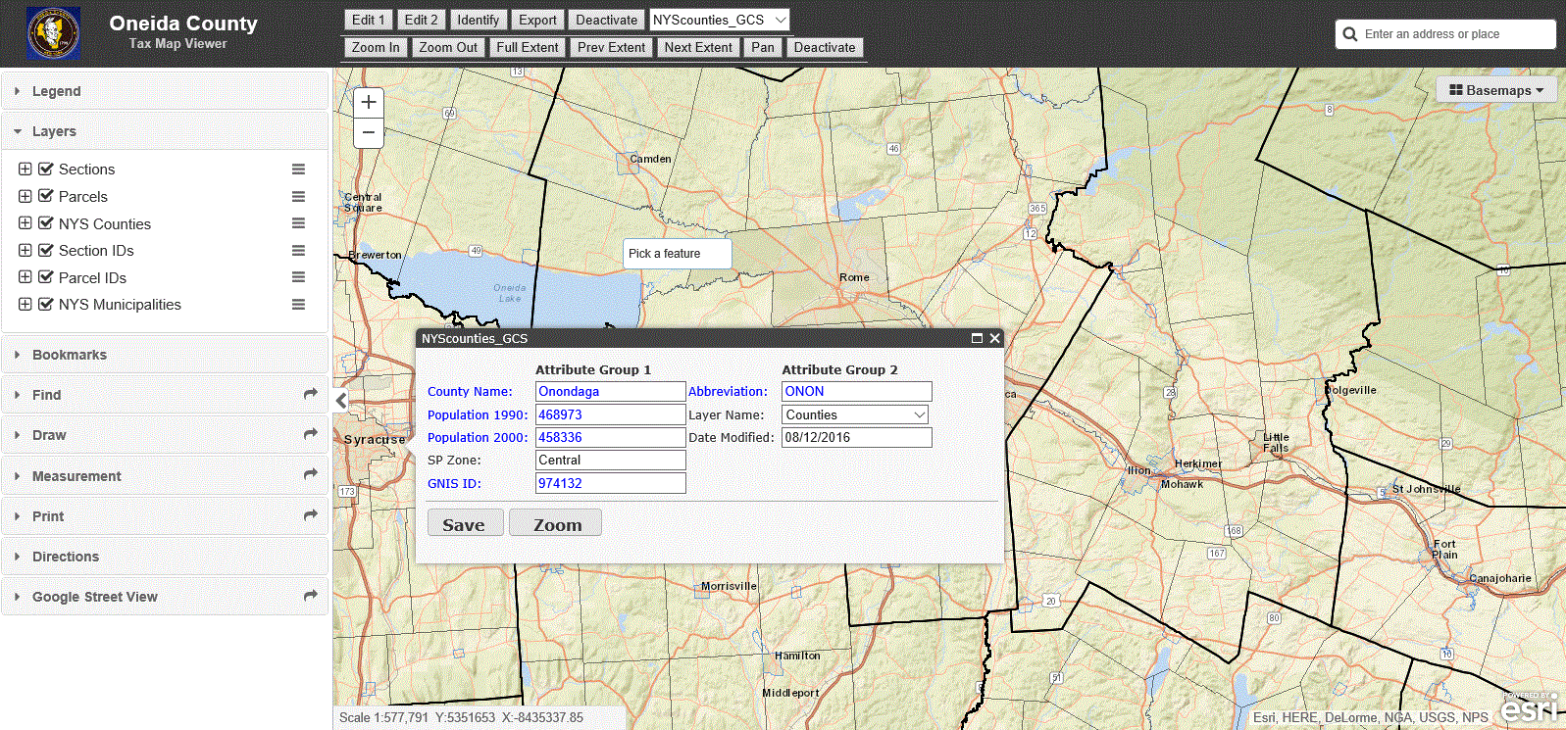
ArcGIS Server – Sample App
Developer has total control of the App’s look and feel as well as its functionality
Developed using JavaScript API
HTML
CSS
Notes:
Here is a sample ArcGIS Server app that was developed using the Esri JavaScript API, HTML ad CSS. The multi-column dialog box is an example of a CEDRA-DataEditor dialog box. The blue labels denote read-only data fields.

Slide 32
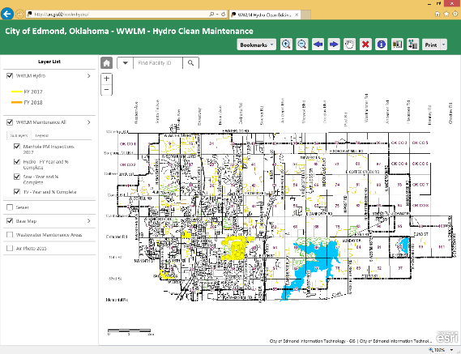
COE – Wastewater Line Maintenance
Platform: JavaScript API 3.17
Purpose: To mark completed inspections of wastewater lines according to fiscal year.
Who uses it? Wastewater Line Maintenance Crews (TV, Saw and Hydro applications)
Browsers: Internet Explorer, Firefox, Chrome, Safari
Deployed: July 2016
Data editor form, export attributes, bookmarks, navigation tools, find asset facility ID number, printing, and popups. CEDRA custom data editor tools incorporated into the application.
Notes:
City of Edmond application with the CEDRA-DataEditor software embedded in it.

Slide 33
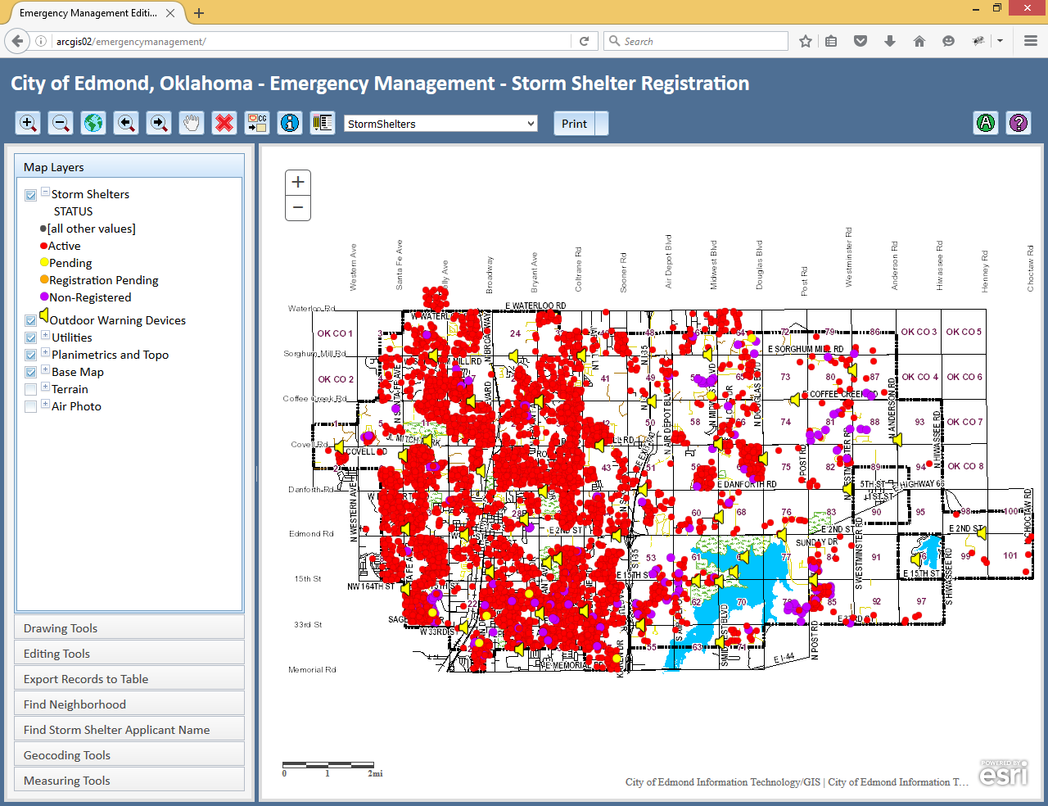
COE – Emergency Management
Platform: JavaScript API 3.09
Purpose: To edit storm shelter registration information.
Who uses it? Emergency Management
Browsers: Firefox, Chrome
Deployed: September 2014
Data editor form, export attributes, navigation tools, search tools, printing, measuring, and template picker for adding features. CEDRA custom data editor tools incorporated into the application. Application is used on desktop.
Notes:
City of Edmond application with the CEDRA-DataEditor software embedded in it.

Slide 34
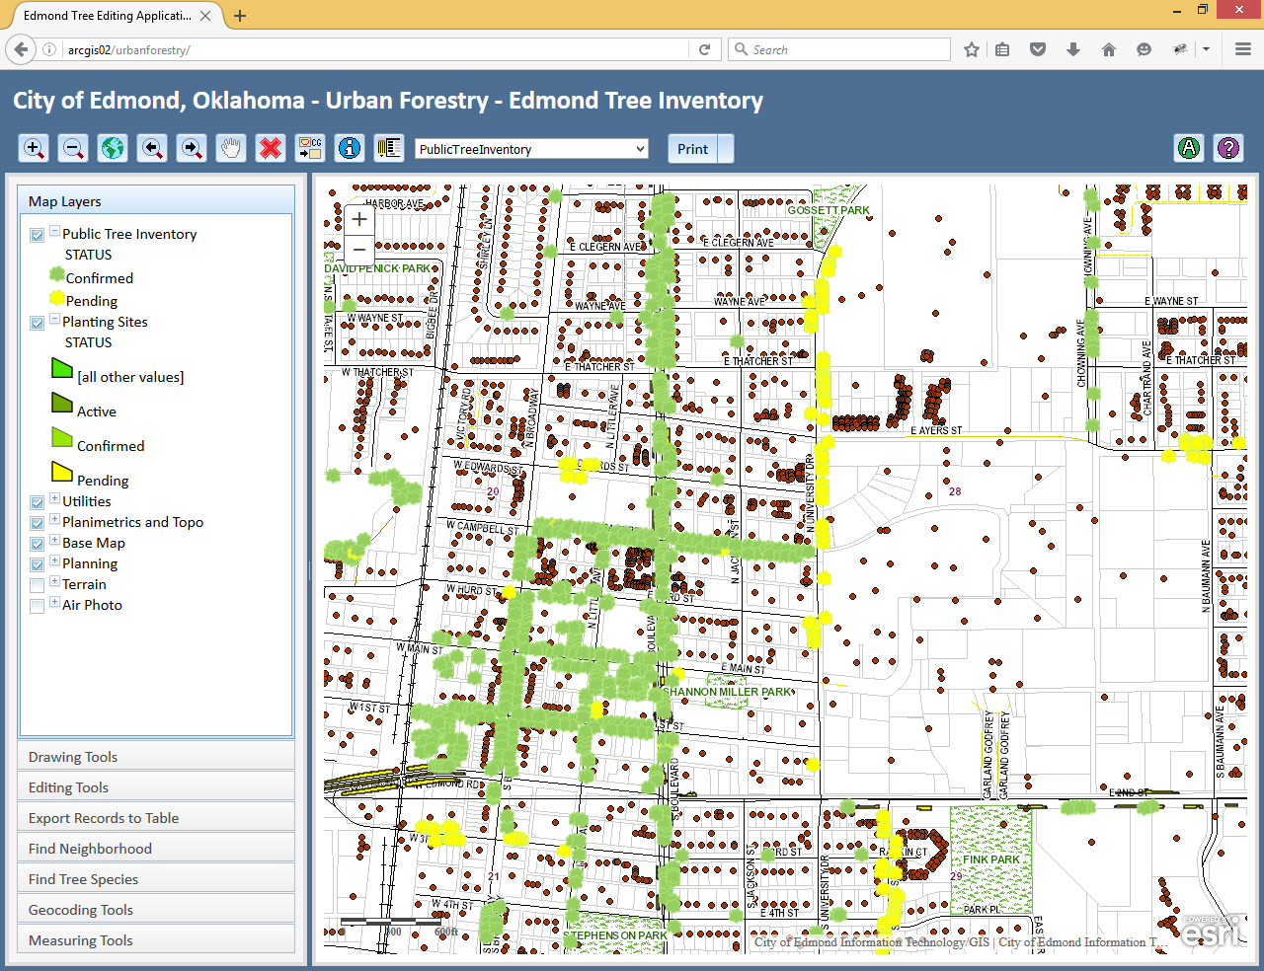
COE – Urban Forestry
Platform: JavaScript API 3.09
Purpose: Maintaining and editing public tree inventory information.
Who uses it? Urban Forestry
Browsers: Firefox, Chrome
Deployed: September 2014
Data editor form, export attributes, navigation tools, search tools, printing, measuring, and template picker for adding features. CEDRA custom data editor tools incorporated into the application. App has been used in mobile (iPad).
Notes:
City of Edmond application with the CEDRA-DataEditor software embedded in it.

Slide 35
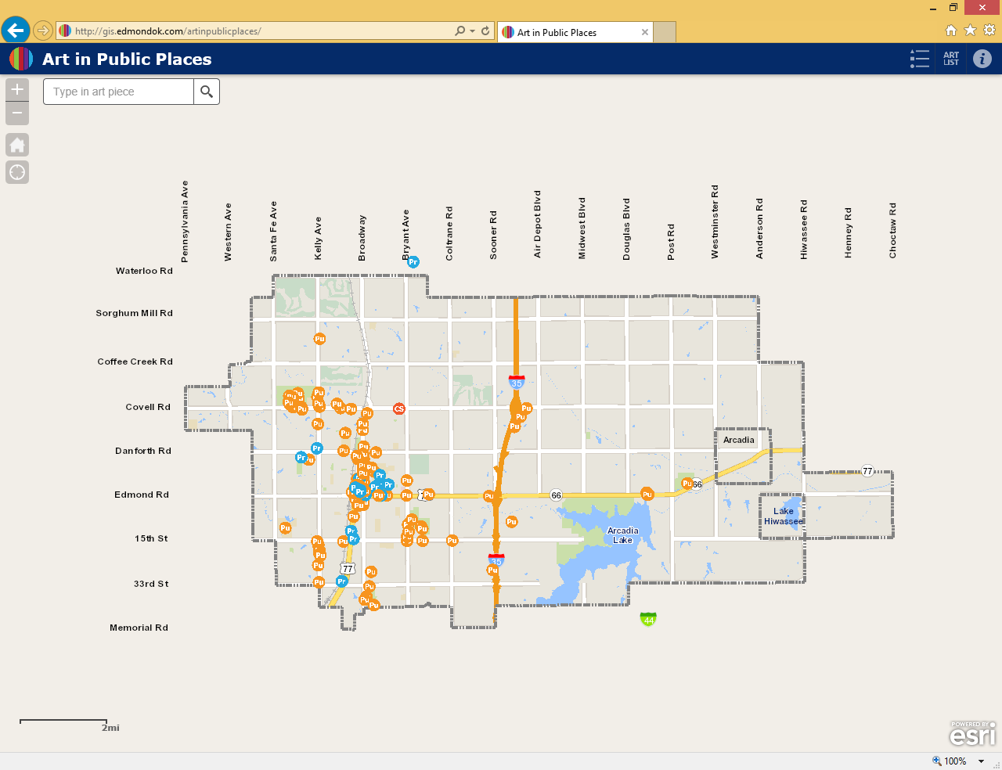
COE – Art in Public Places
Platform: Web App Builder Version 1.3
Purpose: Used for finding and identifying public art. Fact sheets are available.
Who uses it? Open to the Public
Browsers: Internet Explorer, Edge, Firefox, Chrome, Safari
Deployed: February 2016
Art list, Popups, links to factsheets. Required the development of the search tool using a data grid (JavaScript API). Custom fact sheets were built using HTML.
Notes:
City of Edmond application which was developed using the Web AppBuilder

Slide 36
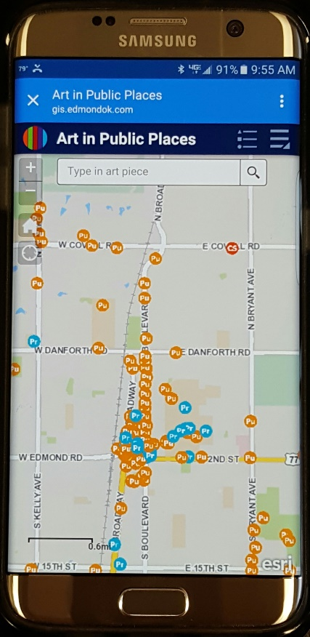
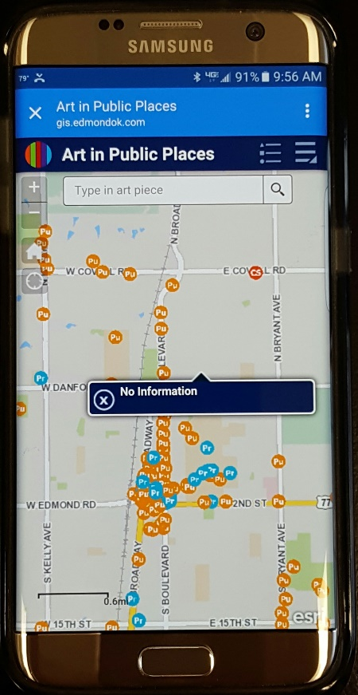
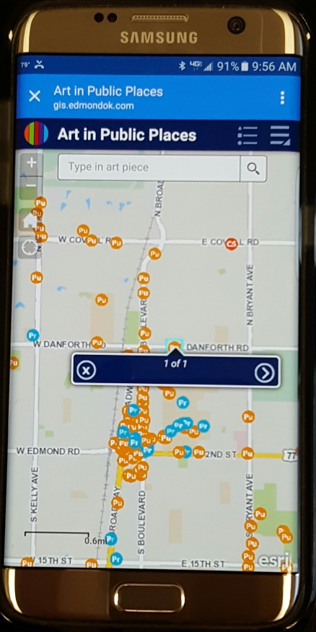
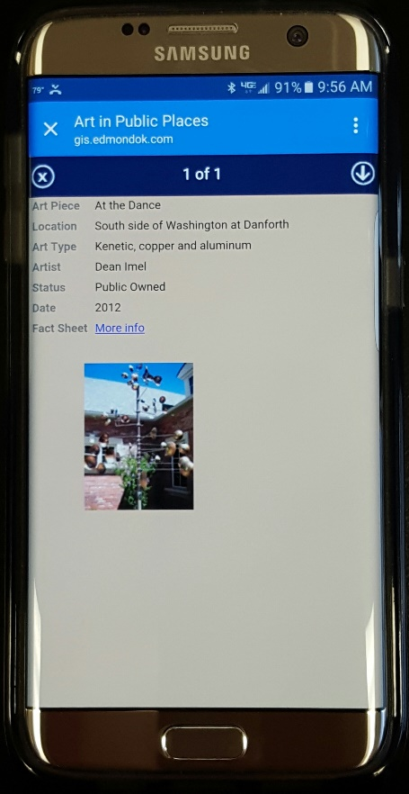
COE – Art in Public Places
No ability to control pixel tolerance results in the application being
“Not Fat-Finger Friendly”
Notes:
One development issue to keep in mind when creating mobile apps is that there is no way to control the pixel tolerance that is used to select features. As such, if a stylus is not used, these apps tend to be “not fat finger friendly”.

Slide 37
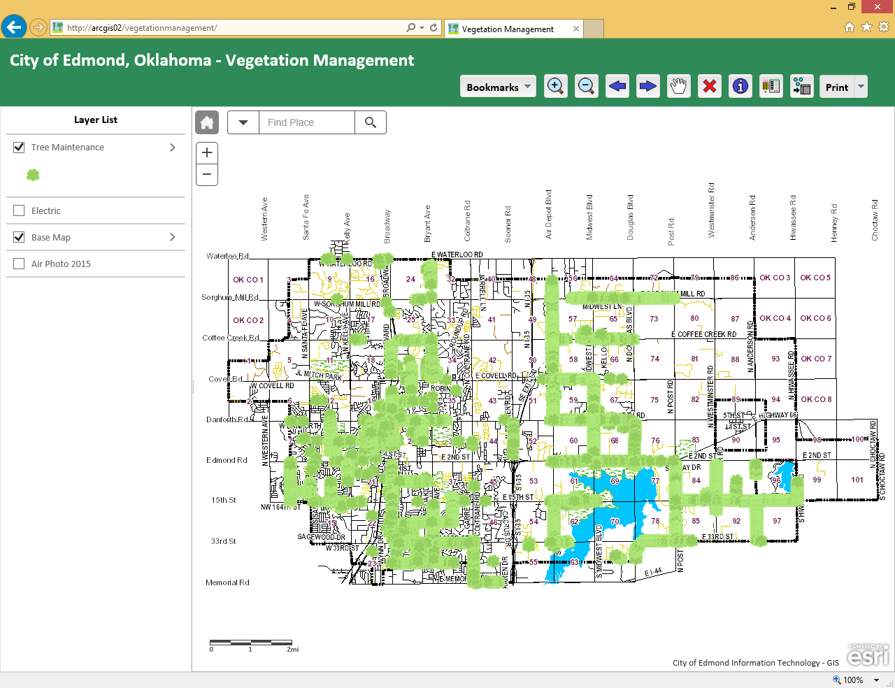
COE – Vegetation Management
Platform: JavaScript API 3.17
Purpose: To mark completed maintenance/work completed for trees near power lines.
Who uses it? Urban Forestry will be using this application.
Browsers: Internet Explorer, Firefox, Chrome, Safari
Deployed: August 2016
Data editor form, export attributes, bookmarks, navigation tools, find asset facility ID number, printing, measuring, and popups. CEDRA custom data editor tools incorporated into the application.
Notes:
City of Edmond application with the CEDRA-DataEditor software embedded in it.

Slide 38
File Management
When developing multiple Applications, some with identical code bases, consideration should be given to the inetpub organization
inetpub
App 1
App 2
Common
Index.html
Index.html
File 1
File 2
File 3
….
Images
Images
CSS
CSS
Data
Data
Notes:
Since the CEDRA-DataEditor software has been embedded in a number of City applications, rather than embedding the same code in multiple apps, a common CEDRA folder was created and the files which are common to all apps are stored in this folder. In so doing there is only one instance of a file. This is a much more efficient way of handling files that are common to a number of apps.

Slide 39
Deployment Issues
v User expectation that App will act like ArcMap
web apps and desktop apps are different
v Different browsers behave differently
decide on the preferred browser to be used
v Browser Cache getting in the way (clear it)
v Network bandwidth impacting performance
v Training
v Designing UI pleasing to all
Notes:
When deploying apps, the City of Edmond has come across the above issues.

Slide 40
JavaScript Application Pros
v ESRI JavaScript API provides lots of functionality
v A variety of widgets can be added into an application
v Build the App the way you want (look and feel)
v Can be built for desktop and mobile environments
v Light weight applications, no installs required
v Easy to deploy
Notes:
Summarizing the pros of JavaScript applications.

Slide 41
JavaScript Application Cons
v Must have knowledge of programming and CSS
v Not intuitive for regular GIS users
v Application development takes time
v Hard to replicate ArcGIS Desktop functionality
Notes:
Summarizing the cons of JavaScript applications.

Slide 42
Web App Builder Pros
v Easy to install and configure
v Can run on any machine
v Can be used by developers and regular GIS users
v Provides easy solution to build applications
v Does not require the use of a cached base map
v Numerous out-of-the-box widgets available
v Compatible in any browser and mobile devices
v Application builder is highly customizable
v Easy to deploy application
Notes:
Summarizing the pros of Web AppBuilder applications.

Slide 43
Web App Builder Cons
v Requires the use of ArcGIS Online to use the WAB
v Popup Identify/pixel tolerances are not configurable
v Hard to identify feature on mobile device
v Multiple related objects are not supported can go only
one level down when using the popup or displaying attribute table.
v Some styling and custom settings are lost when deploying the application to inetpub
Notes:
Summarizing the cons of Web AppBuilder applications.

Slide 44
Summary
ArcGIS Online for those with:
No or few Development/Support Staff
No in-house Server
Budget limitations
ArcGIS Server for those:
Not subject to the above items
Wanting complete control over the App’s
hosting environment
design and development
Notes:
Some guidelines in determining which development environment should be used are listed above.

Slide 45
Application Development Considerations
ArcGIS Online good for:
general viewing and map interaction
ArcGIS Server good for:
when specific functionality, such as editing,
drawing, printing, etc. is desired
Very feasible for ArcGIS Online and ArcGIS Server to coexist (both be used in application development)
Notes:
The City of Edmond’s experience in developing apps using both ArcGIS Online and ArcGIS Server has shown that when the app needs general viewing and map interaction, ArcGIS Online is an excellent resource for developing such an app very quickly. However, if specific functionality is desired, ArcGIS Server is a more robust development environment. It is important to note that it is not unusual to have both development environments in an organization.

Slide 46
Thank you!
Questions
And
Answers
Notes:
Thank you for viewing this presentation and if you should have any questions or comments feel free to contact Nick Tonias at 585-232-6998 or nicktonias@cedra.com.

