Slide 1

Parcel/Easement Creation
Data Entry/Maintenance
and DXF Exporting
In ArcGIS
Nick Tonias, P.E.

Slide 2
The CEDRA Corporation
1985 The CEDRA Corporation is established.
1987 CEDRA begins a long standing relationship
with ESRI.
1993 CEDRA becomes an authorized ESRI Business
Partner and Developer.
CEDRA offers engineering/GIS solutions in the form of software and services to governmental agencies, engineering consultants, tax assessors, oil companies and various utility enterprises.

Slide 3


Stuart asks how to perform
Parcel
Easement Creation

Slide 4
Parcel/Easement Creation
Legal Description with Metes and Bounds
COMMENCING at the Southwest (SW) comer of said Southwest Quarter (SW/4); THENCE North 00°12'58" West along the West line of said Southwest Quarter (SW/4), a distance of 1,320.62 feet; THENCE South 89°36'42" East along the South line of said Unrecorded Plat of Centennial Industrial Addition, a distance of 1,312.91 feet to the Point of Beginning; THENCE from said Point of Beginning South 89°36'42" East along the South line of said Unrecorded Plat of Centennial Industrial Addition, continuing Easterly along said line, a distance of 15.00 feet; THENCE South 00°12'47'' East, a distance of 230.66 feet; THENCE along a curve to the left in a Southwesterly direction with a radius of 125.00 feet an arc distance of 21.34 feet; said arc being subtended by a chord bearing South 44°30'15" West and a chord distance of 21.32 feet; THENCE North 00°12'47" West, a distance of 245.97 feet to the Point or Place of Beginning.

Slide 5
Parcel/Easement Creation
Legal Description Comprised of
2 Tie Line Courses,
3 Line Courses, and
1 Course defined by a Curve

Slide 6
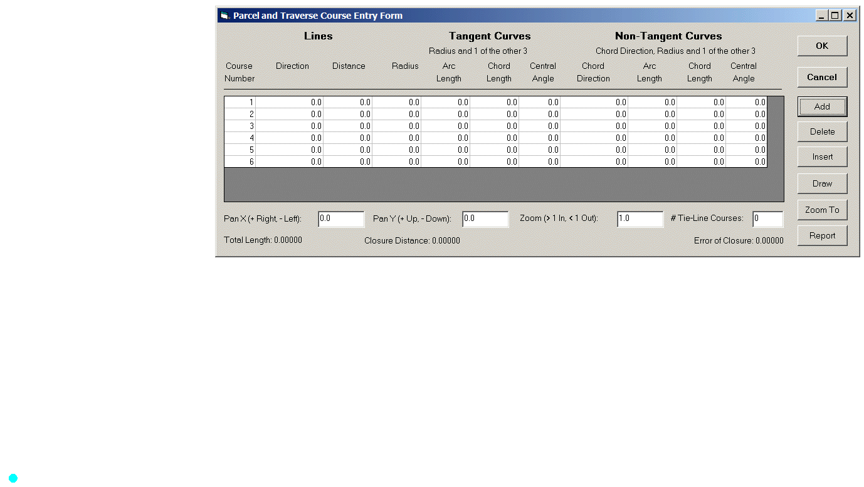
Parcel/Easement Creation
Table
Entry Form
With ability
To Add, Modify and
Delete Rows
Ability to specify
Lines, Tangent Curves
and non-Tangent Curves
in a spreadsheet environment
Pick the POC or POB then Click the Add button to add Rows

Slide 7
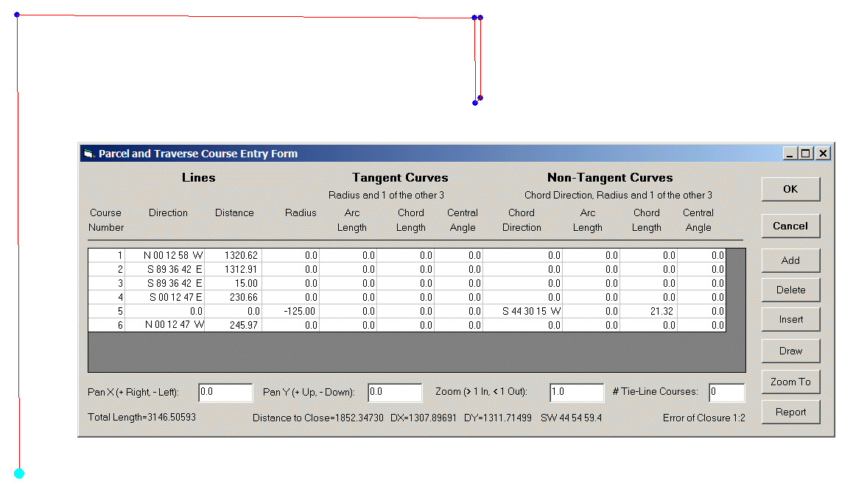
Parcel/Easement Creation
Each course is entered on a row and the Report button is used to Save/Recall
Appropriate columns are filled in for a specific type of feature
As a course is entered it is drawn in red

Slide 8
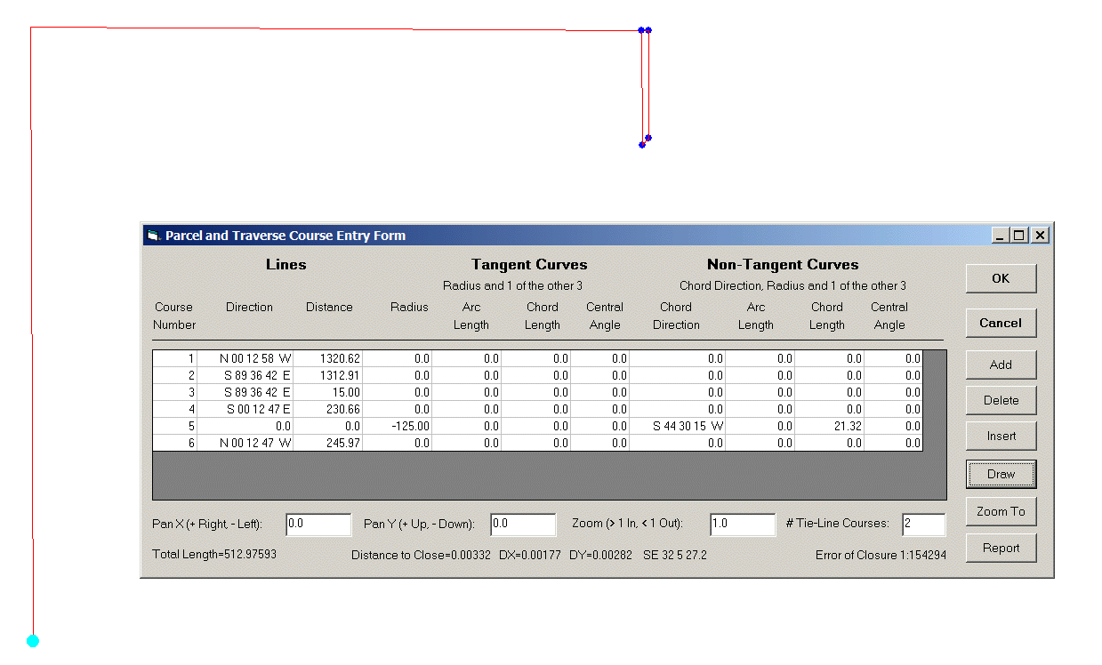
Parcel/Easement Creation
Closure information appears at the bottom of the form
Number of
Tie-Lines Effects
the Closure
This legal contains 2 tie-line courses

Slide 9
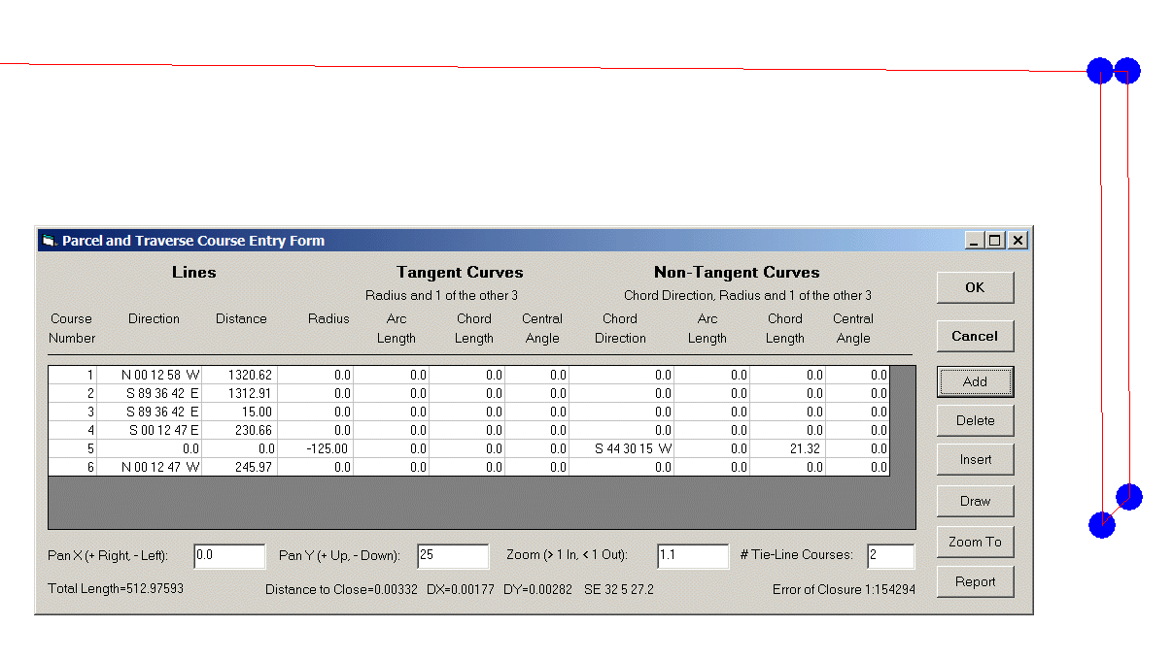
Parcel/Easement Creation
Blue markers appear at the Start and End points of a Course denoting PC and PT locations

Slide 10
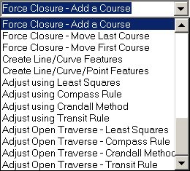
Parcel/Easement Creation
When a Parcel or Traverse does not close, the user has the option of performing an adjustment or creating individual features

Slide 11
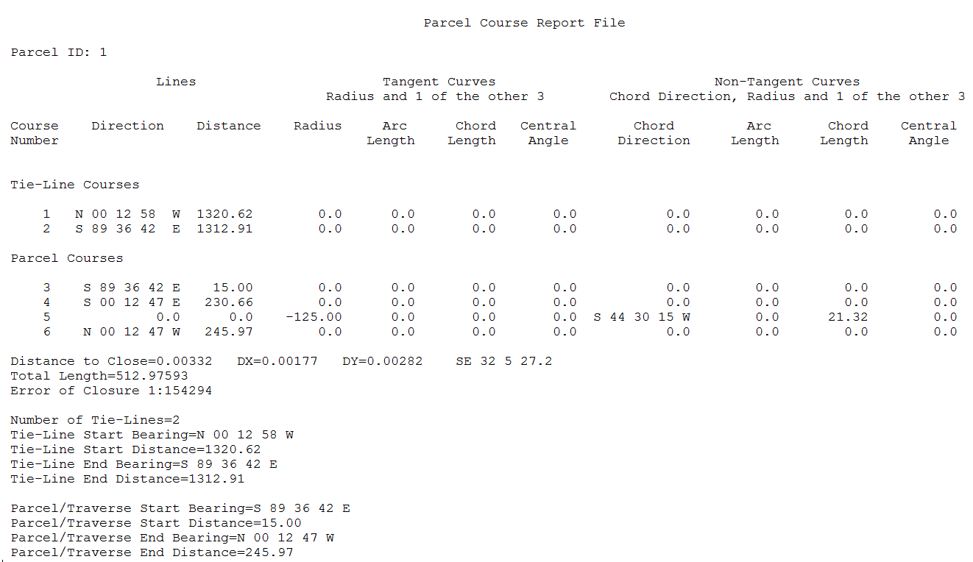
Parcel/Easement Creation
Legal Descriptions can be saved and recalled based upon a user-defined filename

Slide 12
Parcel/Easement Creation
Legal Description with Aliquots
The Southwest Quarter (SW/4) of the Northwest Quarter (NW/4) of Section Seventeen (17), Township Fourteen (14) North, Range One (1) West…

Slide 13
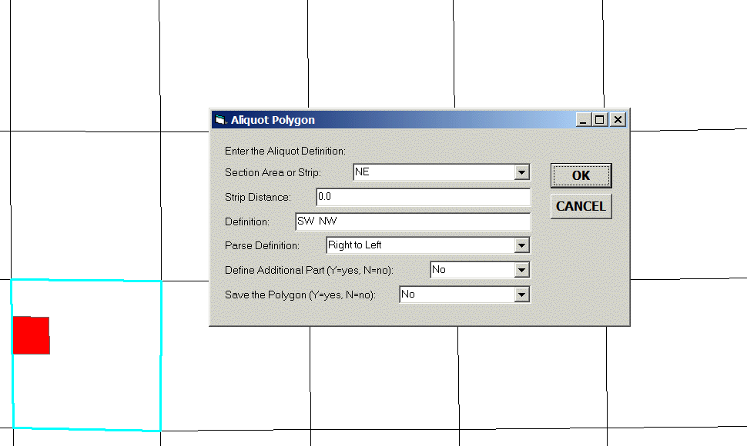
Parcel/Easement Creation
Interactively processing an Aliquot Description

Slide 14
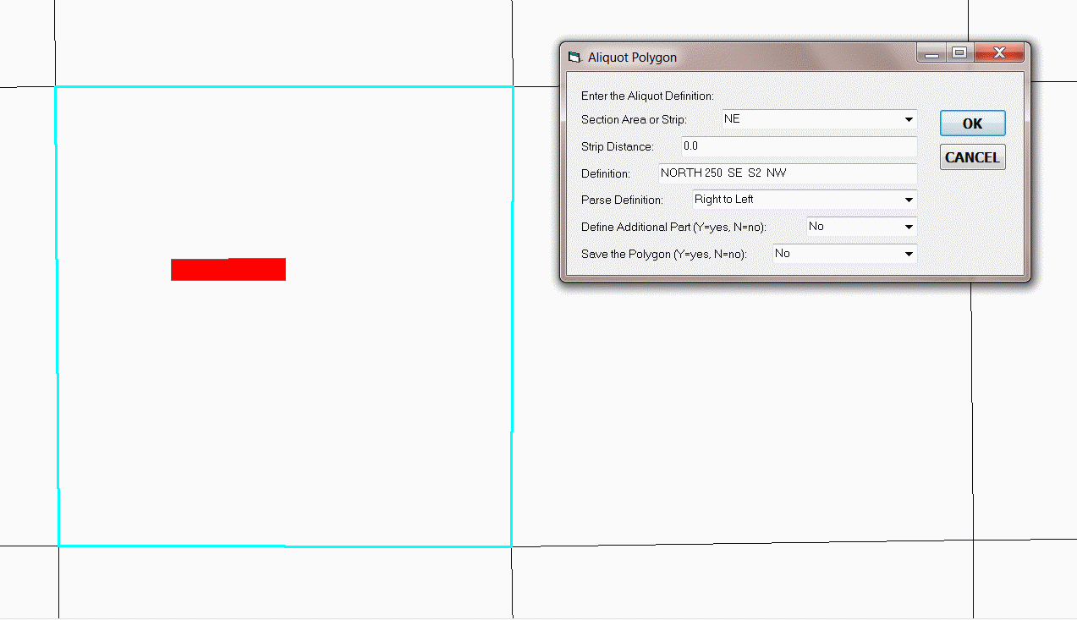
Parcel/Easement Creation
The north 250 feet of the SE/4of the S/2 of the NE/4 of …

Slide 15

Emma asks how to perform
Data Entry
and
Data
Maintenance

Slide 16
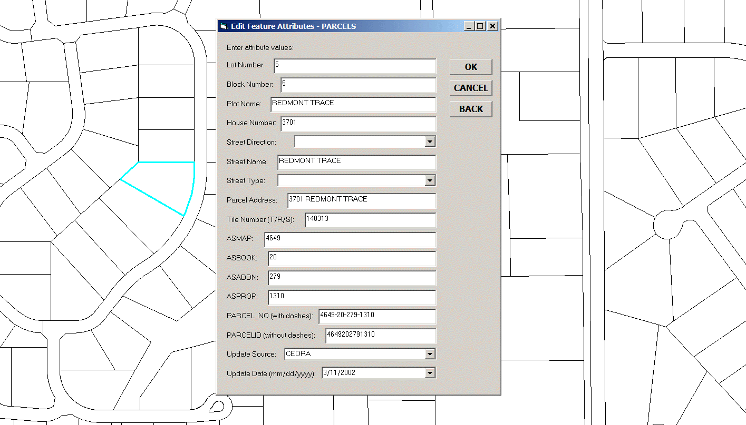
Data Entry and Data Maintenance
Custom Single and Multi-Column Dialog Boxes based upon a user-defined Configuration File
No Programming Required
Click
Confirm
and
Enter

Slide 17
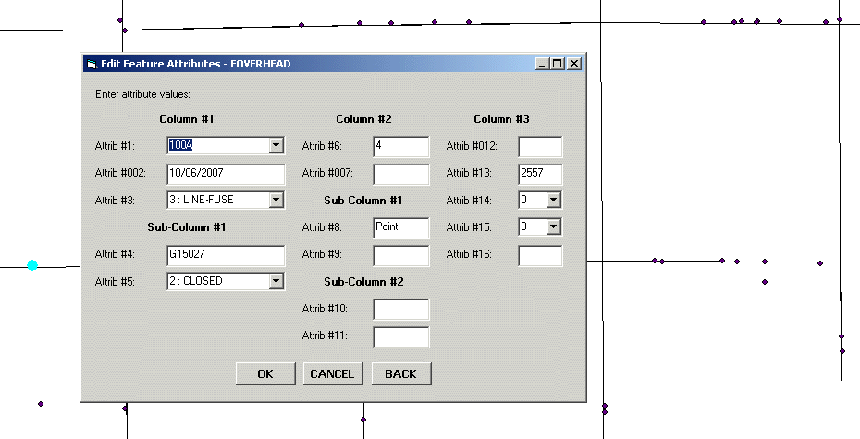
Data Entry and Data Maintenance
Example of a Multi-Column Dialog Box with Custom Labels and Drop-Down Lists
No Programming Required

Slide 18
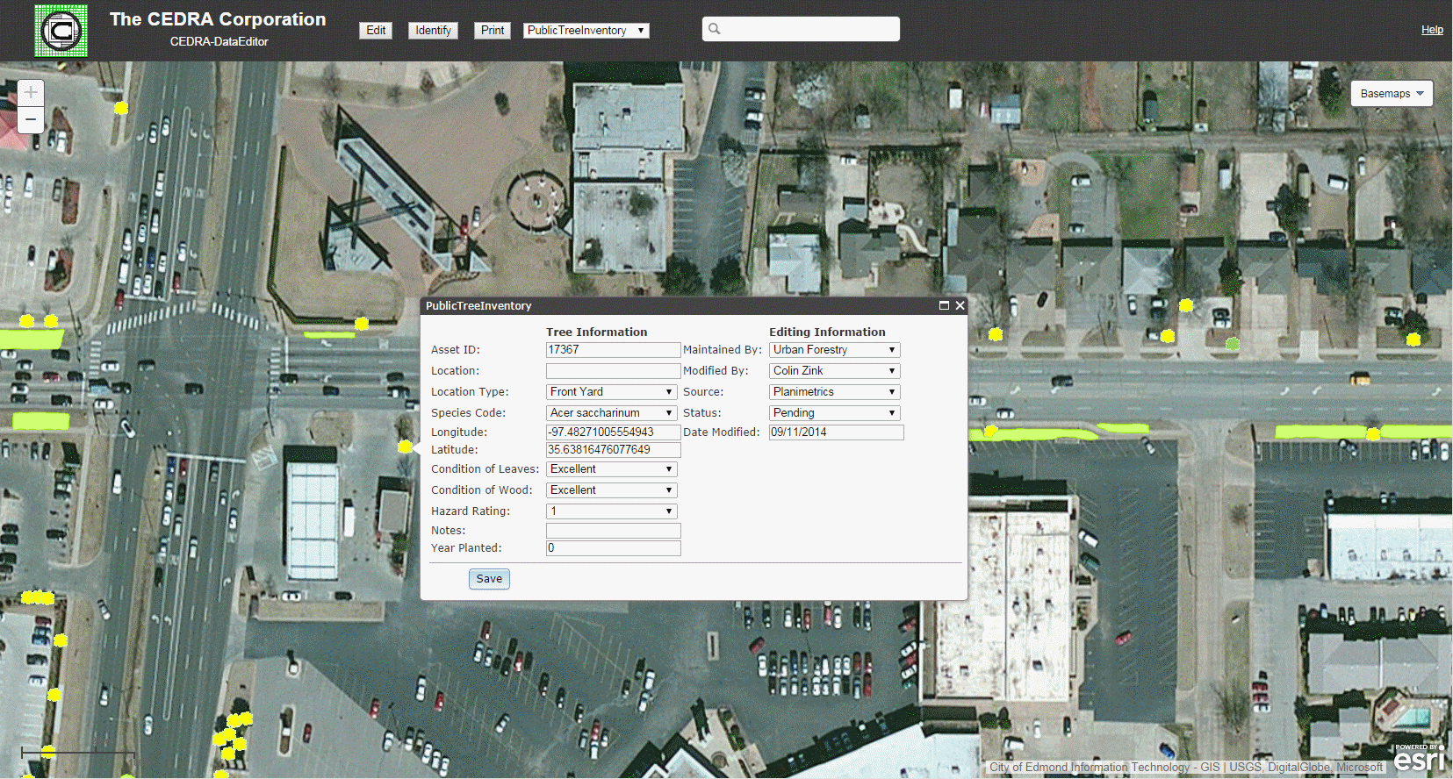
Data Entry and Data Maintenance
Data Entry in a JavaScript based Web Application

Slide 19
Data Entry and Data Maintenance
/*
/* Start of Layer Definition
THEME
parcels
/*
/* Set the Parcel's Lot
LOTNUM
Lot Number:
/*
/* Set the Parcel's Block
BLOCKNUM
Block Number:
REMEMBER_LAST
/*
/* Set the Parcel's Plat Name
PLAT_NAME
Plat Name:
REMEMBER_LAST
Keyword
Name of Layer
Name of Attribute
Attribute Label
Keyword
User-Specifications are Stored in a Text File called THEMES.TXT

Slide 20
Data Entry and Data Maintenance
RANGE
CHOICES
CHOICES_WHEN
DEFAULT
REMEMBER_LAST
ATTRIBUTE_EQUATION
TRANSFER
Specify Valid Numeric Range
Drop-Down List
Conditional Drop-Down List
Default Value to be Assigned
Remember Last Value Entered
Evaluate an Equation
Evaluate using a Spatial Search
Enhanced Attribute Control Keywords

Slide 21
Data Entry and Data Maintenance
/*
/* Set the Parcel's Street Direction
ST_DIR
Street Direction:
CHOICES
N
S
E
W
NE
SE
SW
NW
END
REMEMBER_LAST
Name of Attribute
Attribute Label
Keyword
Choices
Keyword
Keywood
Specification of a Custom Drop-Down List

Slide 22
Data Entry and Data Maintenance
/* Definition for Field A
A
Attribute A:
/* Definition for Field B
B
Attribute B:
CHOICES
1
2
3
4
CHOICES_WHEN,Attribute A:,2
AAA
BBB
CCC
DDD
CHOICES_WHEN,Attribute A:,3
111
222
333
444
END
Name of Attribute
Attribute Label
Name of Attribute
Attribute Label
Default Choices Displayed
Default Choices when Attribute A is equal to 2
Default Choices when Attribute A is equal to 3

Slide 23
Data Entry and Data Maintenance
DEFAULT ADDONE
DEFAULT CURRENT_DATE
DEFAULT RETURN_LENGTH
DEFAULT RETURN_AREA
DEFAULT RETURN_AREA_UNITS
DEFAULT RETURN_X
DEFAULT RETURN_Y
DEFAULT RETURN_X_DD
DEFAULT RETURN_Y_DD
DEFAULT RETURN_X_DMS
DEFAULT RETURN_Y_DMS
DEFAULT RETURN_X_LONG
DEFAULT RETURN_Y_LAT
DEFAULT RETURN_XS
DEFAULT RETURN_YS
DEFAULT RETURN_XS_DD
DEFAULT RETURN_YS_DD
DEFAULT RETURN_XS_DMS
DEFAULT RETURN_YS_DMS
DEFAULT RETURN_XS_LONG
DEFAULT RETURN_YS_LAT
DEFAULT RETURN_XE
DEFAULT RETURN_YE
DEFAULT RETURN_XE_DD
DEFAULT RETURN_YE_DD
DEFAULT RETURN_XE_DMS
DEFAULT RETURN_YE_DMS
DEFAULT RETURN_XE_LONG
DEFAULT RETURN_YE_LAT
DEFAULT RETURN_XM
DEFAULT RETURN_YM
DEFAULT RETURN_XM_DD
DEFAULT RETURN_YM_DD
DEFAULT RETURN_XM_DMS
DEFAULT RETURN_YM_DMS
DEFAULT RETURN_XM_LONG
DEFAULT RETURN_YM_LAT
The keyword DEFAULT can be followed with an
Explicit Value or
one of the above Options

Slide 24
Data Entry and Data Maintenance
/*
/* Set the Parcel's Street Address
PARCEL_ADD
Parcel Address:
ATTRIBUTE_EQUATION
TRIM(HOUSENO)+" "+TRIM(ST_DIR)+" "+TRIM(ST_NAME)+" "+TRIM(ST_TYPE)
The keyword ATTRIBUTE_EQUATION enables the user to populate an attribute by evaluating an equation which can be comprised of intrinsic functions, operators, other attribute names and conditionals.

Slide 25
Data Entry and Data Maintenance
Mathematical Operators
1. ^ Exponentiation
2. / Division
3. * Multiplication
4. + Addition
5. - Subtraction
The Boolean Operators
1. = Equality
2. < Less than
3. > Greater than
4. <= Less than or equal to
5. >= Greater than or equal to
6. <> Not equal to
The keyword ATTRIBUTE_EQUATION supported Mathematical Operations and Boolean Operators
Example of a Nested Conditional Expression
IF(Q2=2.5,0.9,IF(Q2=4.5,0.78,IF(Q2=1.9,0.97,IF(Q2=2.5,(Q2^-0.092*1.0808),4.0))))

Slide 26
Data Entry and Data Maintenance
Intrinsic Functions
ABS = absolute value of a number
ACOS = arc cosine of a number expressed in radians
ASIN = arc sine of a number expressed in radians
ATAN = arc tangent of a number expressed in radians
CHR = character associated with the specified numeric character code
COS = cosine of a number expressed in decimal degrees
DEG2RAD = conversion of degrees to radians
LEFTPADxx = returns a string of xx characters with leading zeroes to pad the string
LEN = returns the number of characters in a string
RAD2DEG = conversion of radians to degrees
RIGHTPADxx = returns a string of xx characters with trailing zeroes to pad the string
ROUND = rounding up of a number to the nearest whole number
SIN = sine of a number expressed in decimal degrees
SQRT = square root of a number greater than zero
TAN = tangent of a number expressed in decimal degrees

Slide 27
Data Entry and Data Maintenance
Intrinsic Functions
TRUNCATE = truncation of a number
STRING = treat the value as a string, not as a numeric value
TRIM = remove leading and trailing blanks from the value
TRIML1 = remove the first character in a string
TRIML2 = remove the first two characters in a string
TRIML3 = remove the first three characters in a string
TRIML4 = remove the first four characters in a string
TRIML5 = remove the first five characters in a string
TRIML6 = remove the first six characters in a string
TRIMR1 = remove the last character in a string
TRIMR2 = remove the last two characters in a string
TRIMR3 = remove the last three characters in a string
TRIMR4 = remove the last four characters in a string
TRIMR5 = remove the last five characters in a string
TRIMR6 = remove the last six characters in a string

Slide 28

Esther the Wonder Pig
asks how to perform
DXF
Exporting
Contact Esther at: https://www.facebook.com/estherthewonderpig/photos_stream?ref=page_internal

Slide 29
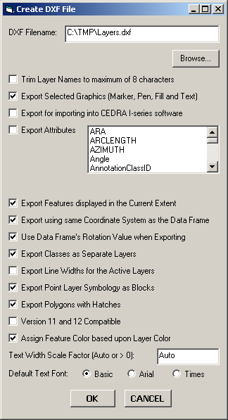
DXF Exporting
Execute from Data or Layout View
All Visible Layers Processed
Attributes exported as Blocks
Symbols exported as Blocks
Annotation exported as Text
Labels exported as Text
3D features Z values are exported
Line Widths can be exported

Slide 30
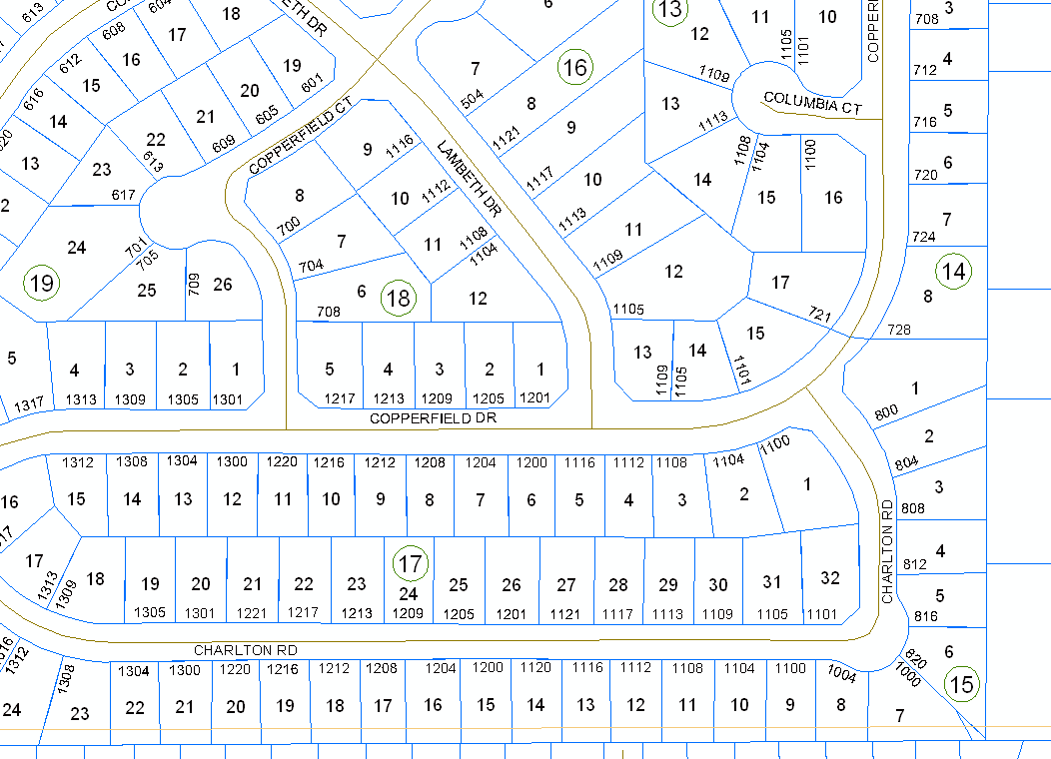
DXF Exporting
Data displayed within ArcGIS

Slide 31
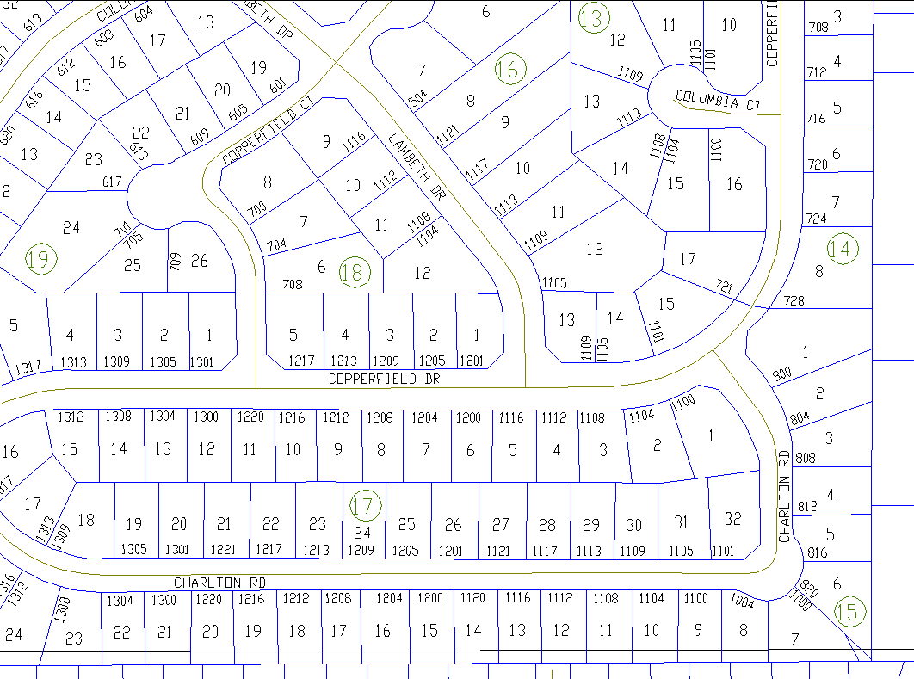
DXF Exporting
Data displayed within AutoCAD

Slide 32


DXF Exporting
Symbols displayed within ArcGIS
Symbols displayed within AutoCAD

Slide 33
DXF Exporting
/*
/* BLACK
/*
33554432 255
33580677 255
13160660 255
11558400 255
/*
/* LIGHT BLACK
/*
38686286 252
/*
/* BROWN
/*
33577630 34
33580677 34
36590241 34
The user is able to create a Color Mapping Definition File which enables the user to map a specific AutoCAD color to an ArcGIS RGB value.
This information is stored in the RGBMAP.TXT file
RGB AutoCAD

Slide 34
Summary
It is possible to customize ArcGIS in a variety of manners to add specific functionality not available in native ArcGIS.
This can be a specific tool or command or a complete application.
ArcGIS provides the user-interface and database functionality for customization.

Slide 35






Contact Info
Stuart, Emma, Sally, Oliver, David and StanLee ask
How do we get to know CEDRA
Web: www.cedra.com
Email: cedra@cedra.com
Phone: 585-232-6998

